Slide 1
Clouds
Formation processes,
Cloud types and Precipitation types
Presented by
Ms. Shine Lithakazi Mkatshwa
Regional Training Centre: Meteorological Qualification Manager

Slide 2
Cloud formation processes
Mechanical Turbulence
Convective
Orographic
Frontal uplift
Widespread ascent
Cloud types
The 10 main cloud genera
Precipitation types
Liquid and solid precipitation

Slide 3
Mechanical Turbulence Cloud Formation (The formation of layer cloud by turbulent mixing)

Slide 4
Smooth air flow occurs above the inversion level
Inversion level
The cloud extends upwards to the base of the turbulence inversion at the upper limit of the friction layer.
Stratiform type clouds form – Stratus or Stratocumulus
Friction layer
Saturation level
Air flow is generally deformed by the Earth’s surface frictional forces into a series of eddies
Air in the friction layer is thoroughly mixed by mechanical turbulence.
The wind speeds causing these eddies are light at around 3 knots
Water vapour becomes evenly spread in these lower levels Saturation and condensation then occur at some distance below the top of the friction layer
Overnight to early morning
The base of the cloud.

Slide 5
MECHANICAL TURBULENCE
The cloud formed by turbulence is initially Stratus, a “sheet” cloud that appears smooth and uniform.
If the wind speed increases to approximately 6 knots, the upper and lower surface develop a wave-like appearance.
When these undulations occur, the thickness of the cloud will vary, and sometimes breaks may be seen.
This cloud is then classified as Stratocumulus.

Slide 6
Convective cloud development

Slide 7
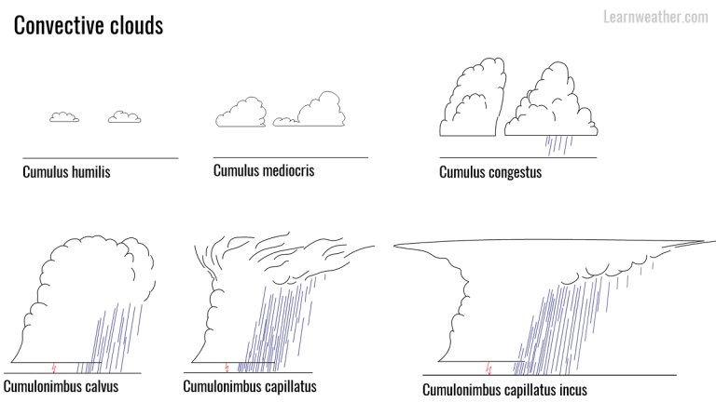

Slide 8
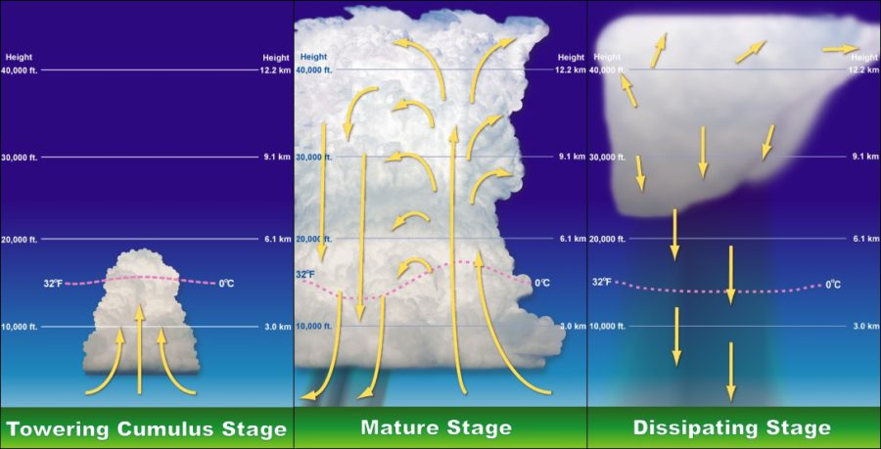

Slide 9
Orographic Cloud Formation

Slide 10
The interaction between moving air and a topographical obstruction
When the air reaches the barrier, it is forced to rise both near the surface and at upper levels.
The air which has been forced to ascend cools adiabatically and clouds may form when sufficient moisture is present in the air.
In general, orographic cloud forms continuously on the windward side of the hill or mountain, but clears on the leeward side.
The cloud as a whole appears to remain stationary, but the air itself actually continues on its way to the other side of the mountain.

Slide 11
The type of cloud formed by orographic ascent depends on a number of factors, one of which is the stability of the air in which it is formed.
Cumulus cloud is characteristic of air which is slightly unstable.
If instability is established through a depth of the atmosphere, Cumulonimbus cloud may develop.

Slide 12
UNSTABLE AIR ALOFT
UPWARD MOVING AIR
T = 0 C
MOIST AIR FORCED TO RISE
3000 m
(900 hPa)
SALR 5C/ KM
T = 5 C
2000 m
(940 hPa)
T = 10 C Td = 10 C
CLOUD BASE
1000 m
(975 hPa)
T = 20 C Td = 10 C
0 m
Moist surface conditions
DALR 10 C/ KM

Slide 13
The type of cloud formed by orographic ascent depends on a number of factors, one of which is the stability of the air in which it is formed.
In moist stable air Stratus is frequently formed - (with a flat base and generally of no great vertical thickness). It forms a sheet covering the higher ground, but breaks occur over lower-laying areas.
The descent on the leeward side causes the air to warm and so the cloud dissolves rapidly.

Slide 14
STABLE AIR ALOFT
DOWNWARD MOVING AIR
T = 0 C
3000 m
AIR DESCENDS ON LEEWARD SIDE
(900 hPa)
MOIST AIR IS FORCED TO RISE
SALR 5C/ KM
T = 5 C
PRECIPITATION
T = 10 C
2000 m
(940 hPa)
DALR 10C/ KM
T = 10 C Td = 10 C
T = 20 C
1000 m
CLOUD BASE
(975 hPa)
T = 20 C Td = 10 C
T = 30 C
0 m
Moist surface conditions
TEMPERATURES INCREASE ON LEEWARD SIDE
DALR 10 C/ KM

Slide 15
STABLE CONDITIONS
When stable air is present with the atmosphere being less moist than previously discussed clouds will form at the height where condensation occurs – this can sometimes be at the top of or above the mountain itself.
When there is a layer of almost saturated air aloft, orographic lifting of the air may cause condensation to occur above the obstruction. A persistent cloud cap may form.

Slide 16
STABLE AIR ALOFT
DOWNWARD MOVING AIR
T = 0 C Td = 0 C
3000 m
CLOUD BASE
AIR DESCENDS ON LEEWARD SIDE
(900 hPa)
T = 10 C Td = 0 C
T = 10 C
2000 m
AIR IS FORCED TO RISE
(940 hPa)
DALR 10 C/ KM
DALR 10C/ KM
T = 20 C Td = 0 C
T = 20 C
1000 m
(975 hPa)
T = 30 C Td = 0 C
T = 30 C
0 m
Less moist surface conditions
TEMPERATURES INCREASE ON LEEWARD SIDE

Slide 17
STABLE CONDITIONS
Under certain conditions, when stable air is present with the atmosphere being fairly dry, lenticularis type clouds can be expected to occur.
These conditions include the following:
A stable atmosphere
Less moist surface conditions
Wind perpendicular to mountain
Wind speed 10 to 20 knots

Slide 18
STABLE CONDITIONS
Further downstream from the mountain, the air ascends once more. This process is repeated many times, gradually decreasing with distance from the barrier – the particles of air therefore follow an undulatory path.
Standing waves are then said to occur and can frequently affect the performance of aircraft.
Conditions are most suitable for waves when a very stable layer lies between an unstable layer at the surface and another above with the waves often having their greatest amplitude within the stable layer.
Lenticular clouds therefore indicate the presence of standing waves in the lee of mountain barriers.
It is important to realise that the undulatory flow may still be present, even if the clouds are absent due to the low moisture content of the air.

Slide 19
STABLE AIR ALOFT
DOWNWARD MOVING AIR
T = 0 C Td = 0 C
3000 m
Air flow ends up as a wave pattern on the leeward side of the mountain –
Called LENTICULARIS clouds
(900 hPa)
T = 10 C Td = 0 C
AIR WITH LESS MOISTURE IS FORCED TO RISE
2000 m
DALR 10 C/ KM
(940 hPa)
T = 20 C Td = 0 C
1000 m
(975 hPa)
Clouds form in the crests of the waves
T = 30 C Td = 0 C
0 m
Less moist surface conditions
Wind perpendicular to mountain
Wind speed 10 to 20 knots
11

Slide 20
Clouds formed due cold and warm frontal boundaries

Slide 21
CLOUD FORMATION AT A COLD FRONT
With continued uplift and available moisture, the convective clouds can develop all the way into Cumulonimbus capillatus clouds
A frontal
boundary
is formed
Air cools as the air rises and if sufficient moisture is present, saturation occurs and clouds form
COLD AIR
starts moving in
Cold air Cu’s
WARM AIR
in circulation
is forced to rise
Cold air is denser and thus heavier than less dense warmer air
Slope of the Cold front is 1:75km

Slide 22
CLOUD FORMATION AT A COLD FRONT
Any precipitation is usually short lived as it depends on the speed of the cold front
With continued uplift and available moisture, the convective clouds can develop into Cumulonimbus capillatus clouds
Air cools as the air rises and if sufficient moisture is present, saturation occurs and clouds form
COLD AIR
starts moving in
WARM AIR
in circulation
is forced to rise
Precipitation in the form of showers can also occur at the frontal boundary
Precipitation types:-
Rain
Snow
Snow pellets
Hail
Slope of the Cold front is 1:75km

Slide 23
CLOUD FORMATION AT A WARM FRONT
Cirrostratus
Altostratus
A frontal
boundary
is formed
Nimbostratus
WARM AIR
COLD AIR
gradually up the slope
in circulation
slides up
Less dense warmer air slides up over the colder denser air
Precipitation types:-
Rain
Snow
Ice pellets
Slope of the Warm front is 1:250km

Slide 24
Overhead view of frontal systems
A
B
WARM AIR
COLD AIR
COLD AIR
L
Cross section A - B
CB
CS
AS
COLDAIR
NS
COLD AIR
Showers
WARM AIR
Rain
Sleet
Snow
A
B
Ice Pellets
4

Slide 25
Slow Widespread Ascent
The upward motion in a depression/low/trough is distributed over an extensive horizontal area.
As a result, the vertical velocities in the upward motion are relatively small.
The upward motion may persist for many days causing large masses of air to ascend through many kilometers.

Slide 26
Widespread ascent air | Convective ascent
Occurs across an extensive horizontal area | Occurs across a small horizontal area
Vertical velocities in up-currents is low | Vertical velocities in up-currents is high
Tropopause
Diverging air
Upper level divergence
Diverging air
With surface convergence and upper level divergence, air ascends over a wide area
… as air rises it cools and when saturation is reached, condensation occurs and widespread cloud forms.
If the moisture content of the air is high these clouds can be many kilometers in depth.
.
With high moisture content of the air
Nimbostratus
Altostratus opacus
Converging air
Surface convergence
Converging air
With surface convergence, the air flow is forced to rise, resulting in upper level divergence
Earth’s surface
1

Slide 27
Tropopause
Diverging air
Upper level divergence
Diverging air
If the moisture content of the air is low, separate cloud layers of smaller cloud depth will form.
With low moisture content of the air
Altocumulus
Altostratus translusidus
Stratocumulus
Converging air
Surface convergence
Converging air
With surface convergence, the air flow is forced to rise, resulting in upper level divergence
Earth’s surface
1

Slide 28
Cloud Types the main cloud genera

Slide 30
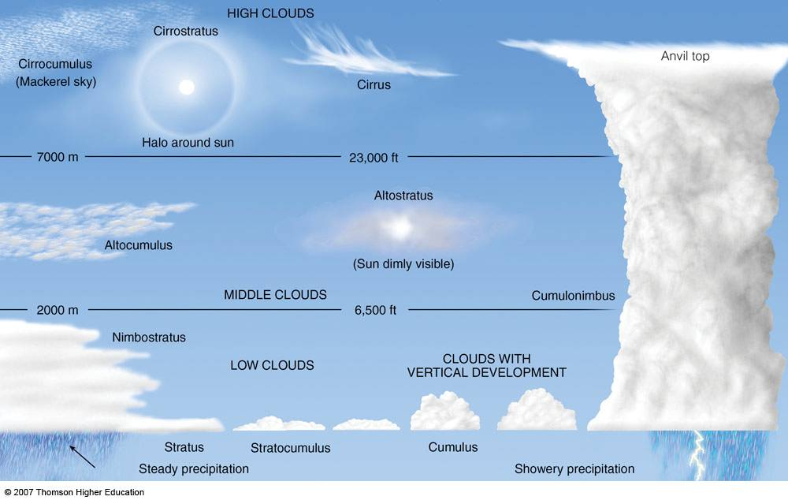

Slide 31
Precipitation types
“Any liquid or frozen water that forms in the atmosphere and falls down to the earth

Slide 32
A fall of liquid particles
Drizzle:
- Fine droplets of < 0.5mm
- Precipitation rate < 1mm/hr
Rain:
Water droplets > 0.5mm
- Light rain: fall rate < 2.5mm/hr
- Moderate rain: 2.5mm/hr < fall rate < 12.5mm/hr
- Heavy rain: fall rate > 12.5mm/hr
Freezing rain:
- Liquid rain that freezes on impact with the ground and exposed objects that are below 0^{O}C
Supercooled rain:
- Liquid rain at temperatures below 0^{O}C that will freeze on contact with a surface

Slide 33
A fall of solid particles
Snow
- Light feathery opaque white ice crystals
- Moderate snow reduces visibility to below 1 km.
- Heavy snow, visibility may range from ±200m to less than 50m.
Snow grains
- Very small opaque white ice crystals that are < 1mm diameter
- Analogous to drizzle, but occurs at temperatures between 0^{O}C and -10^{O}C
Sleet
- A mixture of rain and snow OR frozen raindrops
- It forms like freezing rain, but a deep ‘freezing layer’ allows the precipitate to re-freeze before reaching the surface

Slide 34
A fall of solid particles
Snow pellets – opaque and white, brittle
Hail – typically spherical ice particles that are transparent, or partly or completely opaque
Small hail – translucent, spherical ice particles that typically occur in showers
Ice pellets – translucent, spherical small (diameter < 5mm) particles

