Slide 1
CONVECTIVE CLOUD DEVELOPMENT
By Colleen Rae

Slide 2
CONVECTIVE CLOUD DEVELOPMENT
Three distinct stages are recognized in the life cycle of a cell, based on the speed and direction of the vertical currents:
a) The growing / developing stage (Cumulus stage)
b) The mature / peak stage (Cumulonimbus stage)
c) The dying / dissipating stage.

Slide 3
-65 ^{O}C
Tropopause
The DEVELOPING stage
– up-drafts are dominating
-40 ^{O}C
Occurs from late Spring through to early Autumn
-20 ^{O}C
-10 ^{O}C
No
precipitation
0 ^{O}C
White cloud colour with virtually no shading.
wd
CL1
Cloud base
= Is where saturation occurs
Warm air rises via convective currents
Cumulus humilis
Clouds of only a slight vertical extent; they generally appear flattened.
Earth receives solar radiation and re-radiates it out as terrestrial radiation. Convection currents develop

Slide 4
-65 ^{O}C
The DEVELOPING stage
– up-drafts are dominating
Tropopause
-40 ^{O}C
Rounded masses displaying shape and thus shading.
Cloud colour is white with grey shading.
One or more small cumuli begin to grow into a large cumulus.
A general up draft prevails throughout the cell in this stage, in which extreme velocities up to about 30 m/second have occurred.
At the same time, inflow to the cell takes place through the sides at all levels as well as through the bottom of the cloud.
-20 ^{O}C
-10 ^{O}C
No
precipitation
No
precipitation
Precipitation – showers of rain, snow, snow pellets
0 ^{O}C
White cloud colour with virtually no shading.
scwd
wd
wd
wd
CL1
CL2a
Cloud base
= Is where saturation occurs
CL2b
TCU
Warm air rises via convective currents
Cumulus congestus
Clouds which are markedly sprouting and are often of great vertical extent; their bulging upper part frequently resembles a cauliflower with a defined shape.
Cumulus mediocris
Clouds of moderate vertical extent, the tops of which show fairly small
protuber­ances.
Cumulus humilis
Clouds of only a slight vertical extent; they generally appear flattened.

Slide 5
-65 ^{O}C
The MATURE stage –
up- and down-drafts dominating
Tropopause
Smooth upper part due to the presence of ice crystals but no anvil. Upper cloud colour is white. Lower part is white with grey shading.
-40 ^{O}C
The main difference between a Cumulus cloud and a Cumulonimbus cloud
The Cumulus will have a defined cauliflower shape, Cumulus congestus.
The Cumulonimbus cloud is smooth on top due to the presence of ice crystals, Cumulus calvus without an anvil and Cumulonimbus capillatus with an anvil.
-20 ^{O}C
Precipitation – thundershowers or showers
of rain, snow,
snow pellets or hail
ic
-10 ^{O}C
scwd
0 ^{O}C
scwd
wd
CL3
Cloud base
= Is where saturation occurs
Warm air rises via convective currents
CB
Cumulonimbus calvus
Clouds of extensive vertical growth in which at least some protuberances of the upper part are beginning to lose their cumuliform outlines but in which no cirriform parts can be distinguished. Protuberances and sproutings tend to form a whitish mass, with more or less vertical striations (Grooves or channels in cloud formations, arranged parallel to the flow of air and therefore depicting the airflow).

Slide 6
-65 ^{O}C
The MATURE stage –
up- and down-drafts dominating
Tropopause
Upper part in the shape of an anvil and due to the ice crystals, it also appears smooth.
-40 ^{O}C
ic
-20 ^{O}C
Precipitation – thundershowers or showers
of rain, snow,
snow pellets or hail
ic
-10 ^{O}C
scwd
As the cold down drafts from the mature and dissipating cells spread out above the ground, they cause convergence in adjacent regions and so may set off new convective cells near by.
scwd
0 ^{O}C
wd
CL9
Warm air rises via convective currents
Cloud base
= Is where saturation occurs
CB
Cumulonimbus capillatus
Clouds vast vertical growth characterized by the presence, mostly in its upper portion, of distinct cirriform parts of clearly fibrous or striated structure, frequently having the form of an anvil, a plume or a vast, more or less disorderly mass of hair. Cumulonimbus capillatus is usually accompanied by a shower or by a thunderstorm, often with squalls and sometimes with hail; it frequently produces very well-defined virga.
CB
The diameters of individual cells vary from 1 to 8 km while between neighboring cells there are cloud‑filled lanes up to two km in width.

Slide 7
The DISSIPATING stage –
the down-drafts dominate the up-drafts
-65 ^{O}C
Eventually, the water droplets or ice crystals within the cloud reach a size where the ascending air currents are no longer able to sustain them within the cloud and they will fall to the ground as a form of precipitation
CH3
-40 ^{O}C
-20 ^{O}C
The cloud’s official name is now Cirrus spissatus cumulonimbogenitus
(a Cirrus cloud originating from a Cumulonimbus cloud),C_{H}3.
-10 ^{O}C
As the cloud “rains itself out”, the upper part of the cloud (the anvil) sometimes remains behind.
0 ^{O}C
This cloud is then not referred to as a Cumulonimbus capillatus cloud anymore (as the shape of the cloud has now changed completely) but as a Cirrus cloud (due to its location above 18 000ft and that it is made up of ice crystals.
CL9
As the precipitation starts to fall, the water droplets sometimes evaporate below the cloud base.

Slide 8
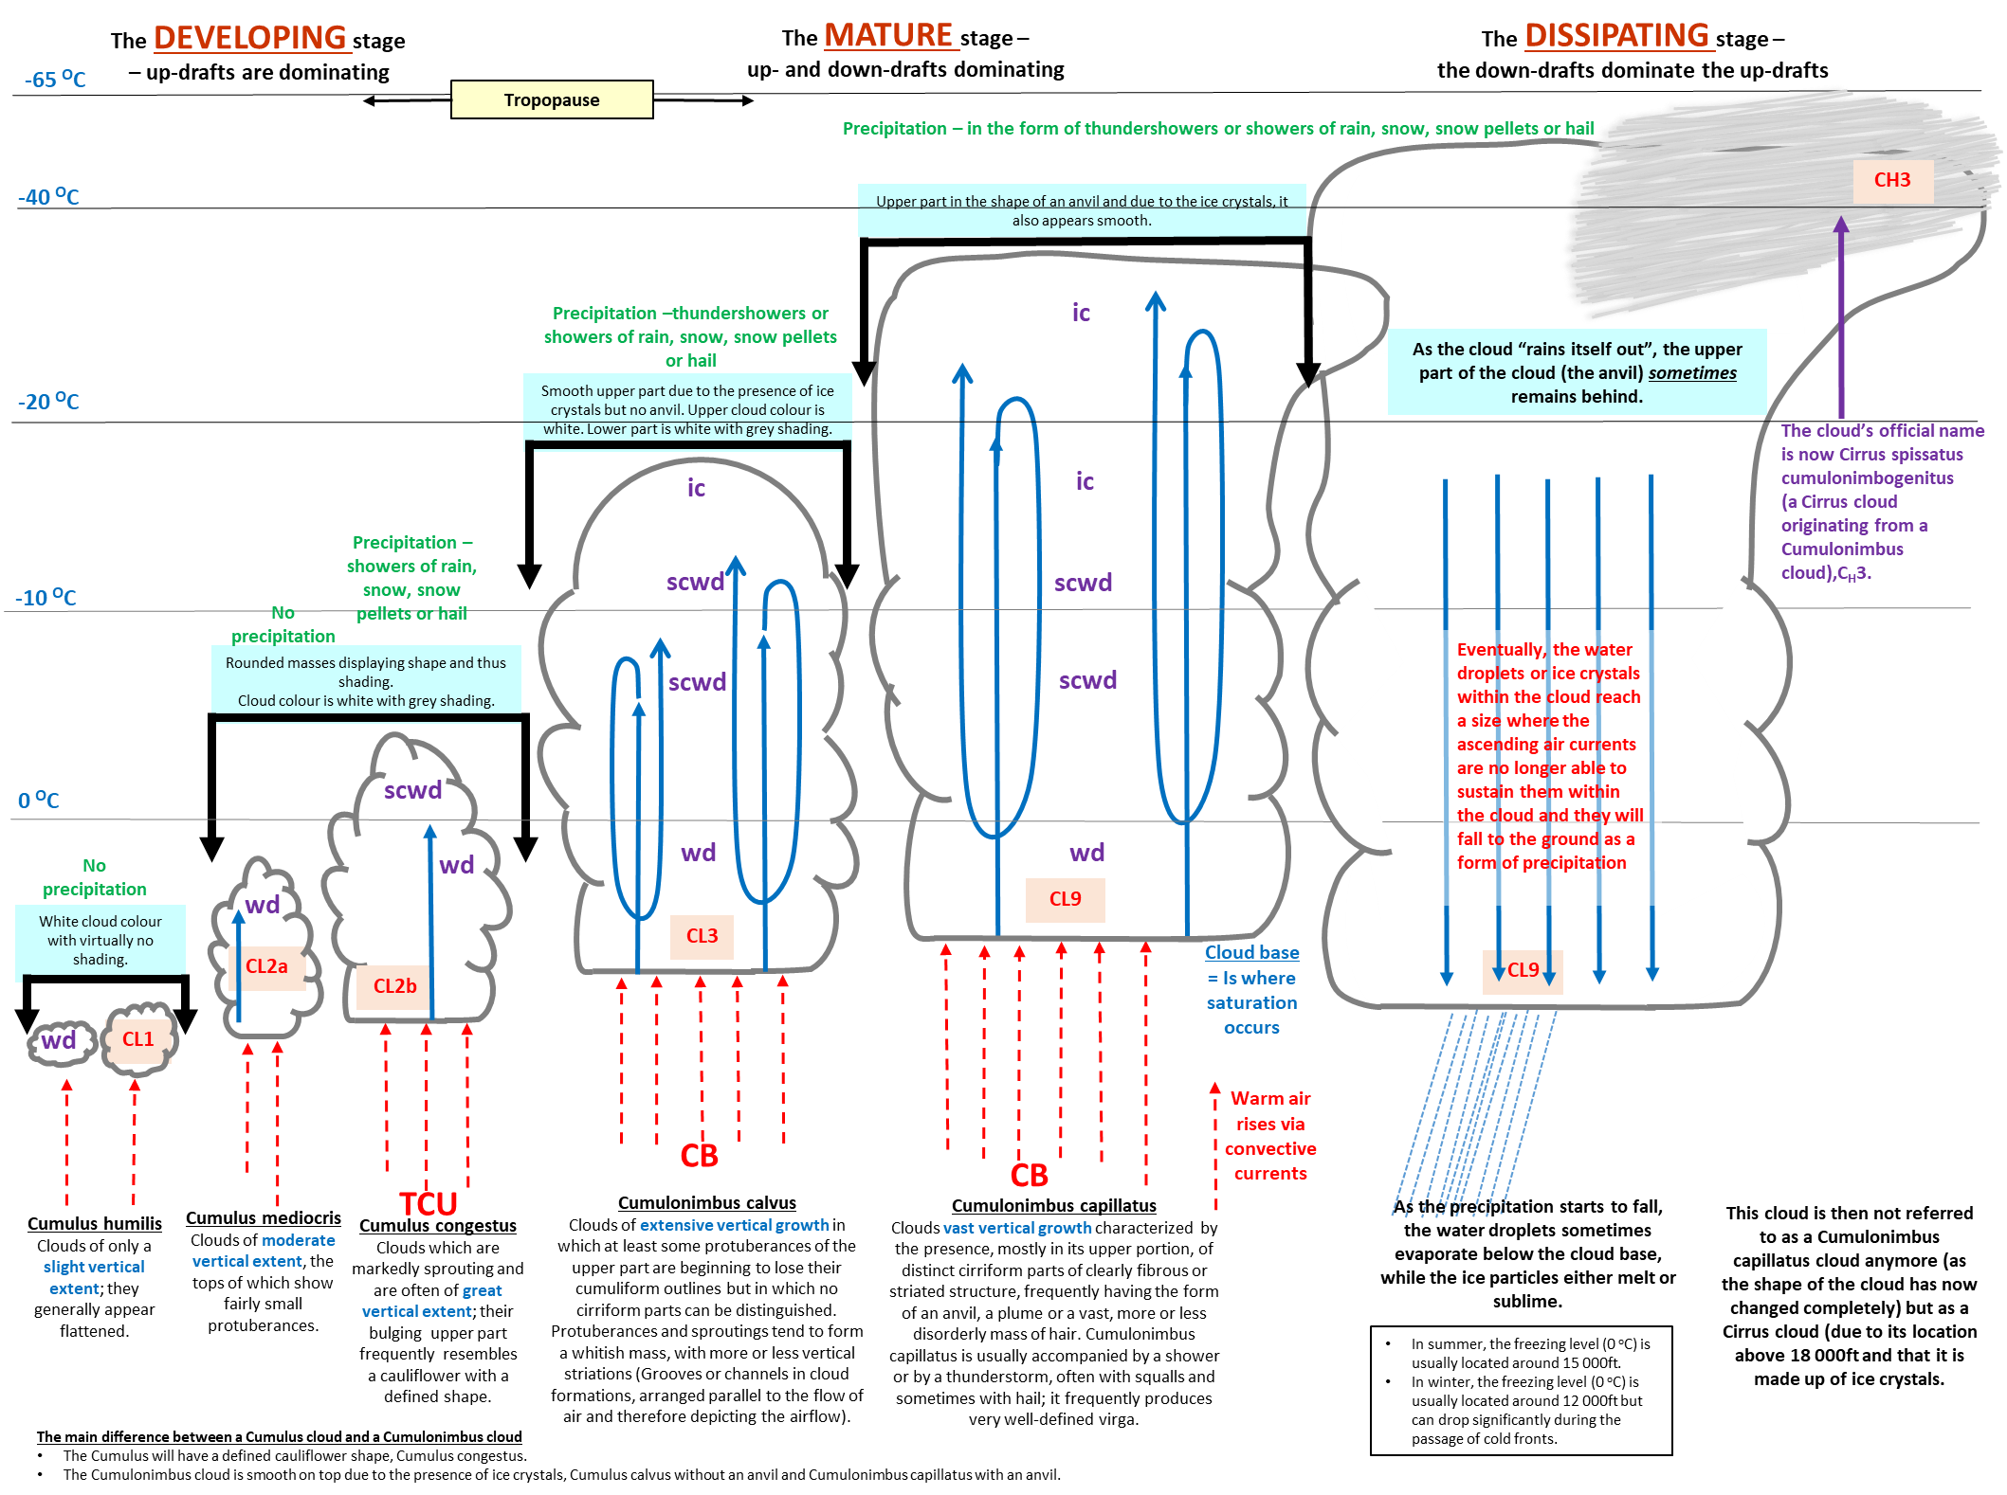

Slide 9
THUNDERSTSORM CHARACTERISTICS

Slide 10
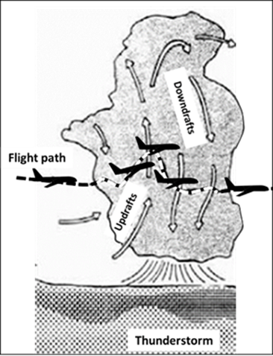
THUNDERSTSORM CHARACTERISTICS -TURBULENCE
The local variations of air motion that are superimposed on the general horizontal flow in the area.
The motion that is experienced inside the aircraft as it moves through the air is like a boat on water that moves with the motion of the water.
In a thunderstorm the turbulent motions are:-
Drafts – the sustained vertical currents occupying a large part of the cloud.
Gusts – the local and temporary variations
of speed, occurring both inside and
outside the main drafts.
Figure 2.1 Turbulence within a Cb cloud
(Adapted from http://aviationknowledge.wikidot.com/aviation:atmospheric- turbulence)

Slide 11
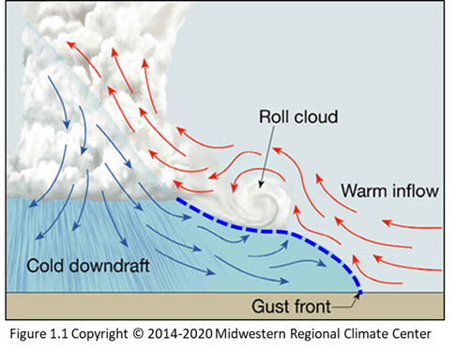
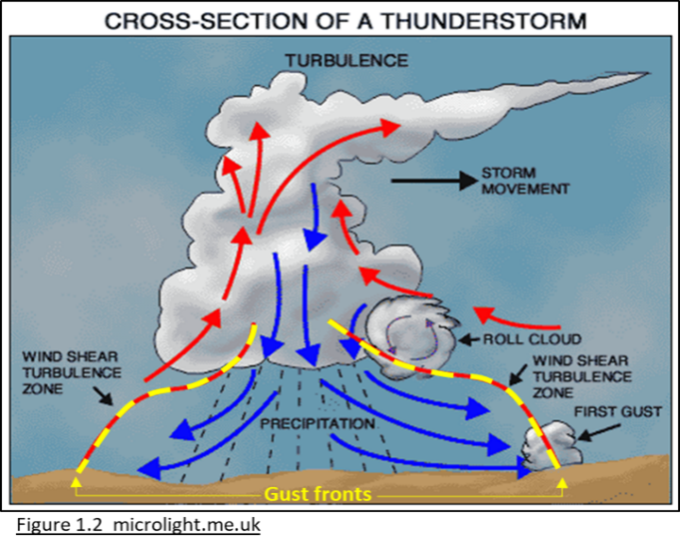
THUNDERSTSORM CHARACTERISTICS - GUST FRONT
As the down draft from a Cb nears the ground, it spreads out horizontally
Its leading edge is known as the "gust front".
The down draft is cold as it is coming from areas within the cloud that are well below 0ºC.
It appears as if it is a miniature cold front,
often with a severe squall that has a marked increase of wind speed, often accompanied by a change in direction.

Slide 12
THUNDERSTSORM CHARACTERISTICS –
UP AND DOWN DRAFTS and GUSTS
Highest values of up drafts and down drafts occur in the middle and higher levels of the clouds.
The mean up drafts are > than the mean down drafts.
The down drafts and outflowing air and the associated wind shear represents a serious hazard to aircraft in the process of landing or taking off.
The more intense gusts are associated with the stronger drafts.
The effectiveness of gusts in creating the bumpiness depends on the maximum gust velocities and on the frequency with which the gusts are encountered.
Outbreaks of severe turbulence, wherever they occur, are localized and of brief duration.

Slide 13
THUNDERSTSORM CHARACTERISTICS –
LIGHTNING and THINDER
A lightning flash is a large-scale example of an electric spark .
A spark occurs between two points when the difference in electric potential reaches a certain value depending on the conductivity of the air and on the distance between the points.
Electrically charged areas within the cloud are known to be positively charged in the top of the cloud and negatively charged lower down, the cloud being said to have positive polarity.
Once the critical field strength has been built up, a lightning discharge occurs and temporarily neutralizes the field, but if the cell is still active the building up process is immediately resumed.
Discharges may take place from cloud to earth, between two different clouds or two parts of the same cloud, or from a cloud surrounding air.
An active storm consisting of several cells may produce lightning flashes at an average rate of four a minute; of these, the number entirely within the cloud much exceeds the number passing from cloud to earth.

Slide 14
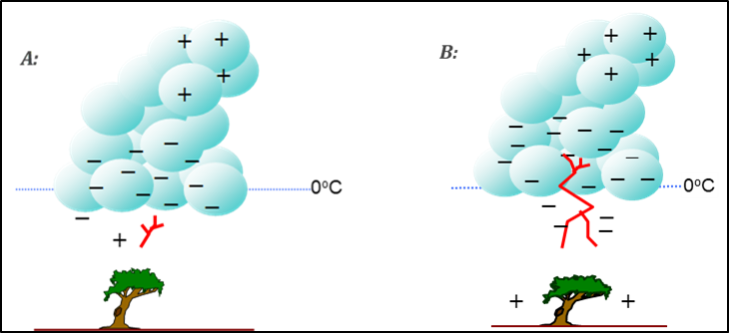
THUNDERSTSORM CHARACTERISTICS –
LIGHTNING
The electrons move towards the surface in the form of discrete steps that are invisible for the eye.
The discharge, which moves downwards, is called the stepped leader.
Each step of about 50 meters takes about 1μs to form.
The time interval between steps is about 50μs.
Negative charges in the stepped leader induces positive charges at the surface of the Earth.
When the stepped leader is about 10 to 100 meters from the highest point on the Earth’s surface (e.g. a tree), a traveling spark moves up from the surface to meet it.
After contact between the stepped leader and traveling spark large numbers of electrons flow to the surface and a visible lightning stroke propagates upward (from the surface) along the path followed by the stepped leader.

Slide 15
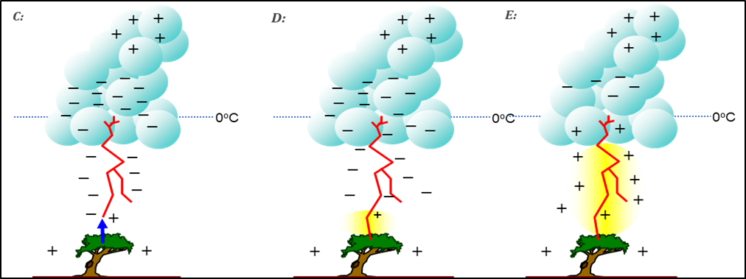
THUNDERSTSORM CHARACTERISTICS –
LIGHTNING
The downward flow of electrons at a speed of almost 50 000 km/s is responsible for the upward propagation of the positively charged return stroke (visible as a lightning stroke).
Most lightning flashes contains 3 or four strokes separated in time by approximately 50 ms (millisecond).
Despite the downward flow of electrons, both the return stroke and ground remains positively charged in response to the negative charged particles still present in the lower parts of the cloud.
The first stroke carries the largest electrical current.
Subsequent strokes can occur along the same main channel followed by the first stroke.

Slide 16
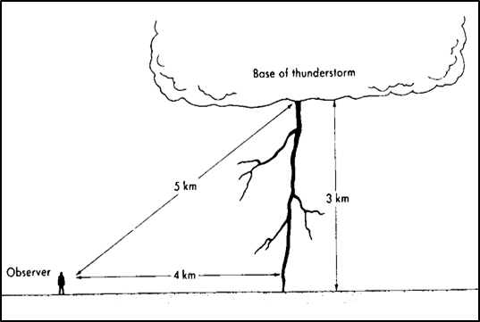
THUNDERSTSORM CHARACTERISTICS – THUNDER
The visible lightning stroke is a channel of incandescent air not more than an inch or two in diameter.
The temperatures in the flow channel are increased to about 30 000 ºC by the return stroke in such a short time that the air has no time to expand.
Thunder is the accompanying explosive report caused by the sudden expansion of the air.
The shock wave, which travels at about 1 km every 3 seconds, can be heard as thunder.
The flash is seen immediately, because the light travels at 300,000 km per second, but sound takes five seconds to travel 1,5 km and thunder is therefore heard an appreciable time after the lightning is seen.
Sound waves generated by the upper part of the
lightning stroke reach the observer later than the
one generated by the bottom of the flash.
Since the flash and the noise originate simultaneously, the distance of the lightning from the observer may be estimated from the interval which elapses between the time when the lightning is seen and the time when the thunder is heard.

Slide 17
THUNDERSTSORM CHARACTERISTICS – HAIL
Hail is usually produced by large, long lasting thunderstorms classified as multicell or supercell thunderstorms.
These storms can last for many hours, producing heavy rain, frequent lightning, hail and occasionally tornadoes.
Hailstorms begin to form in water rich, rising air and they grow by colliding with supercooled drops.
As they get bigger they fall at increasing speeds and intercept increasing quantities of supercooled water.
If the updraft speed exceeds the terminal velocity of the hailstones, they are carried back upward.
When the updrafts are not strong enough to hold up the hailstones they fall to the ground.
Hailstones vary greatly in size from storm to storm – hailstones > 2cm in diameter are not unusual in regions of high hail frequency.

Slide 18
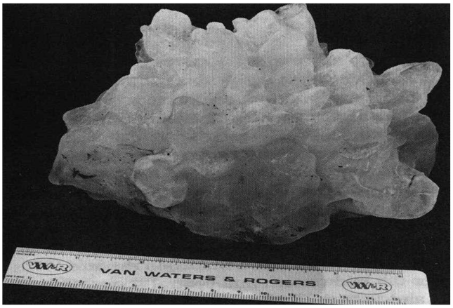
THUNDERSTSORM CHARACTERISTICS – HAIL
A common property of a hailstone is that the ice of which it is composed is not uniform in texture, but instead there are alternating layers of clear and milky ice.
When a growing hailstone falls through a cloud region containing small concentrations of supercooled water, the hailstone intercepts small quantities of water that may freeze almost instantly. In the process, tiny air bubbles are trapped in the ice and milky ice results.
When a falling stone accumulates large quantities of water, it cannot freeze instantly because the latent heat of fusion (80 cal/g) cannot be carried away fast enough. Instead, the stone gets wet, and the freezing proceeds slowly. In the process, the air is forced out of the water, and clear ice is produced.
Figure 7.1 Extremely large hailstone
In extreme cases, hailstones may exceed the diameter of a cricket ball!
A record size hailstone that fell at Coffeyville, Kansas, on 03/09/70 had a circumference of 44 cm and a mass of 7668 g.

Slide 19
THUNDERSTSORM CHARACTERISTICS – TORNADOES
Thunderstorms producing large hail are also likely to produce tornadoes.
They often strike suddenly, with little warning, and in a few minutes cause extensive damage to property, injuries, and loss of life.
They have the appearance of a narrow funnel, cylinder, or rope extending from the base of a thunderstorm to the ground.
The visible funnel consists mostly of water droplets formed by condensation in the funnel, while near the ground, blowing dust, leaves, and other debris identify the presence of a strong vortex.
They are generally small, typically less than a few hundred meters in diameter, but some are larger than 1 km.
The funnels usually touch the ground for only a few minutes or so, but some have been reported to last for much more than an hour.

Slide 20
THUNDERSTSORM CHARACTERISTICS – TORNADOES
The maximum wind speeds in tornadoes usually are between about 66 and 200 knots, but occasionally they may exceed 240 knots.
The pressure in a tornado funnel is substantially lower than the surrounding atmospheric pressure.
in a very severe tornado the central pressure might be > 100 hPa less as compared to the pressure outside the funnel.
The strong winds of a tornado ‑ especially if they exceed speeds of about 80 knots are primarily responsible for property damage.
The resulting forces directed from high to low pressure, can tear off roofs and destroy walls while the winds scatter the debris.

Slide 21
THUNDERSTSORM CHARACTERISTICS – WATERSPOUTS
The structure of a waterspout is similar to that of the tornado except that the occurrence takes place over the sea and the phenomena does not reach the same intensity.
The so‑called "cloud pendant" develops downwards until it forms an unbroken column of cloudy whirling air joining sea and cloud; this is the waterspout.
The dimensions of the vortex are quite small; 10 or 20 m for the diameter and 200 to 300 feet for the height.

Slide 22
The end
Thank you!

