Slide 1
Highlights of Spring Weather Activities
Teke Ramotubei

Slide 2
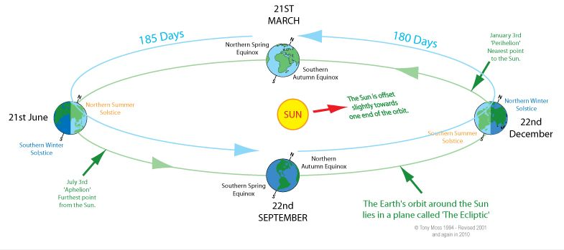
Recap
Spring – transition Season
More solar energy received by the surface in the Southern hemisphere
What is the relationship between plants’ flowering & Spring?
Action and reaction

Slide 3
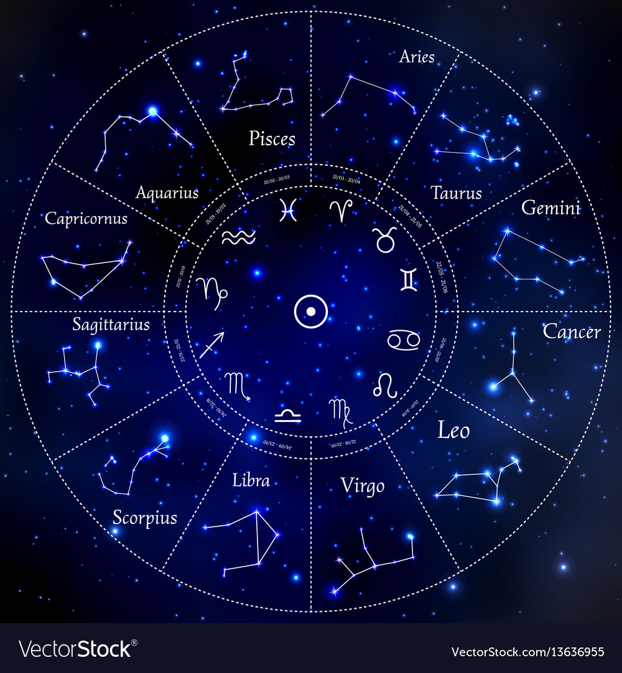
Interesting Features about the Stars
Stars and Constellations
Have you ever noticed that Cities form certain shapes as you fly in at night?
Do you think your city also has a shape?
Are there any stars you know of which appear only at a particular time in the year?

Slide 4
Unique Features of Spring Season
Strong Winds and dust
Vertically extended, dark (and often scary) clouds
Can you tell from the high temperatures experienced during the day about the weather activities later in the afternoon? Heat driven storms!
Is there any connection between mirrors and lightning?
Trying to find the connection between EMW & the Mirror
Similar to 5G and COVID-19

Slide 5
Take Home from the Sessions
Clouds related to thunderstorms
Necessary ingredients for thunderstorm formation
Severity of thunderstorm

Slide 6
Questions?
I hope what you learn through this course helps you add more value to what you normally hear on the news about weather!
Thank you

