Slide 1
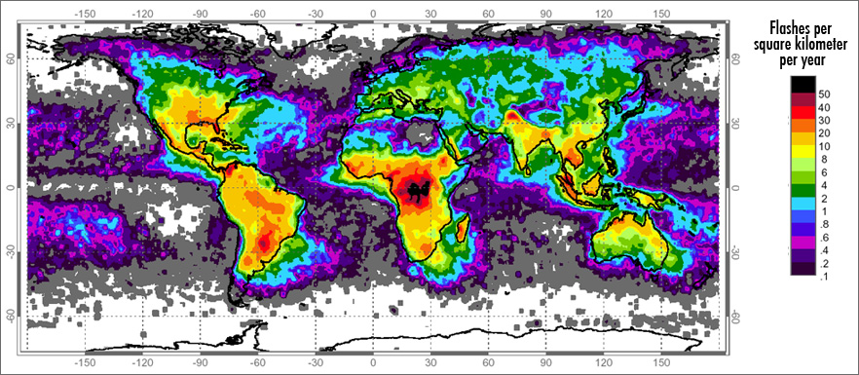
Lightning overview in South Africa
Large portion of South Africa is dominated by summer rainfall which is convective in nature from convective storms, and a large portion of this region receives more than 60 thunderstorm days a year.
Lightning frequently occurs in the region, where thunderstorms are common.
There are more lightning flashes per square kilometer per year over the eastern interior of South Africa.

Slide 2
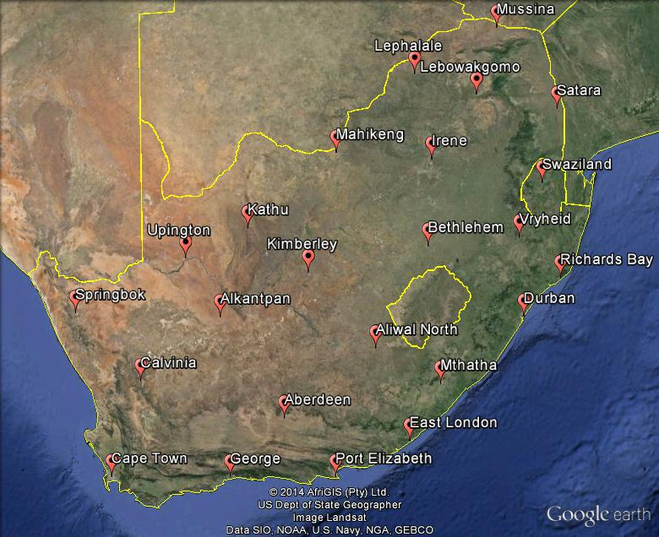
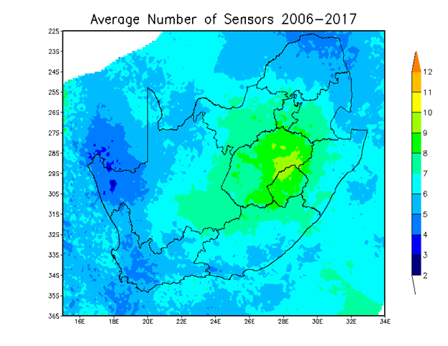
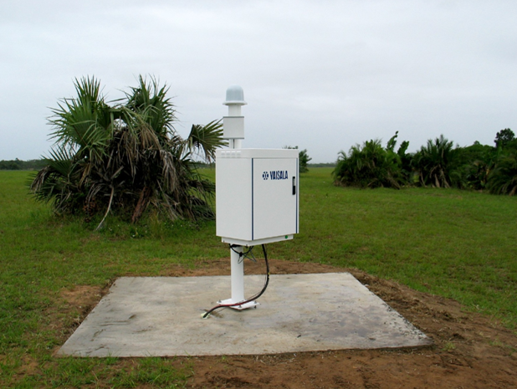
SAWS Lightning Detection Network
South Africa lightning detection network.
25 sensors
Multiple sensors detect lightning
The network can detect >90% of cloud-to-ground lightning flashes and can accurately position lightning stokes within <500 meters over South Africa.

Slide 3
Example of Lightning Detection Network
Detection Efficiency
The percentage of all lightning flashes that can be detected (90% means that 90% or more CG lightning is detected)
Location Accuracy
The distance in which a detected lightning stroke is placed with regards to the actual lightning stroke (0.5km means that a detected lightning stroke is located by the sensor 500 meters or less from the actual lightning stroke)
Source: Morne, 2012

Slide 4
How the Lightning Detection Network works ?
Sensors
immediately detect electromagnetic signals as soon as the lightning strikes the earth
The sensors send the raw data to the Network Control Center
Within seconds the central analysers on the main server process the information into location, time, polarity and amplitude of each stroke and send it to the clients across the country in the appropriate format
Data is archived in a Separate data base for later retrieval using the

Slide 5
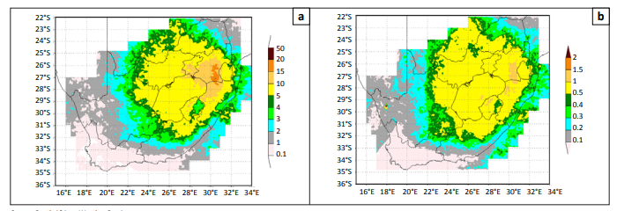
Lightning ground flash density map
Source: Morne, 2012

Slide 6
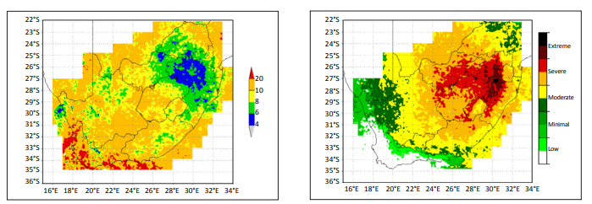
Positive lightning risk map
Source: Morne, 2012

Slide 7
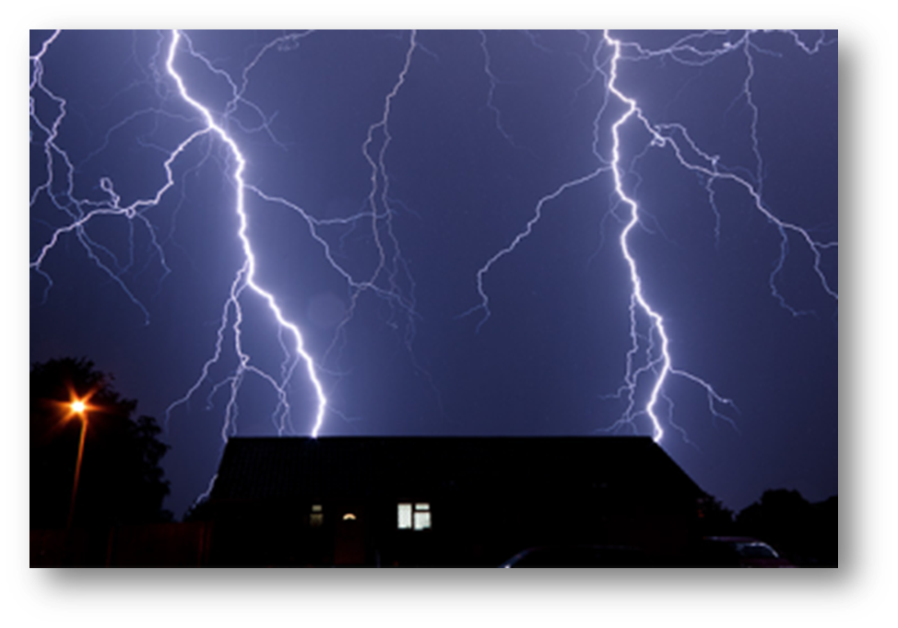
Physical Damage
According to the (Gill,2006 and Morne, 2012) a typical lightning flash is about 300 million Volts, 30,000 Amps and can heat the air up to 27760°C.
This combination of power and heat can cause serious damage to the human body and nearby buildings and equipment.

Slide 8
Secondary Effect Damage
Indirect effects can also be damaging. For example, if lightning strikes a building transient over voltages maybe caused through resistive, inductive and capacitive coupling.
If it takes place:
Within a flammable material, it can cause a fire or explosion.
Within a bearing, such as in a pump in a treatment plant, it can scar the bearing and cause premature wear.
On a circuit board, it can damage the circuit board and its components.

Slide 9
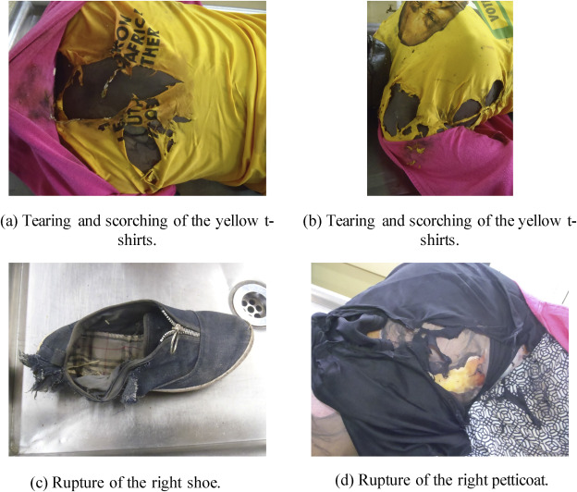
Case A
Source: Hunt et al., 2020

Slide 10
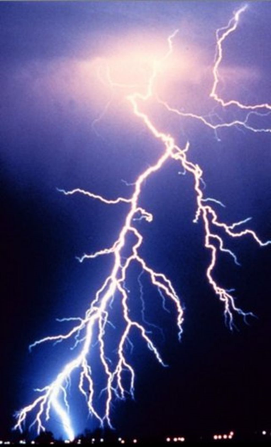
What can be done to Prevent Lightning Strikes
One of the simplest methods to prevent lightning damage is to install a lightning protection system.
Lightning Eliminators is a one stop shop for lightning safety products.
Lightning will strike whatever it desires, buildings, trees, mountains, cars, etc. so it’s important to be aware of both direct and indirect lightning strikes and the damages that they can create.

