Slide 1
The Planet Earth: Movements & Composition of the Atmosphere
Presented by
Ms. Shine Lithakazi Mkatshwa
Regional Training Centre: Meteorological Qualification Manager

Slide 2
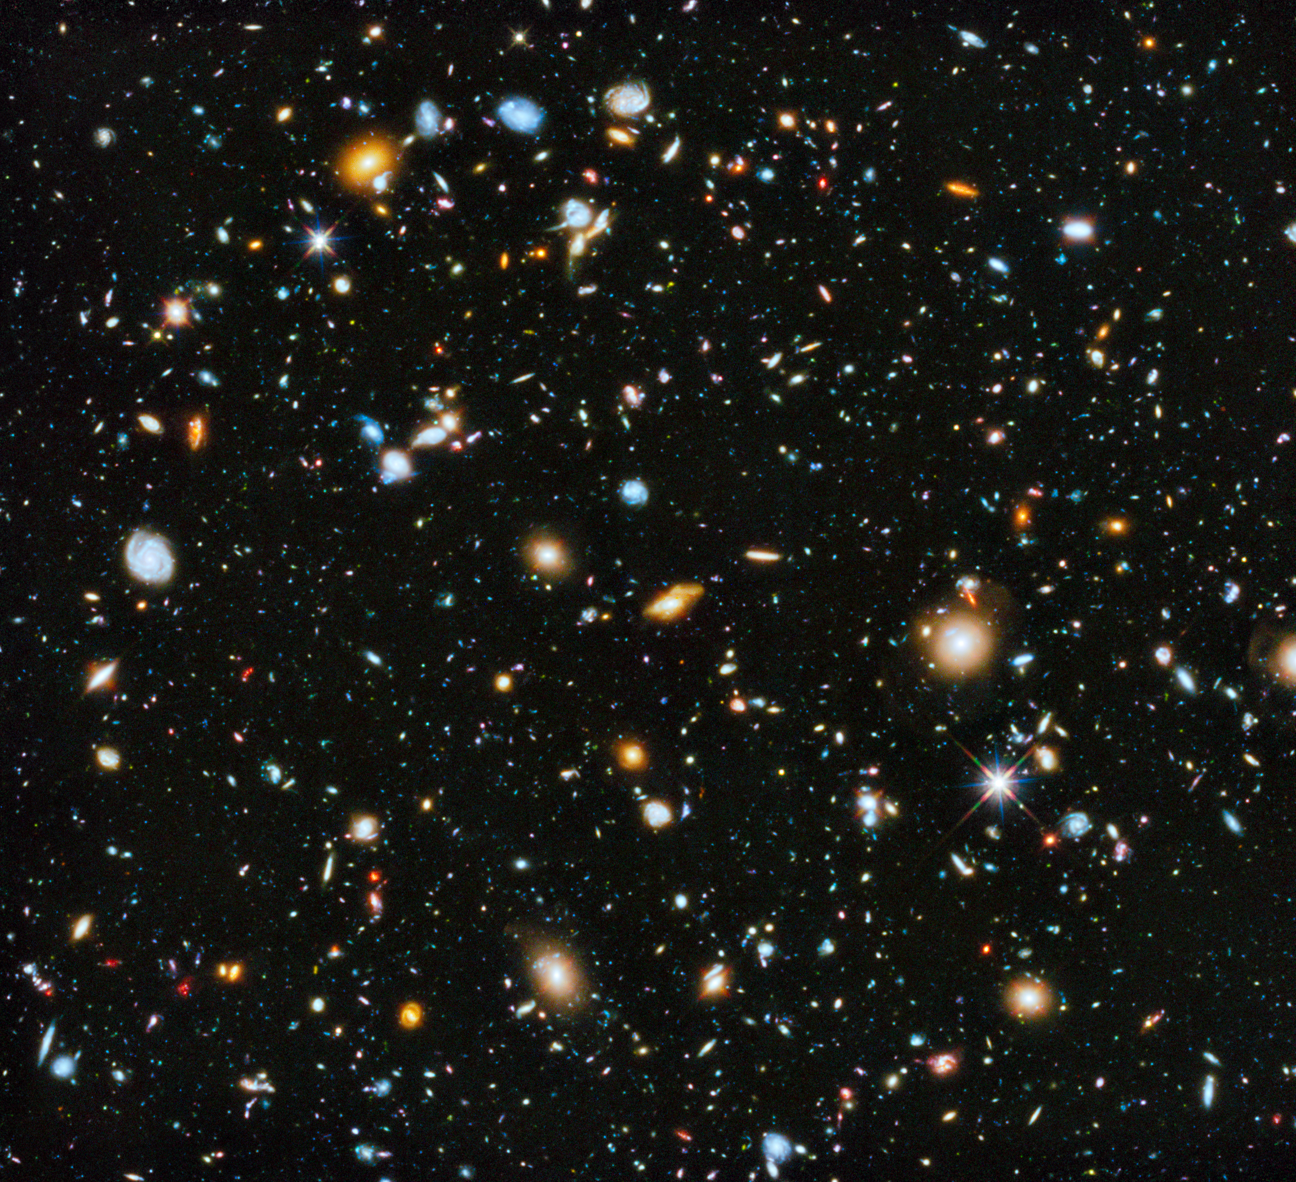
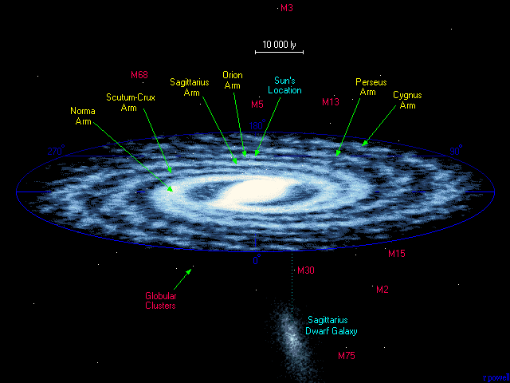
Mars
Notes:
Universe, contains billions of galaxies
Milky way is our galaxy, made up of 220-400 billion starts
One of those starts is our sun: the centre of our solar system the 3rd rock from the sun A day is the length of time it takes for a planet to complete one rotation on its axis – 360°. Since all of the planets rotate at different speeds, the length of a day on each one differs:
Mercury - 58 days and 15 hours
Venus – 243 Earth days
Earth – 23 hours and 56 minutes
Mars – 24 hours 39 minutes and 35 seconds
Jupiter – 9.9 Earth hours
Saturn – 10 hours 39 minutes and 24 seconds
Uranus – 17 hours 14 minutes and 24 seconds
Neptune – 16 hours 6 minutes and 36 seconds
Pluto – 6.39 Earth days
The sun is the primary source of energy for the earth

Slide 3
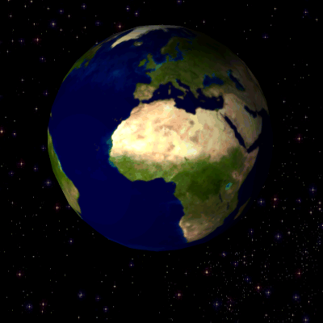
Movements of the earth
1) The rotation of the earth about its own axis: day and night

Slide 4
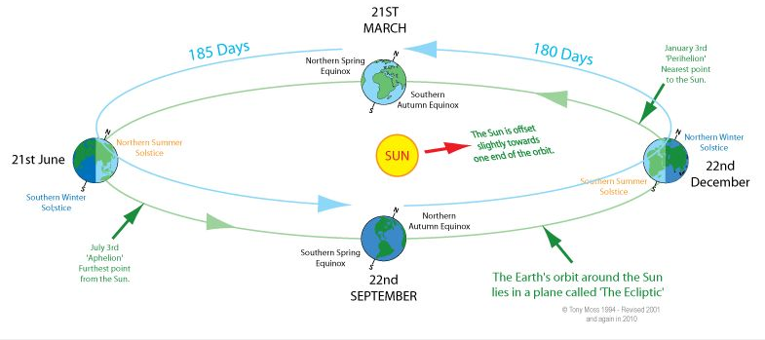
Movements of the earth
2) The revolution of the earth around the Sun
Perihelion Jan 1st
Aphelion July 1st

Slide 5
Earth-moon interaction
The gravitation pull on the fluid portion of the earth’s surface results in what we observe as ocean tides

Slide 6
At full and new moon, the gravitational force of the sun and moon are combined causing a higher high tide (and lower low tide). Maximum tides = spring tide
At first & last quarter, the sun’s gravitational pull is perpendicular to the moon’s, resulting in lower than average tides. Moderate tides = neap tides

Slide 7
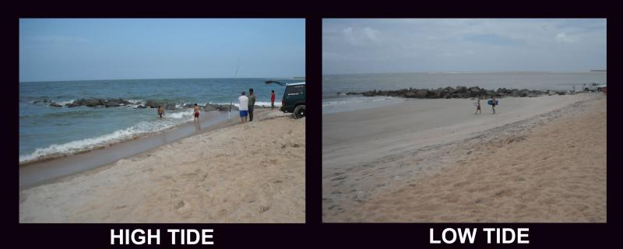
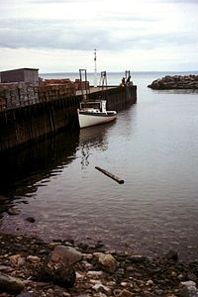
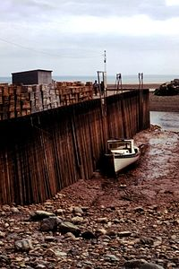
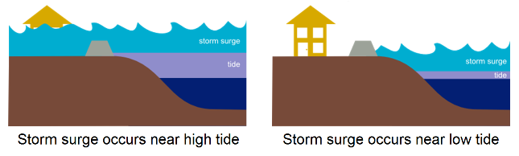
Tidal Effects

Slide 8
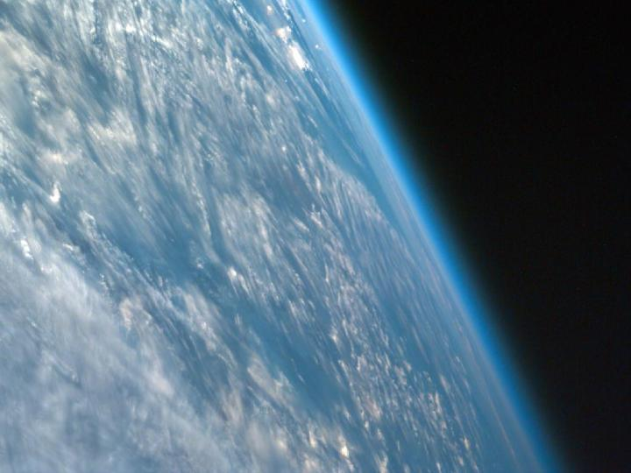
Our Atmosphere
Notes:
The Earth's atmosphere extends from the surface of the Earth to the edge of space. The Earth has a roughly 13 000 km diameter (at equator); the thickness of the atmosphere is about 100 km. If the Earth were the size of a basketball, the thickness of the atmosphere could be modeled by a thin sheet of plastic wrapped around the ball.
It makes the planet habitable: keeps surface warm, and contains life-sustaining gases.
Picture is taken from a spacecraft orbiting at >300km above the surface, the atmosphere is visible as the thin blue band. Gravity holds the atmosphere to the Earth's surface.
Meteorologists are concerned with the happenings in the atmosphere: thermodynamics and fluid dynamics thereof

Slide 9
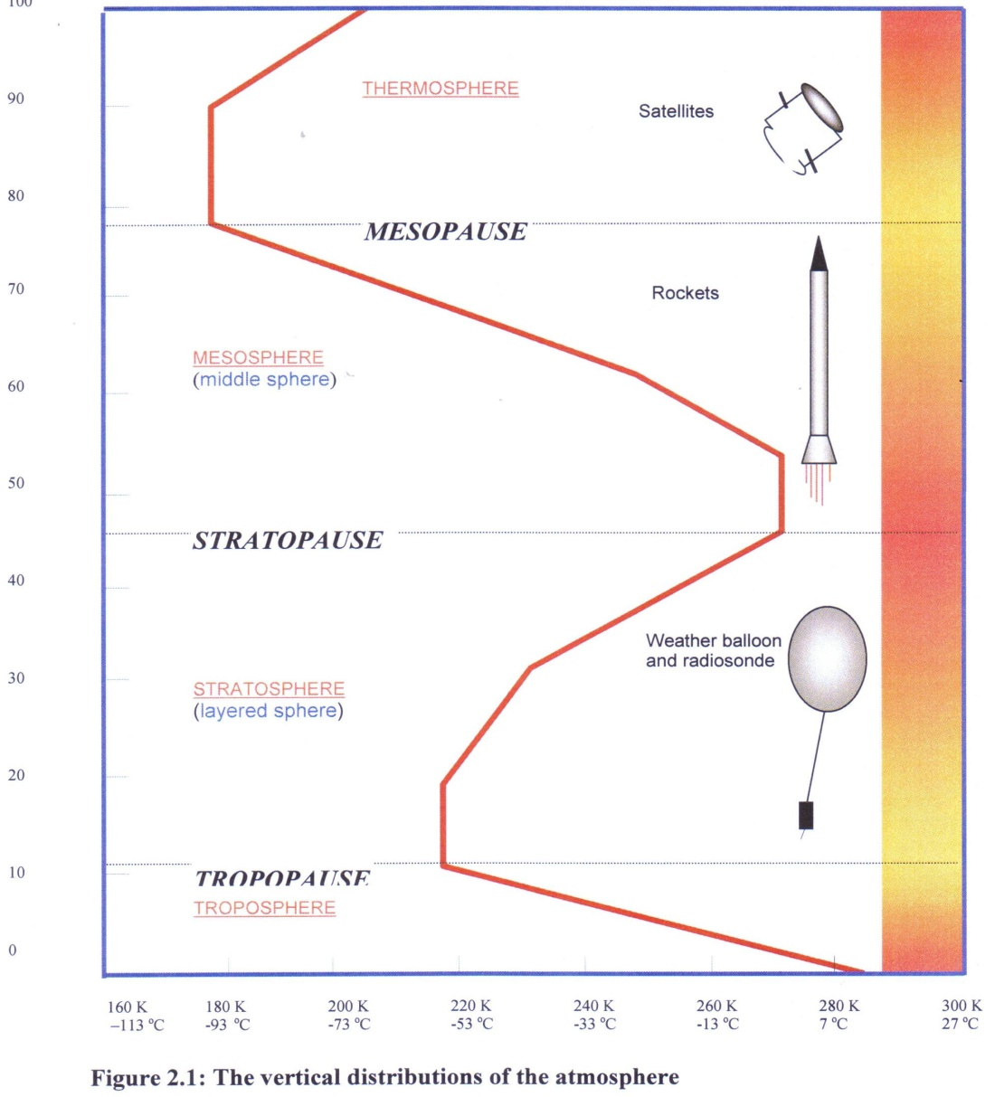
Vertical Structure
Four regions
Troposphere,
Stratosphere,
Mesosphere
Thermosphere
Ionosphere and Exosphere
Higher temperatures occur near the earth's surface, in the vicinity of the stratopause and thermosphere.
Temperature lapse rate - an average value of 6.5 °C/km.
THERMOSPHERE
MESOPAUSE
MESOSPHERE
STRATOPAUSE
STRATOSPHERE
TROPOPAUSE
TROPOSPHERE

Slide 10
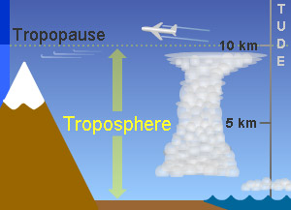
Troposphere
The troposphere contains the greater part of the mass of the atmosphere
marked by vertical motions
high water-vapour content
cloud and weather. As a result, it is of great concern to meteorologists.
Generally, the temperature dereases with height. However, layer(s) in which the temperature increases with height occur: temperature inversion layer.
Its upper boundary is the Tropopause. Its altitude varies over the earth

Slide 11
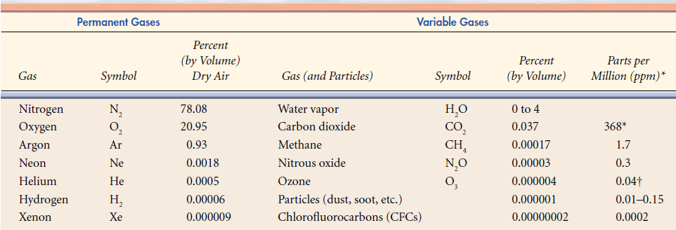
Composition of Dry Air
Atmosphere is composed of a mechanical mixture (not compound) of gases and impurities
The distribution of these components varies over time
Major Gases: Nitrogen and Oxygen (about 99%)
Green-House Gases (GHG) in high concentrations affect temperatures we experience on the surface

Slide 12
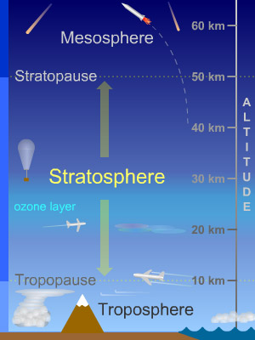
Stratosphere
Extends from the Tropopause up to 50 km.
Temperature characteristics are:
It generally remains constant up to about 20 km: referred to as the isothermal layer
then it increases (at different rates) above that.
In the upper parts, the temperatures are similar to those near the Earth's surface owing to the effects of Ozone
Stratospheric ozone absorbs much of the lethal ultraviolet radiation (UV) from the Sun, making the Earth’s surface safely habitable for human life
Notes:
High atmospheric ozone concentrations occur at levels from 10 up to 25km
The presence of ozone in the stratosphere is essential to our well being on Earth

Slide 13
Ozone
Most ozone forms in the upper stratosphere as a result of a process that involves the absorption of UV radiation.
High atmospheric ozone concentrations occur at levels from 10 up to 25km
Ozone concentrations vary with: altitude, Seasons

Slide 14
…

