Slide 1
Atmospheric Pressure, Temperature and Moisture
Presented by:
Ms. Shine Lithakazi Mkatshwa
Regional Training Centre: Meteorological Qualification Manager

Slide 2
Atmospheric Pressure

Slide 3
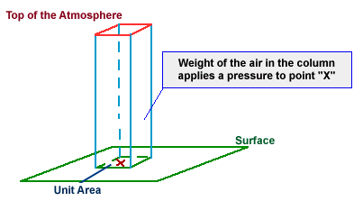
Nature and Definition
Atmospheric pressure is the force exerted on a unit area surface by atmospheric gases that bombard the surface area
The pressure of the atmosphere at the earth's surface represents the weight of a column of air exerted on a unit area extending from the earth's surface to the upper limits of the atmosphere.

Slide 4
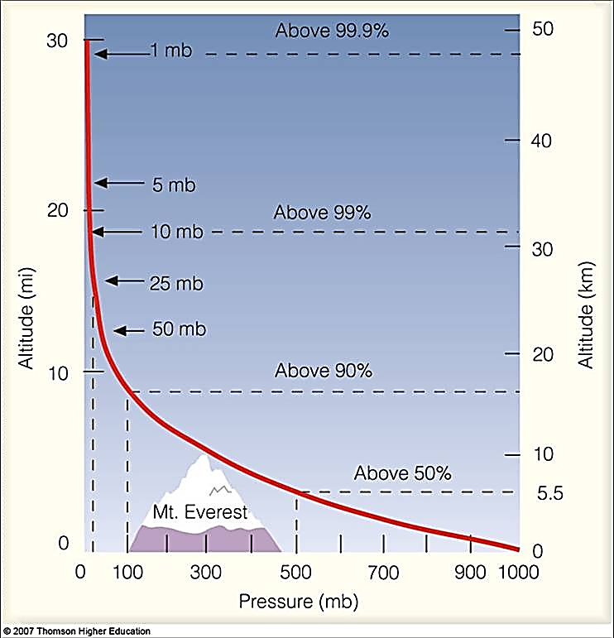
The vertical variability of pressure is much larger than the horizontal variability.
  The rate at which the pressure decreases with altitude is not constant
About 99% of the mass of the atmosphere lies within the lowest 30km above sea level.
For instance, the pressure near the earth's surface is greatest at about 1000 hPa, whereas at an altitude of about 5.5 km it is only half this value.
Air pressure differences lead to the wind flow of air from one place to another.

Slide 5
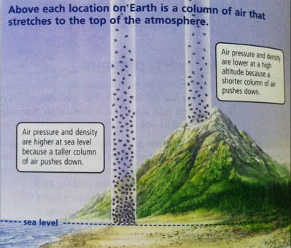
At higher altitudes the pressure is lower, due to the fact that there is less air at higher altitudes than there is at the earth's surface.
The density (i.e. the number of particles per volume) gradually decreases with height.

Slide 6
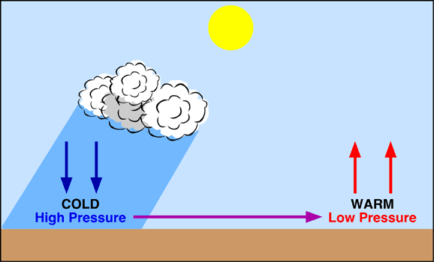
Pressure related to Temperature
Pressure is related to temperature:
  High surface temperatures will lead to lower surface pressures.
  The same effect with blood pressure and tyre pressure
  Lower surface temperatures will lead to higher surface pressures
  The same effect with blood pressure and tyre pressure

Slide 7
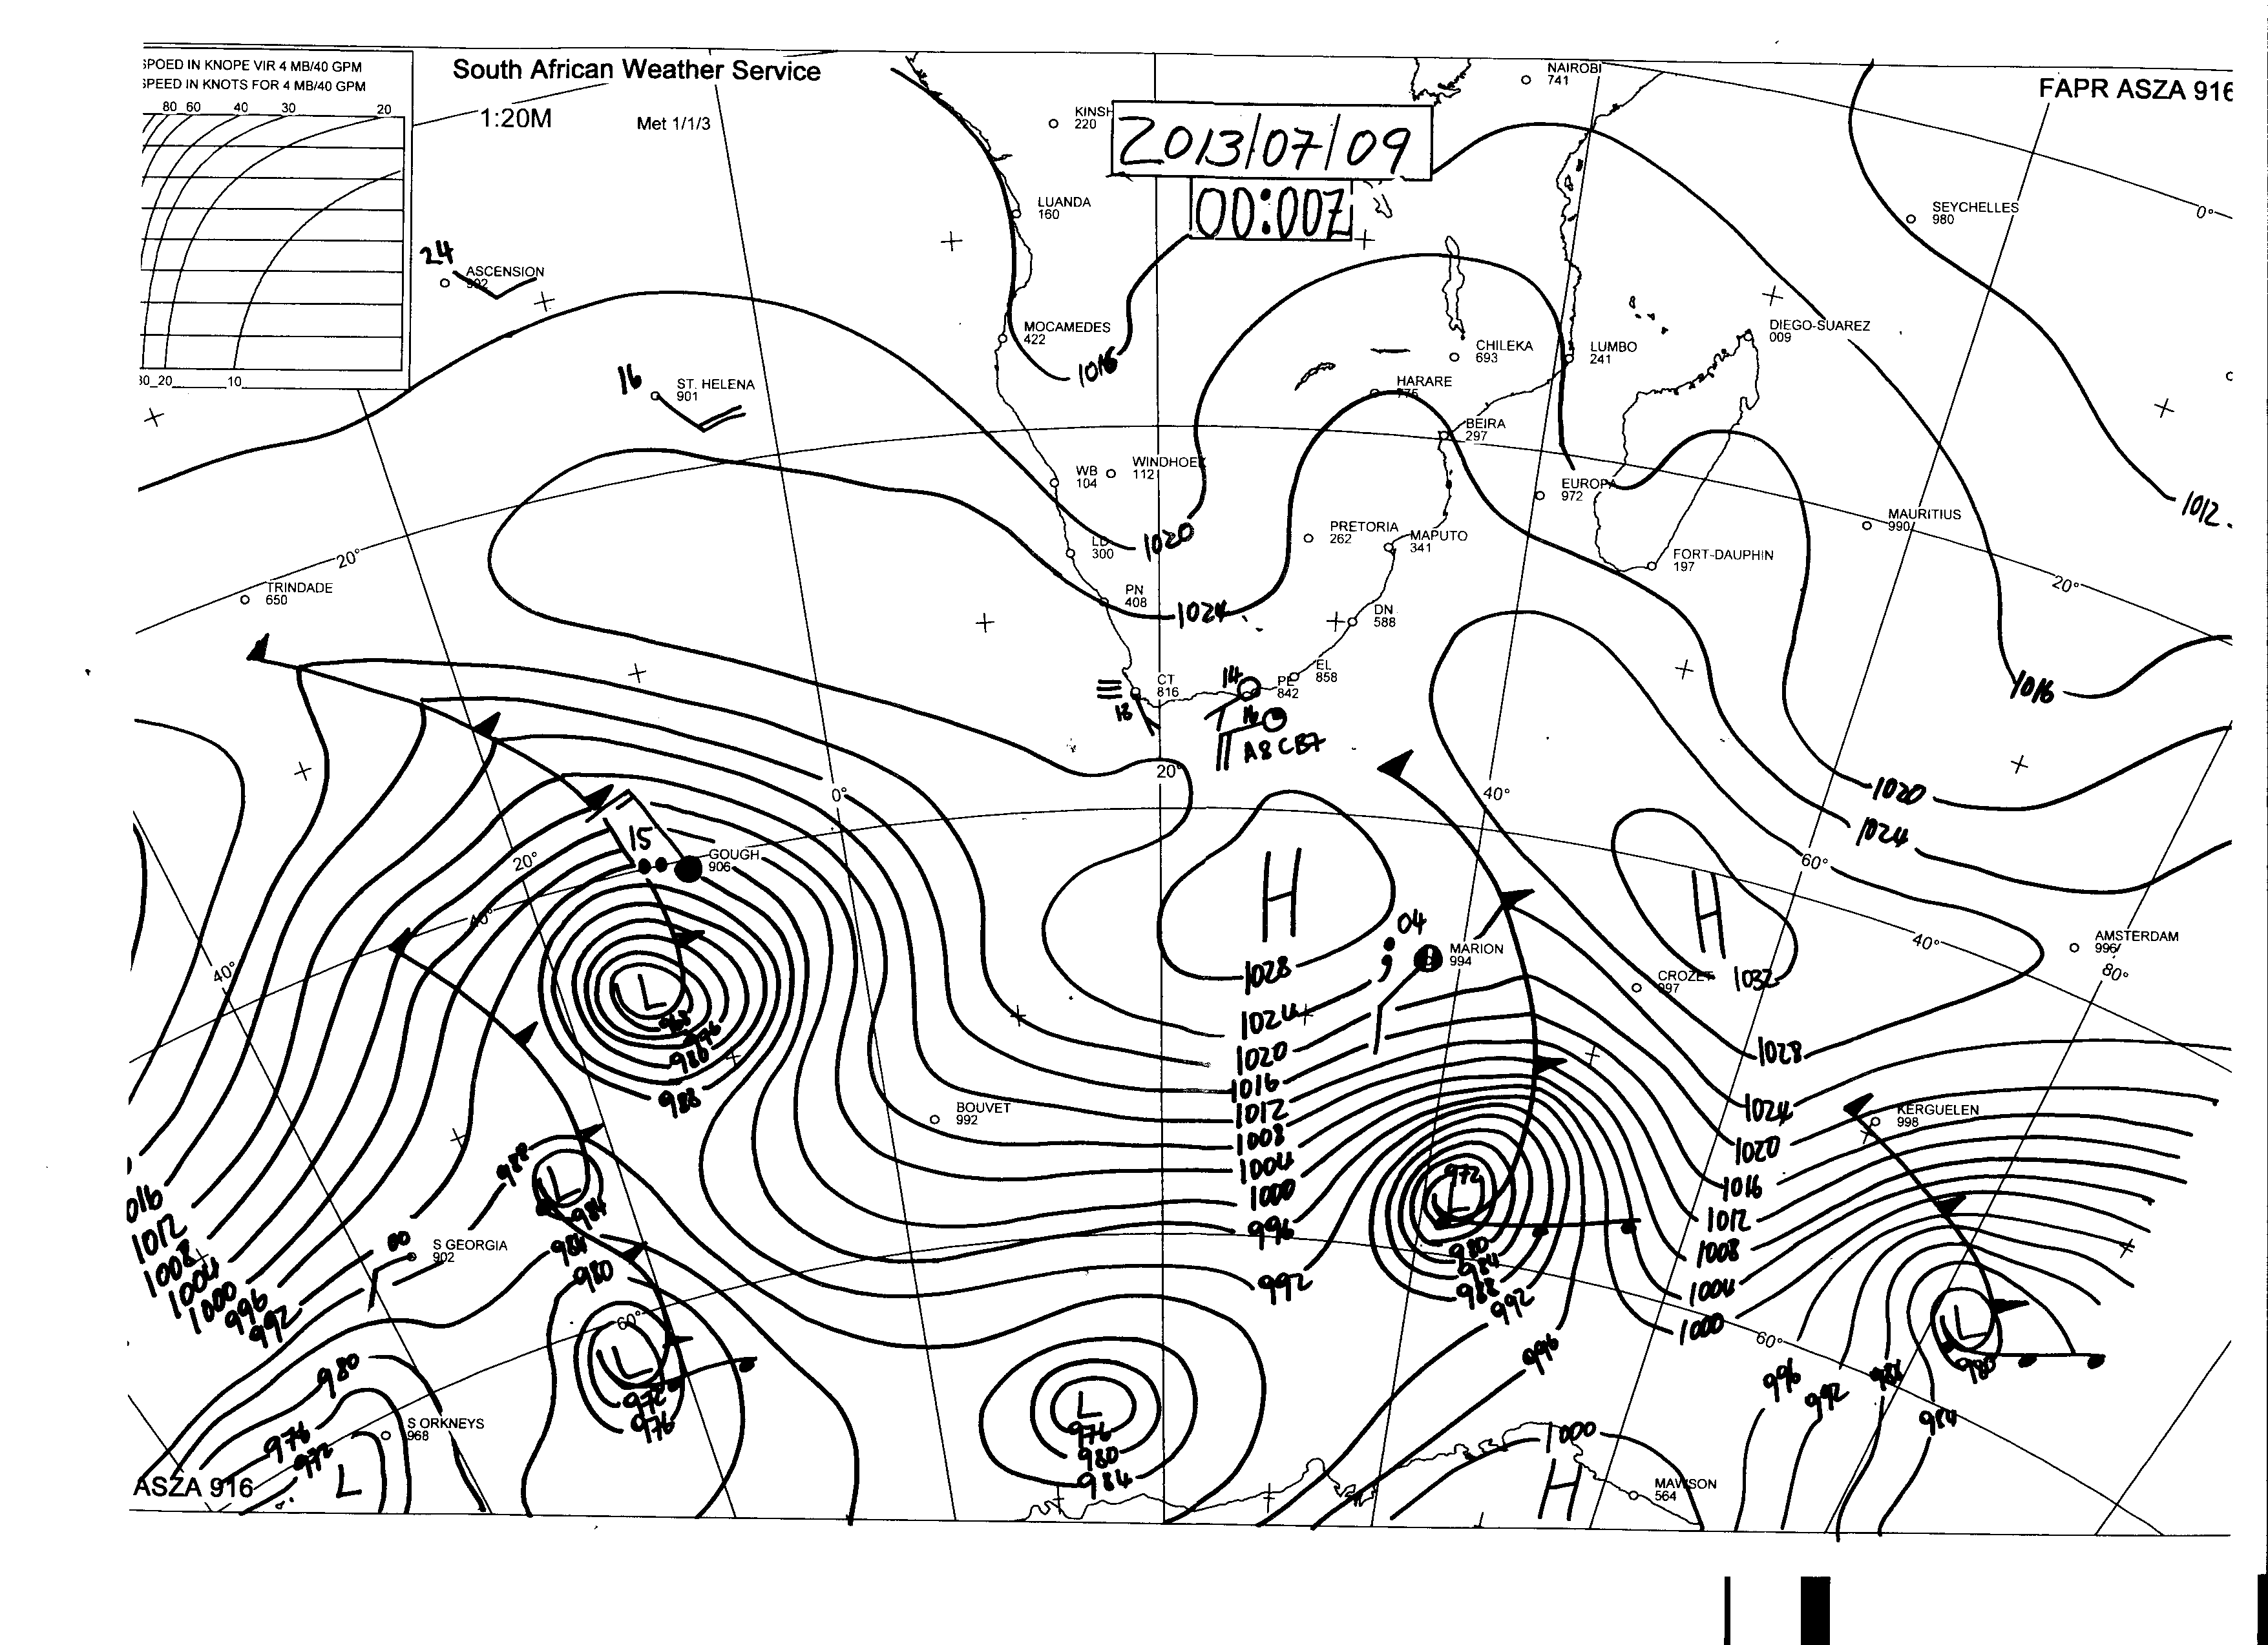

Slide 8
PRESSURE VARIATIONS AND WIND
The rate of pressure variations (rise or fall) is called the tendency (rapidly or slowly) over a three hour period.
Isobars drawn on synoptic charts, present variable and complex configurations. Isobars will then also represent a specified pressure level.
The tighter the pressure gradient, the stronger the wind and the weaker the pressure gradient, the weaker the wind.

Slide 9
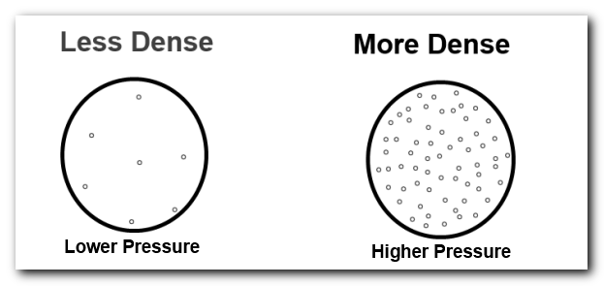
DENSITY AND PRESSURE
As pressure increases (high pressure), volume decreases and density increases
Consider two columns of air, at different temperatures, but exerting the same pressure at the surface.
The cold air will have greater density than the warm air and will therefore occupy a smaller volume than the warm air.

Slide 10
TEMPERATURE
&
HEAT EXCHANGE
Document Reference: RTC-PRE-037.3 _31 Aug 2017
Notes:
Meteorologists have to consider the atmosphere as a whole, if they are to predict its future behaviour.
Surface - surface meteorological networks are being extended throughout the world.
Upper atmosphere. Increasing use of satellites, rockets and electronic equipment.

Slide 11
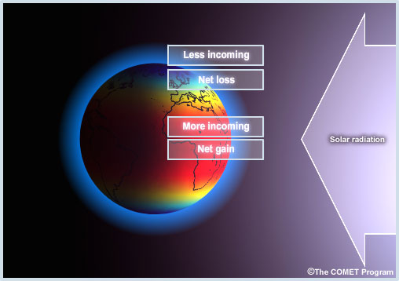
Earth’s source of energy
Radiant energy from the sun is emitted across the electromagnetic spectrum
At the earth’s surface, this is converted into thermal energy
Energy from the sun is not evenly distributed in both space and time;
  Conduction Convection Radiation
Notes:
Meridional heat gradient: heat energy received is maximum at equator, minimal at the poles.
Has to do with the movements of the earth that have previously explained

Slide 12
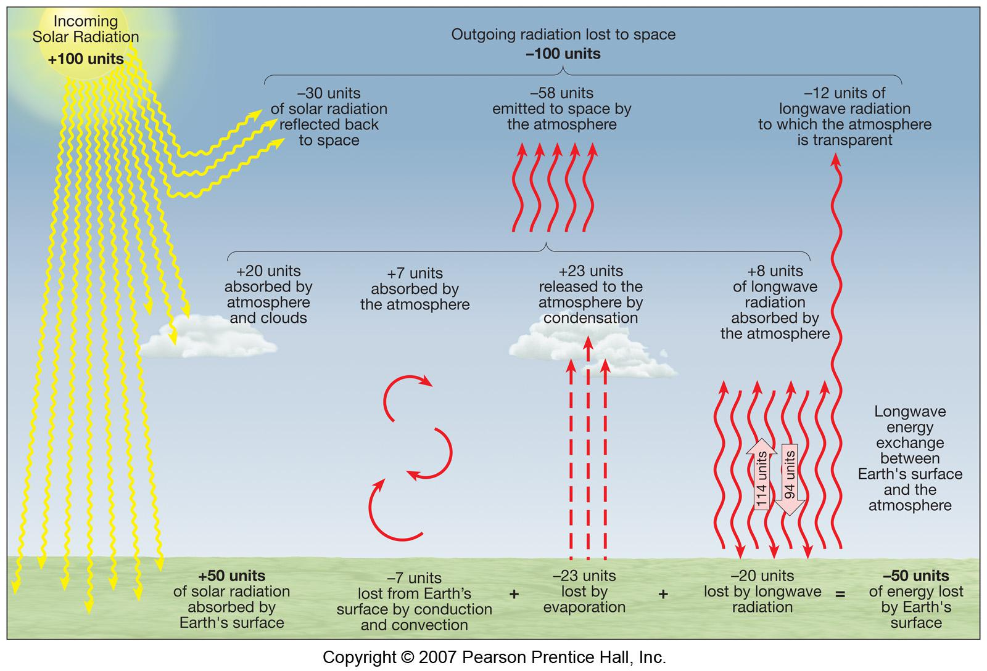
Earth’s heat budget
When solar radiation reaches the Earth's surface, it is affected in various ways, ranging from almost total reflection to almost complete absorption.
Notes:
?
Earth maintains an average surface temperature of about 15deg. This means it has achieved radiative balance, incoming = outgoing
Energy received is converted: short wave to long wave
Circulation

Slide 13
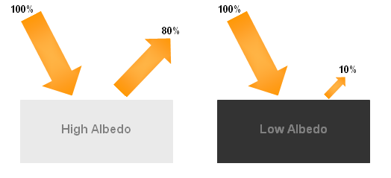
Albedo
Albedo is
  forests, grasslands, ploughed fields have a low albedo.
  Dry sand and snow would have a higher albedo.
The albedo of a water body will depend on the incidence angle of incoming radiation:
  More incoming radiation is absorbed if the angle of elevation of the sun is high (perpendicular). By contrast, water reflects most of the radiation if the angle of elevation of the sun is low.

Slide 14
“Temperature is the average energy of motion (kinetic energy) of the molecules.”
Indicates how cool/cold or warm/hot an object is and determines a body’s ability to transfer or receive heat
Allows for certain physical changes occur:
  Expand
  Contract
  Change state: freeze / melt / evaporate / condensate
Notes:
Temperature is therefore a function of molecular motion

Slide 15

Land vs sea temperatures
The specific heat of a substance is the quantity of heat required to raise the temperature of a unit mass of the substance by 1º C.
Water has the highest specific heat of any substance.
  It requires a relatively large amount of heat energy to raise the temperature of a unit mass of water by 1º C.
  its temperature rises slowly as mixing tends to spread any temperature changes through a considerable depth.
  At night, the incoming radiation ceases and heat is lost by radiation. However, there is a large store of heat energy below the water surface, so very little change occurs in the surface temperature.
The variation in the temperature of sea surfaces between daytime and night time is therefore very small.

Slide 16
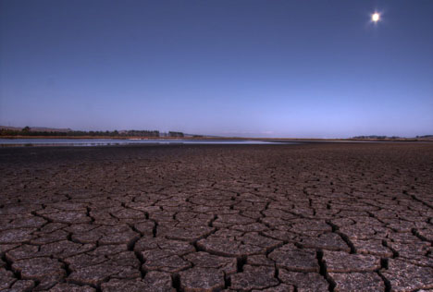
Land vs sea temperatures
Land has a low specific heat → its temperature rises rapidly, when it is heated.
  Only a thin layer of land absorbs the radiation. As a result, the temperature rises rapidly during the daytime.
  At night, incoming solar radiation ceases and the land loses heat by radiation and becomes increasingly colder during the night.
Land surfaces are therefore subject to large extremes of temperature between daytime and night time.

Slide 17
24-hour variation of surface air temperature

Slide 18
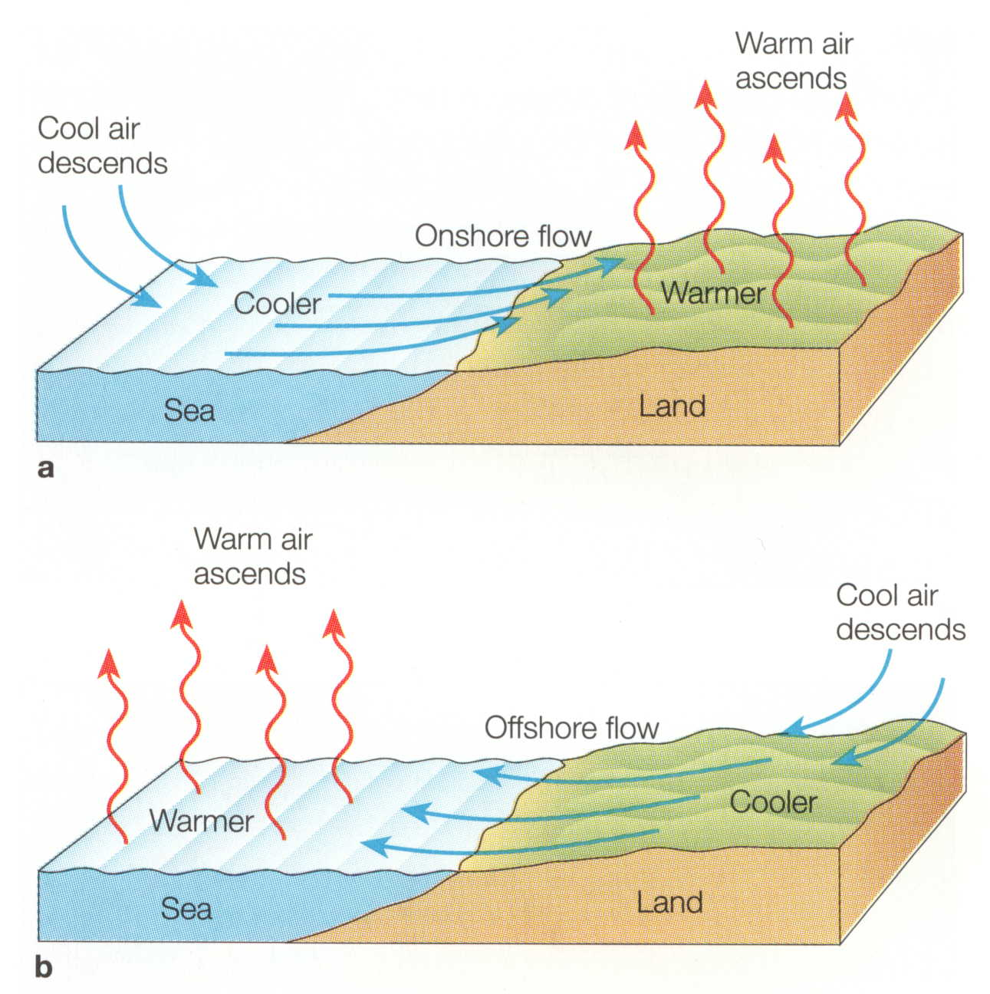
Over Sea surfaces – usually <1 ^{O} C
Over Land surfaces – can be as much as 20 ^{O} C
Near the coast – Depends largely on the wind direction –
        Large variation if the wind is coming from the land
        Small variation if the wind is coming from the sea

Slide 19
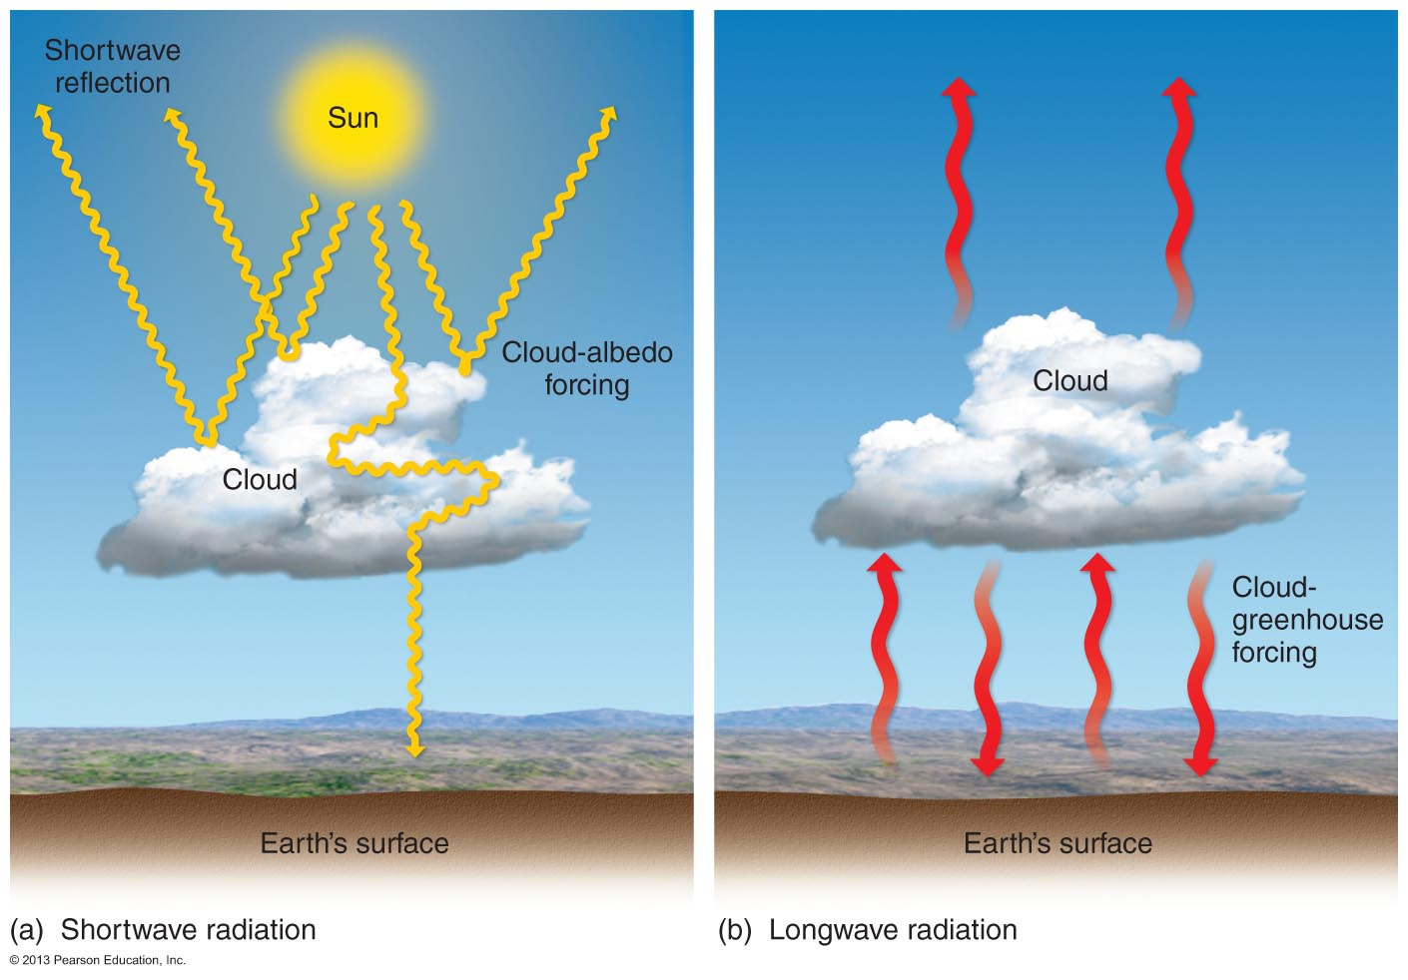
Calm conditions – variations can be great
Windy conditions – variations may be reduced due to the air being
mixed through
Cloudiness – variations are reduced
Notes:
Variation of Maximum and Minimum temperatures will then also occur between Summer and Winter.

Slide 20
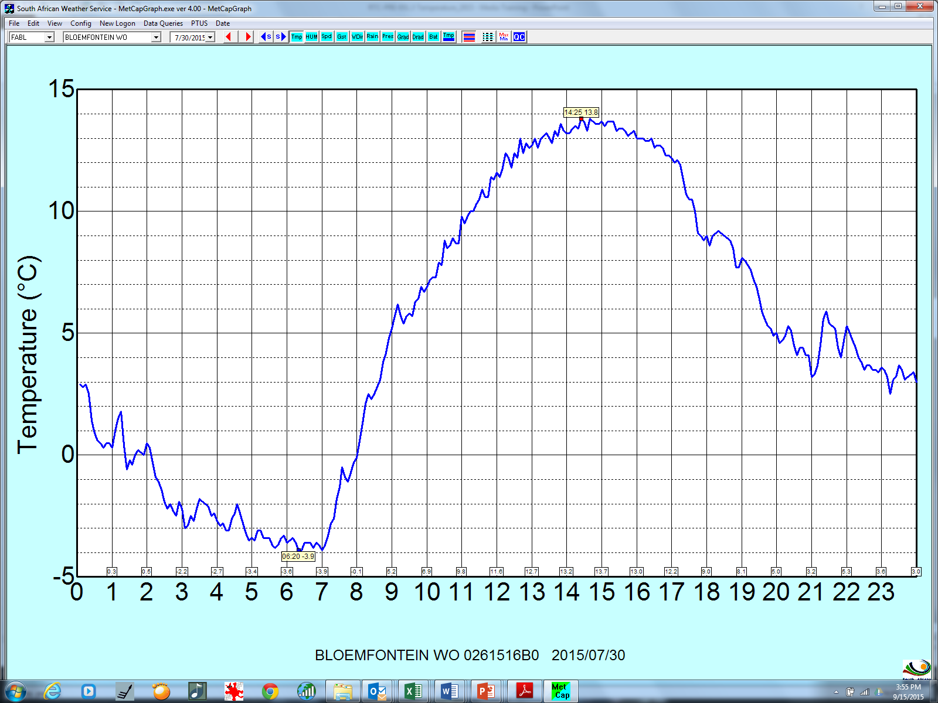
24-hour graphical variation of temperature

Slide 21
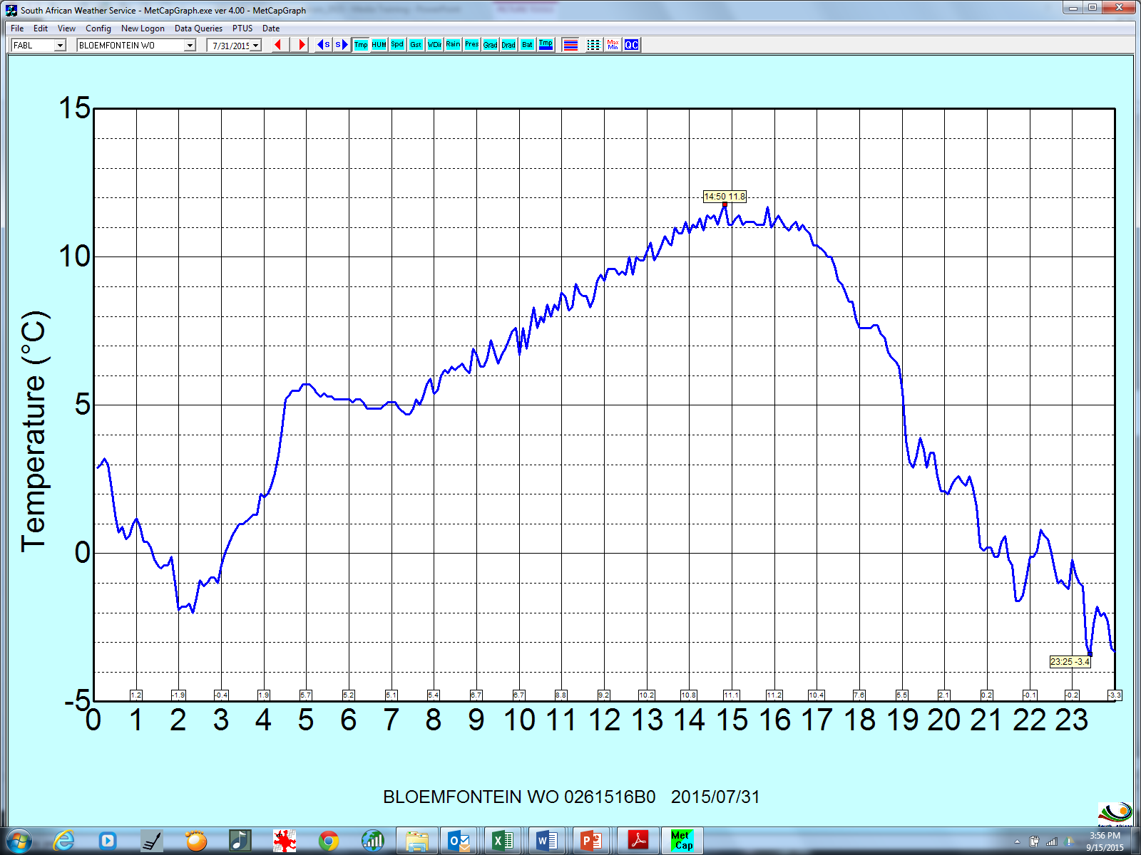
24-hour graphical variation of temperature

Slide 22
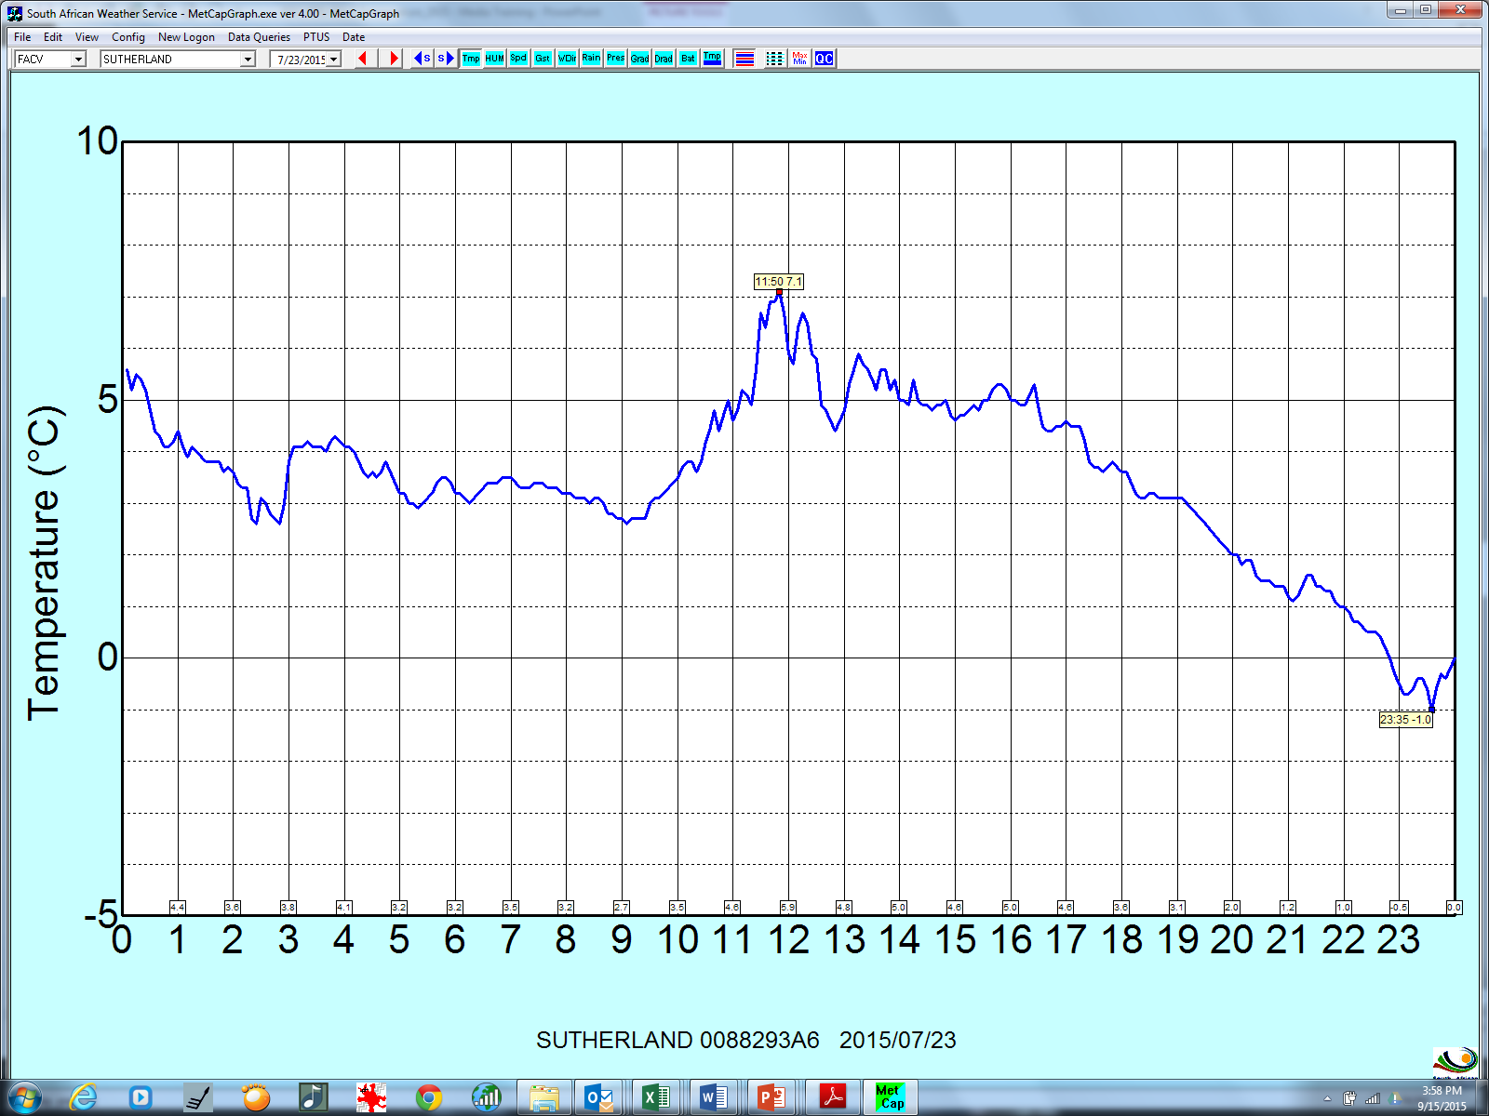
24-hour graphical variation of temperature

Slide 23
Atmospheric Moisture and
Cloud Formation

Slide 24
Atmospheric moisture
Water vapour is an important atmospheric gas
Water Vapour is the source of moisture for:-
  cloud development
  resultant precipitation in solid and liquid forms
Composition of the Atmosphere
Nitrogen (N₂) 75%
Oxygen (O₂) 23%
Argon (Ar) 1%
Water vapor (H₂O)
Carbon dioxide (CO₂)
Neon (Ne)
Helium (He) 1%
Krypton (Kr)
Hydrogen (H)
Ozone (O₃)

Slide 25
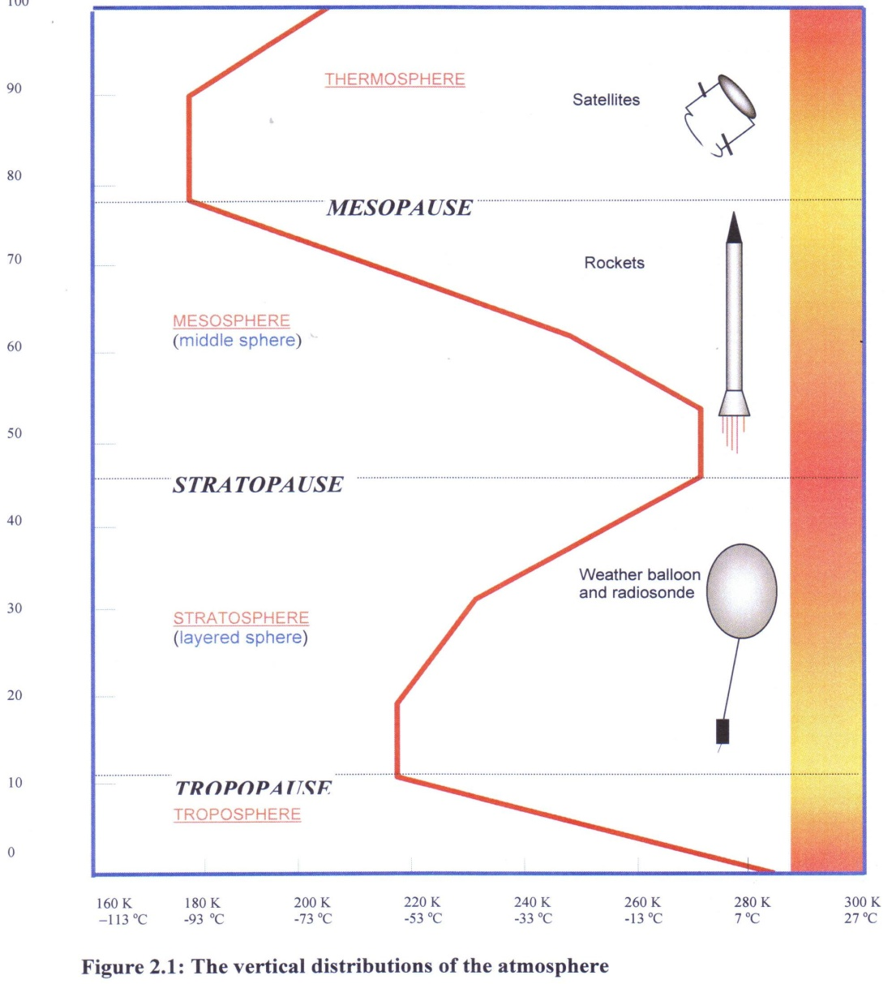
Atmospheric moisture
100
90
80
70
60
50
40
30
20
10
0
THERMOSPHERE
<1%
MESOPAUSE
Water vapor (H₂O)
Carbon dioxide (CO₂)
Neon (Ne)
Helium (He)
Krypton (Kr)
Hydrogen (H)
Ozone (O₃)
MESOSPHERE
KM
STRATOPAUSE
STRATOSPHERE
TROPOPAUSE
Within the first 6 km of the troposphere
TROPOSPHERE
-113 -93 -73 -53 -33 -13 7 27
ºC

Slide 26
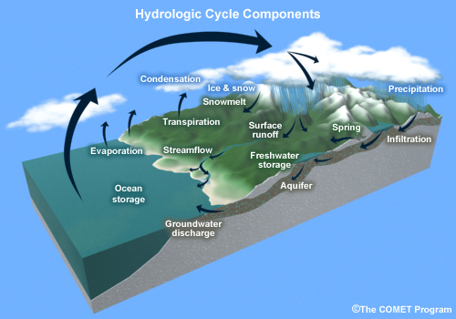
Atmospheric moisture
As part of the hydrological cycle water exists in different phases; solid, liquid, and vapour. Within the atmosphere this water exists in vapour form (water vapour).
At all times, some water is entering the atmosphere (through evaporation and transpiration) and some is leaving the atmosphere (condenses into liquid droplets).

Slide 27
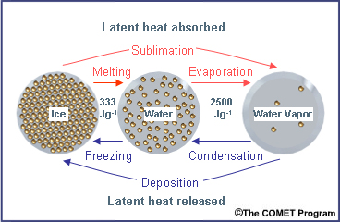

Slide 28
Condensation process
Formation of liquid drops of water from water vapor - process which creates clouds
Condensation usually occurs as a parcel of rising air expands and cools
  Also results when air comes into contact with a surface colder than its dew point temperature
Process requires condensation nuclei – dust, smoke, salt
  Hygroscopic nuclei, are those that attract water, fostering condensation - salt
  Hydrophobic nuclei, are those that repel water - oil
Release of the latent heat of condensation.

Slide 29
Freezing and Deposition
Freezing occurs when liquid water cools to temperatures below 0ºC
  Pure liquid water can be cooled to temperatures below this, and remain liquid → supercooled
  The introduction of a freezing nucleus will cause freezing to take place in supercooled water (freezing will also occur if the supercooled droplets are disturbed)
Lab experiments have shown that the lowest temperature at which supercooled droplets can exist is about ‑40º C. Below this temperature water freezes, regardless of whether there are nuclei or not
Deposition occurs when water vapour changes directly to into ice
  Doesn’t happen often as sublimation nuclei are less numerous than condensation nuclei
Saturation vapour pressure over ice is less than that over supercooled water, it is possible for water vapour to be deposited as ice onto sublimation nuclei

Slide 30
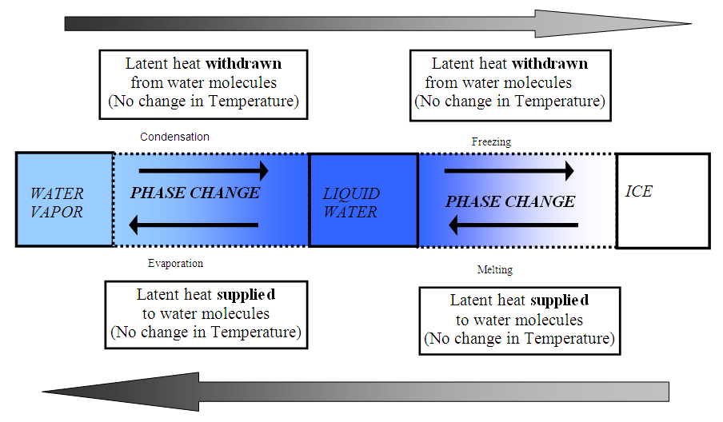

Slide 31
Moisture Indicators
Relative humidity(RH %): is a ratio of the actual water vapour present, to the amount required to saturate,
  doesn’t tell how much moisture in the atmosphere but only how close the atmosphere is to saturation
Absolute humidity: refers to the weight of water in a certain volume of gas.
  E.g. on a typical summer day (23º, 55% RH), there are 11.3 grams of water vapour per cubic meter.
Density of air varies with pressure, so the absolute humidity depends quite strongly on the gas pressure

Slide 32
Moisture Indicators cont…
Wet bulb temperature measure of the cooling effect on a wet bulb thermometer (saturated wick)
  indicates the temperature a parcel of air, that is cooling, would reach when saturation occurs (ºC).
Dew-point temperature The temperature at which saturation is reached
  T-Td → dew point depression
Mixing ratio: The weight of water in grams contained in a kilogram of dry air(g/kg).

