Slide 1
Surface wind & visibility
Presented by:
Ms. Shine Lithakazi Mkatshwa
Regional Training Centre: Meteorological Qualification Manager

Slide 2
Wind: Nature and definition
Wind is air in natural motion,
It refers to a broad flow of air, either near the earth's surface or in the free atmosphere and is caused by pressure and temperature variations.
The flow of air is seldom smooth. Turbulence results in eddies developing within the air and interfering with its direct progress
Turbulence produces rapid, irregular changes in both the speed and direction of the wind

Slide 3
A wind gust is a sudden and brief increase in the strength of the wind relative to its mean value (over a period of time). A gust has a very short duration (seconds-long) and is followed by a lull (dying down) in the wind
A squall is a specific phenomenon where there’s a sudden strong increase in wind speed of at least 16 knots, with the speed increasing to 22 knots or more and lasting for at least one minute.
If there is no appreciable motion of the air, the wind conditions are said to be calm. Wind speed < 1 knot

Slide 4
Measuring wind
The wind direction is the direction from which the wind is blowing
It is expressed in degrees measured clockwise from geographical (or true) north, or in terms of the cardinal directions.
In coded meteorological reports, the wind direction is expressed on the scale 00‑36.
The 10 minute mean direction is reported
Sometimes it’s necessary to estimate direction, especially at speeds < 2knots

Slide 5
Measuring wind
Wind speed is reported in knots: ( nautical mile/hour
1 knot = 1.852 km/hr
1 knot = 0.5 m/s
Wind varies rapidly and continuously. It’s the gustiness of the wind that produces variations which are irregular both in period and in amplitude. For most purposes an average wind is required
For synoptic meteorological reports - mean speed of the surface wind over a period of ten minutes is reported (determined to the nearest knot)

Slide 6
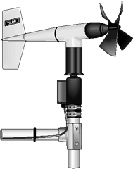
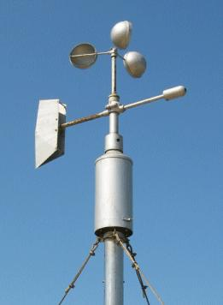
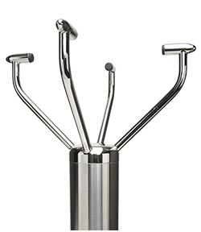
Wind measuring instruments
Propeller anemometer integrated with a wind vane
Cup anemometer with wind vane
Ultrasonic anemometer

Slide 8
Beaufort Force | Knots | Description | Land Condition | Sea Condition
0 | 0 | Calm | Calm; smoke rises vertically | Sea like a mirror
1 | 1 – 3 | Light air | Direction of wind shown by smoke drift but not be wind vanes | Ripples but without foam crests
2 | 4 – 6 | Light breeze | Wind felt on the face; wind vanes move | Small wavelets. Crests do not break
3 | 7 – 10 | Gentle breeze | Leaves and small twigs in constant motion; wind extends light flag | Large wavelets. Perhaps scattered white horses
4 | 11 – 16 | Moderate breeze | Raises dust and loose paper; small branches are moved | Small waves. Fairly frequent white horses.
5 | 17 – 21 | Fresh breeze | Small trees in leaf begin to sway; crested wavelets form on inland waters | Moderate waves, many white horses
6 | 22 – 27 | Strong breeze | Large branches in motion; whistling heard in telegraph wires; umbrellas used with difficulty | Large waves begin to form; white foam crests, probably spray
7 | 28 – 33 | Near gale | Whole trees in motion; inconvenience felt when walking against the wind | Sea heaps up and white foam blown in streaks along the direction of the wind
8 | 34 – 40 | Gale | Breaks twigs off trees; generally impedes progress | Moderately high waves, crests begin to break into spindrift
9 | 41 – 47 | Strong Gale | Slight structural damage occurs (chimney pots and slates removed) | High waves. Dense foam along the direction of the wind. Crests of waves begin to roll over. Spray may affect visibility
10 | 48 – 55 | Storm | Seldom experienced inland; trees uprooted; considerable structural damage occurs | Very high waves with long overhanging crests. The surface of the sea takes a white appearance. The tumbling of the sea becomes heavy and shock like. Visibility affected
11 | 56 – 63 | Violent Storm | Very rarely experienced; accompanied by widespread damage | Exceptionally high waves. The sea is completely covered with long white patches of foam lying in the direction of the wind. Visibility affected
12 | 64 + | Hurricane | – | The air is filled with foam and spray. Sea completely white with driving spray. Visibility very seriously affected.

Slide 9
Wind variations
Vertical velocities in the atmosphere are significantly smaller than horizontal velocities – but they are important for cloud formation!
Places near hills in valleys and places adjacent to the sea often experience marked variations in the direction and speed of the surface wind, either in daytime or night-time. Why??
If the nature of the surface is fairly uniform in an inland area, a marked change in wind speed frequently occurs during the day. Maximum wind speeds are usually experienced from midday until late afternoon, then speeds decreases and reach a minimum at dawn.

Slide 10
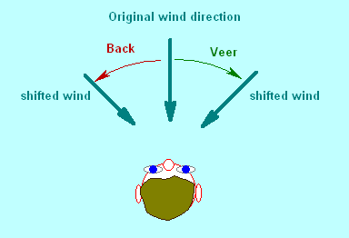
Backing and veering
Veering - wind direction changes so that the observer facing the wind has to move in a clockwise direction (to his right) in order to continue facing the wind
Backing - the wind direction changes so that the observer facing the wind has to move in an anticlockwise direction (to his left) in order to continue facing the wind.

Slide 11
Meteorological visibility
Day Visibility
In daylight, meteorological visibility is defined as the greatest distance at which a black object of suitable dimensions can be seen and recognized against the horizon sky.
The identification of an object depends on the observer's familiarity with the surroundings.
Night Visibility
The meteorological visibility is then defined as the greatest distance at which the black object of suitable dimensions could be seen and recognized, if the general illumination were raised to the normal daylight level.

Slide 12
Factors affecting visibility
The main causes of reduced meteorological visibility are as follows:
Precipitation
Fog and mist
Wind-blown spray from the sea
Oils
Smoke
Dust and Sand
Salt

Slide 13
Precipitation effects
Rain: Effects depend on both the size of the droplets and their number in a given volume of air.
- Moderate rain reduces the visibility to 3-10 km.
- Heavy rain reduces visibility as low as 50-500 m.
Drizzle may reduce visibility to 0.5 to 3 km.
Snow has more effect than rain and blowing snow even worse.
- Moderate snow reduces visibility to below 1 km.
- Heavy snow, it may range from about 200 m to less than 50 m.

Slide 14
Fog and mist
When the water droplets in the air reduce the visibility below 1000 m (1 km), meteorologists describe the phenomenon as fog, instead of mist.
Most types of fog are dispersed either by turbulence or by warming.
Fog usually consists of water droplets, but ice crystals may be present in some circumstances. Over high ground fog can be regarded as a cloud on the ground.

Slide 15
Wind-blown sea spray
As the wind speed increases over the sea, the crests of the waves become higher, and eventually spray begins to form from the breaking waves with streaks of foam blown through the air.
Once the wind speed reaches that of a strong gale (41-47 knots) the spray begins to affect the surface visibility.
The effect increases with increases in wind speed. When it reaches hurricane force (>64 knots), the visibility may be seriously reduced.
The deterioration in visibility produced by wind-blown spray can affect coasts with on-shore winds.

Slide 16
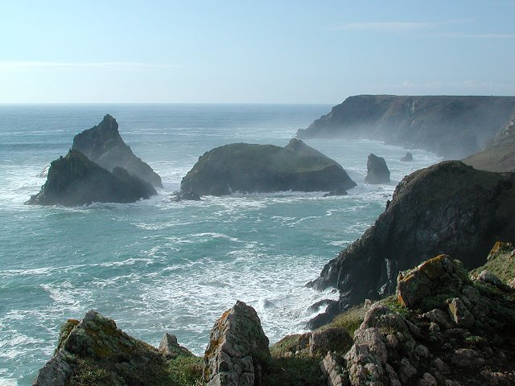
The effects of salt particles
Sea spray often evaporates after being blown into the atmosphere. Each droplet then leaves behind a particle of salt to become a condensation nucleus at a later time for water.
For the same concentration of particles, sea salt is much more effective than smoke in reducing visibility.
The haze produced by sea salt has a whitish appearance.

Slide 17
Oil particles
The escape of oil fumes from motor vehicles and industrial sources is the main source of these particles.

Slide 18
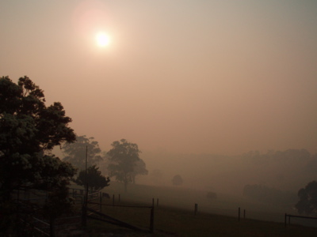
Smoke
A thick haze is often produced by smoke from industrial and domestic fires.
Although larger particles tend to settle the smaller particles remains suspended in the air.
These small particles are often comparable in size to water- droplets in mist or fog.
Materials which are burnt produce minute carbon particles which creates a black haze, which is characteristic of large industrial cities.

Slide 19
Dust and sand
Dust or sand may be raised from the ground by the wind and carried upwards.
When the visibility is reduced below 1000 metres, the phenomenon may be referred to either as a sandstorm or as a dust storm.
Dust storms consist of minute particles of fine dust, and may on occasions be distributed to heights of several kilometres above the Earth's surface.
Sandstorms consist of relatively coarse sand that is too heavy to be lifted far. The particles rarely extend to a height of more than 20 or 30 m
Many of the particles are too small to fall by gravity at any measurable speed. As a result, air of desert origin retains its haziness for a long period of time.

