Slide 1
Continental Tropical Lows (“Africanes”)
Presented by; Lee-ann Simpson
Content courtesy of; Elizabeth Webster (DRR)

Slide 2
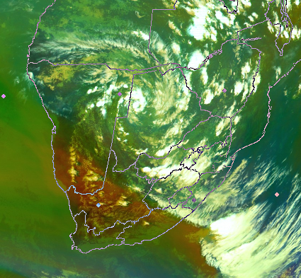
Definition
What is a Continental Tropical Low pressure (CTL)?
- Tropical weather system
- Warm cored
- Low pressure
- Over land

Slide 3
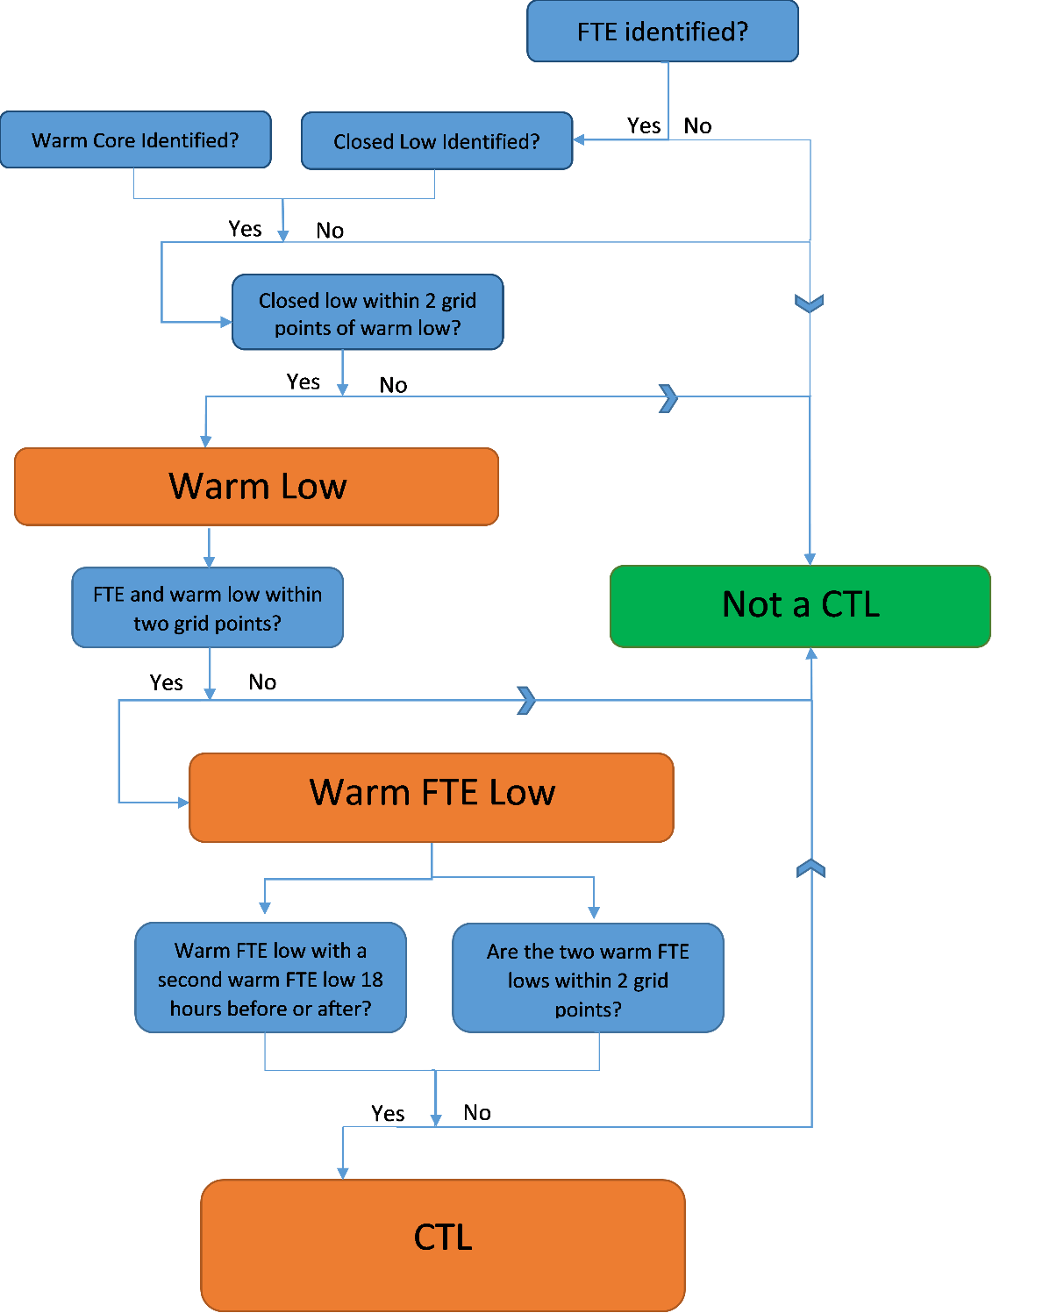
Objective Identification Method
Four criteria to identify a CTL over southern Africa:
1. Detect a favourable tropical environment (FTE).
2. A closed 500hPa geopotential low with a warm core of 500-300hPa temperatures are present and within two grid points.
3. The FTE and warm low are within two grid points of each other.
4. The fourth criteria is two-fold. It is required that the current warm FTE low has another warm FTE low either 18 hours before or after and lies within two grid points of the current warm FTE low.

Slide 4
Climatology of CTLs over Southern Africa
CTLs occur most frequently over southern Angola and Zambia
CTL occurrences decrease southwards
Favour north-eastern RSA
Tropical cyclones
Average of 19 CTL days per year over entire region
Average of 2 CTL days over South Africa (south of 22.5˚S)

Slide 5
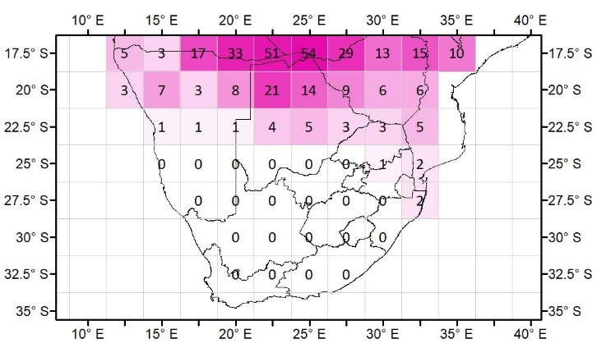
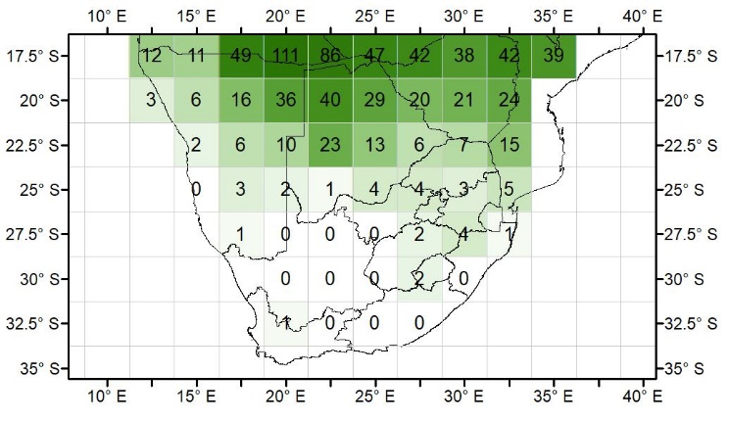
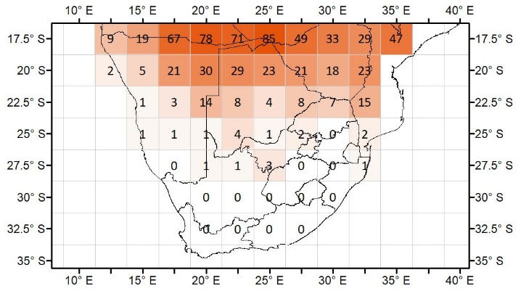
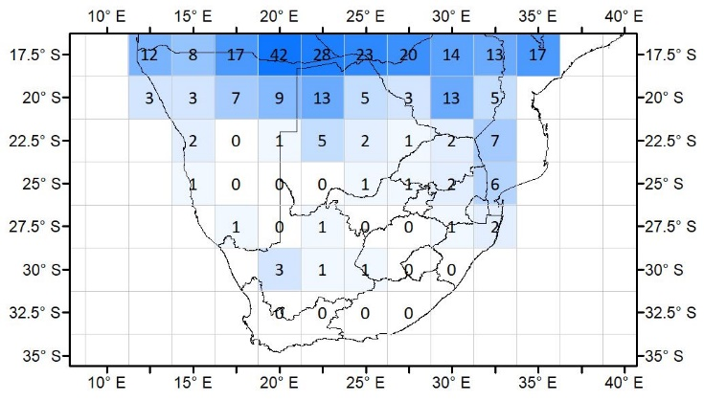
Climatology of the monthly distribution over Southern Africa
DEC
JAN
Least CTL events during December months over SA
Increase from January
Spread further westwards by February
Over the western and central interior by March
FEB
MAR

Slide 6
Lifespan of CTLs
The highest number of days a CTL existed for was 19, this occurred between 3 and 21 January 2017.

Slide 7
The influence of CTLs on rainfall distribution in South Africa
Demonstrates the rainfall distribution (forecasters)
Rainfall mainly occurs to the east of the CTL

Slide 8
The influence of CTLs on rainfall distribution in South Africa-rainfall extremes

Slide 10
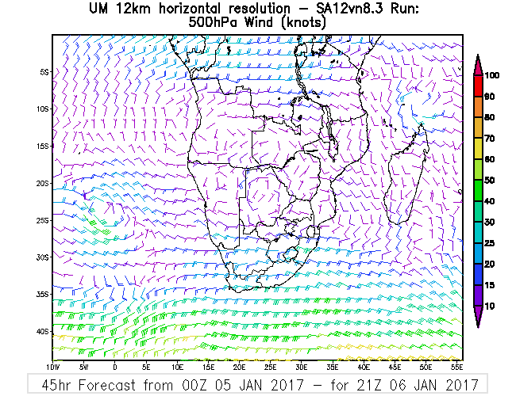
L
L

Slide 11
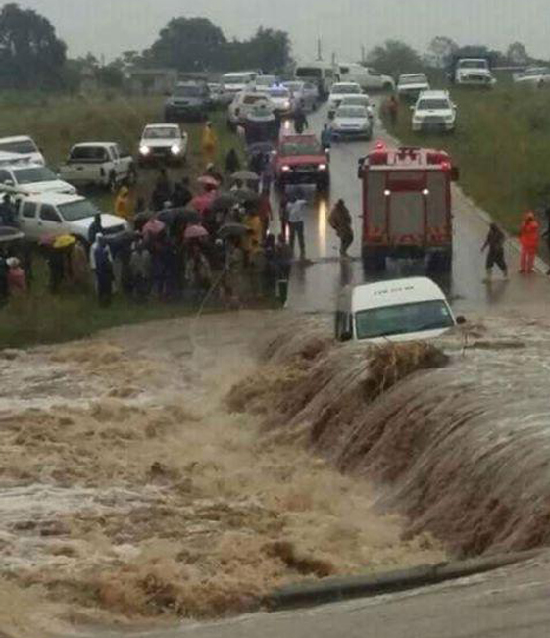
Potential Weather Impacts (Rainfall)

