Slide 1
The Forecasting Process and Terminology
Lee-ann Simpson

Slide 2
Analyse
and
monitor
Warn of
Hazardous
Phenomena
2. Forecast
WMO Competency Requirements for Public Weather Forecasters
4. Communicate Met. Info
5. Ensure quality of Met. Info and services

Slide 3
The Forecasting Process
Need to look back before looking ahead
Be aware of the major weather systems at play
Have an idea of the weather for the coming 3 days without having a look at any information (experience & knowledge)
1. Analyse and Monitor

Slide 4
Look at weather from previous day
Look at real time data:
Satellite imagery
Radar
Observational data
Use NWP to predict changes and progression of the weather systems and associated conditions
Continuously monitor the real time weather
Compile a concise forecast, including alerts, and communicate the forecast with Media, Public and disaster management
1. Analyse and Monitor
STEP 1
2. Forecast & 3. Warnings/IBF
STEP 2
4. Communicate & 5. Quality
STEP 3

Slide 5
STEP 1; System identification
1

Slide 7
Observational Data
1

Slide 8
STEP 2 – Apply changes to Current situation and Continuously monitor
2
3

Slide 9
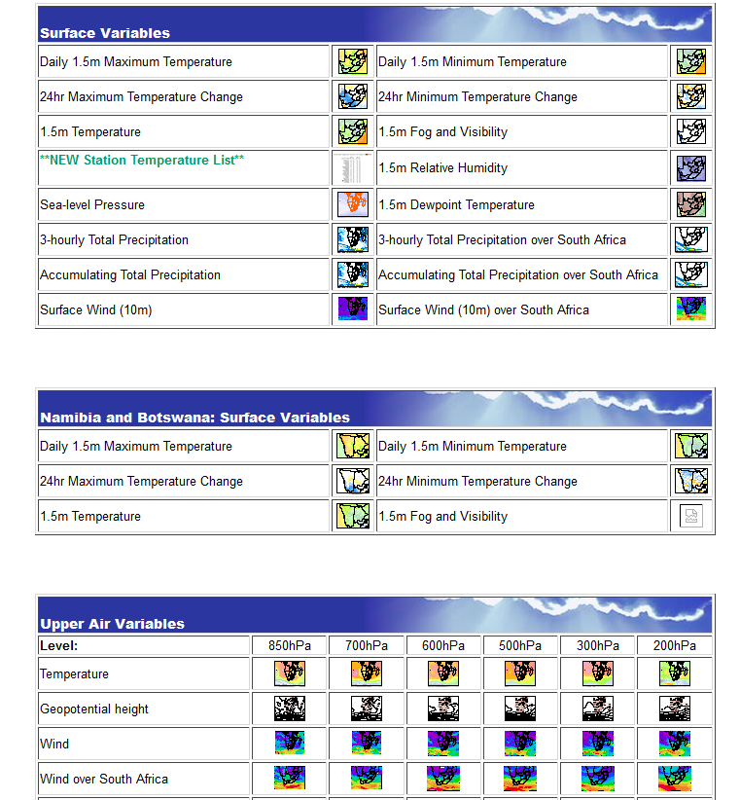

Slide 10
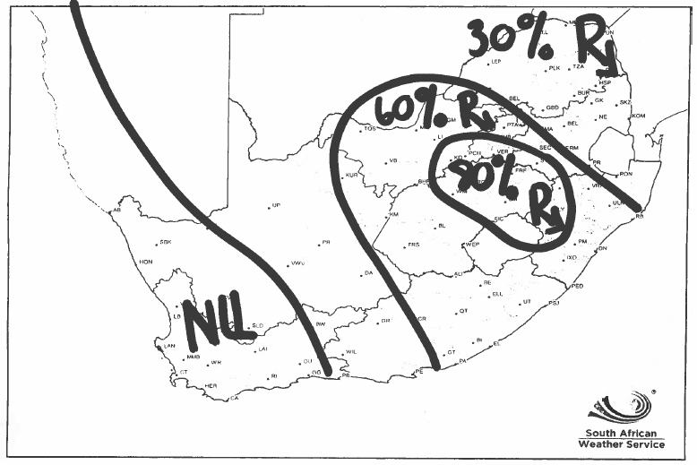
STEP 3 – Compile a Forecast
1
4
5

Slide 11
3 Disciplines/Specialized Areas of Alerts (Current practice)
1
3
Aviation Weather related Hazards
These will not be disseminated in the public domain
Marine Weather related Hazards
These will be disseminated in the public domain
Public Weather related Hazards
These will be disseminated in the public domain
4

Slide 12
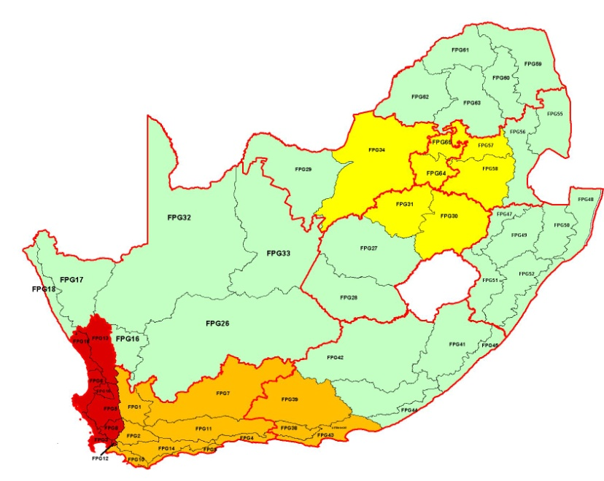
Classifications of Hazards (current practice)
1
3
4
No Alert | Special Weather Advisory | Watch | Warning
 | Be Aware! | Be Prepared! | Take Action!
No hazardous weather expected in next few days | Early warning of potential hazardous weather | Weather conditions are likely to deteriorate to hazardous levels | Hazard is already occurring somewhere or is about to occur with a very high confidence
 | 2 to 6 days period | 1 to 3 day period | Next 24 hours, 3 hrs for FF, TS

Slide 13
Special Weather Advisories
1
3
Large scale expected potential disruptive weather that could lead to warnings with time
Less urgent alerts of uncommon conditions
Disseminated via email, telephone and standard media channels. NOT via SMS
4

Slide 14
Weather Watch
1
3
4
These could lead to disruptive and disastrous conditions
Via SMS, email, telephone and standard media channels
Within day 1 -3

Slide 15
Weather Warning
1
3
4
These could lead to disruptive and disastrous conditions
Via SMS, email, telephone and standard media channels
Within the next 24 hours
Already occurring or imminent
1 – 3hours for severe thunderstorms

Slide 16
Severe weather Watches/Warnings
1
3
Gale force winds
Heavy Rainfall
Heavy rainfall leading to flash flooding
Localised Urban Flooding
Disruptive Snowfalls
Severe thunderstorms
High Seas
4

Slide 17
Impact Based Forecasting(IBF) Information and slides courtesy of Elizabeth Webster
1
3
4

Slide 20
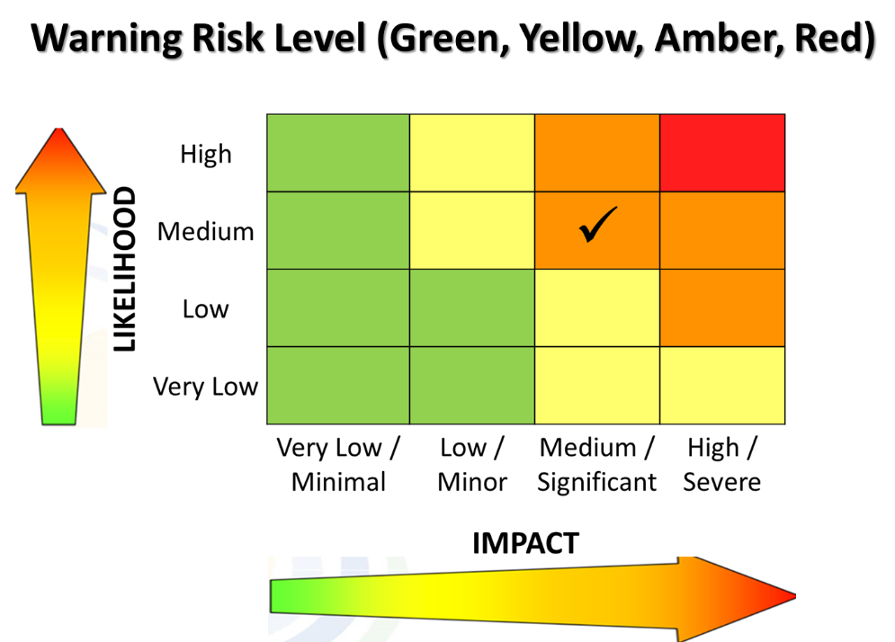

Slide 21
Forecasting Terminology
4
Isolated
Scattered
Widespread
Thunderstorms

Slide 22
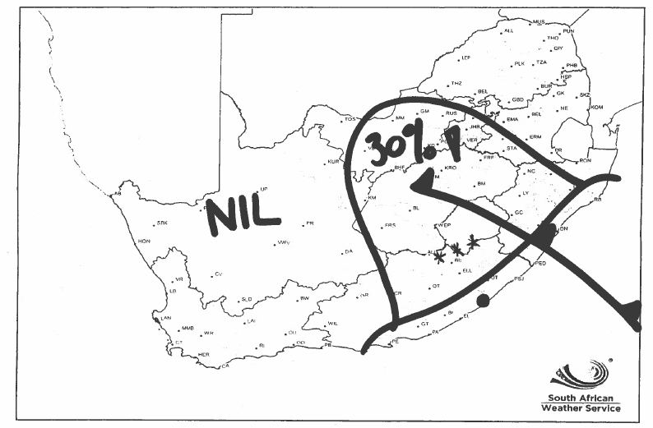
Rain
Snow
Showers

Slide 23
Any Questions?

