Slide 1
Marine Weather Forecasting

Slide 2
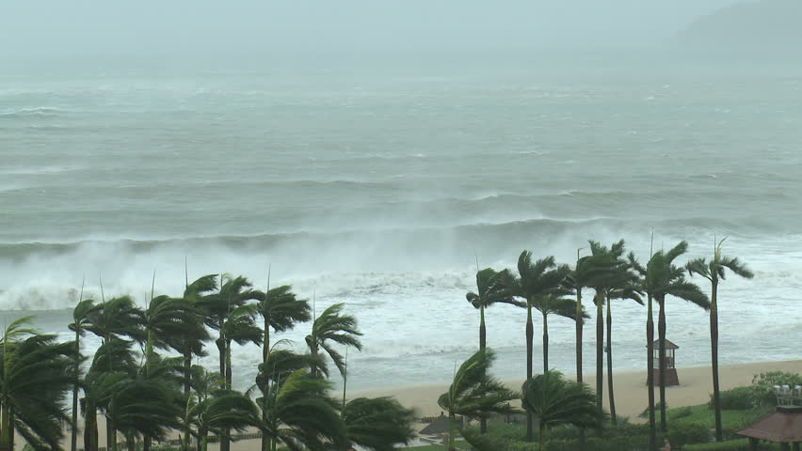
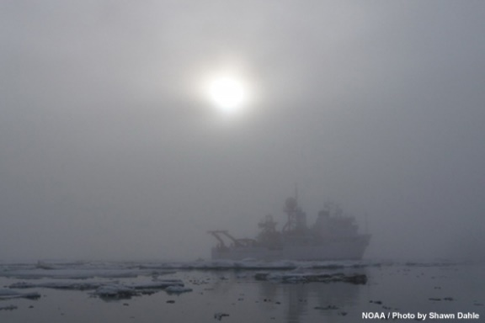
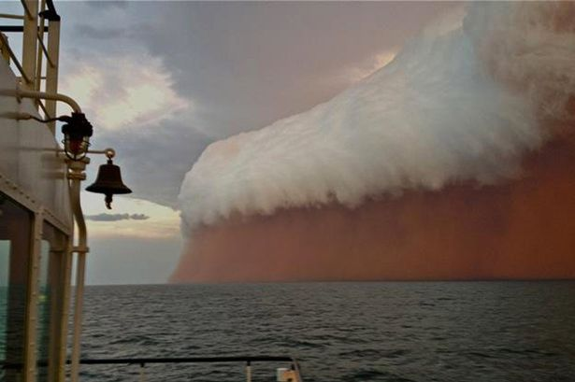
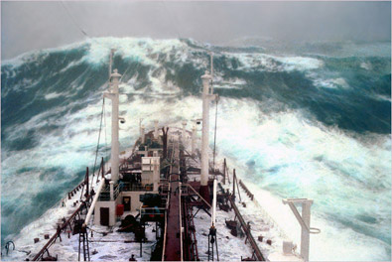
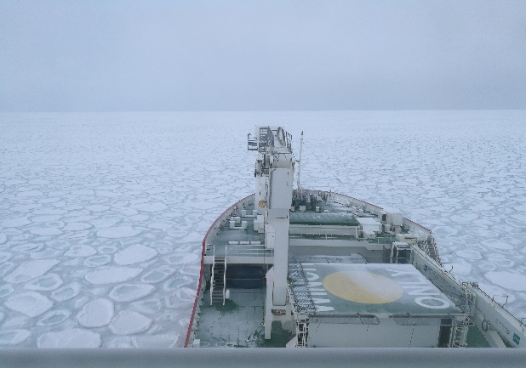
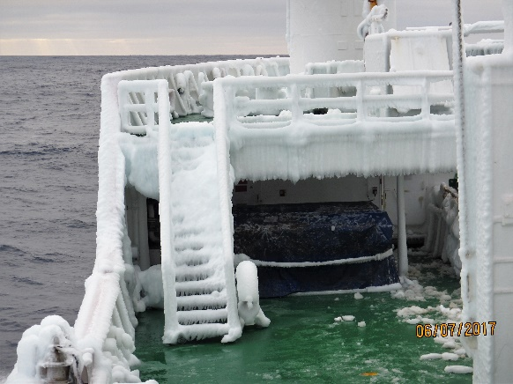
What is Marine Weather Forecasting?
It is the forecast of future weather conditions over the ocean
This forecast may include the following information (but not limited to)
Wind
Reduced visibility (including phenomena)
Sea State (waves)
Sea Ice and vessel icing (not yet done at SAWS)
M de Villiers
M de Villiers

Slide 3
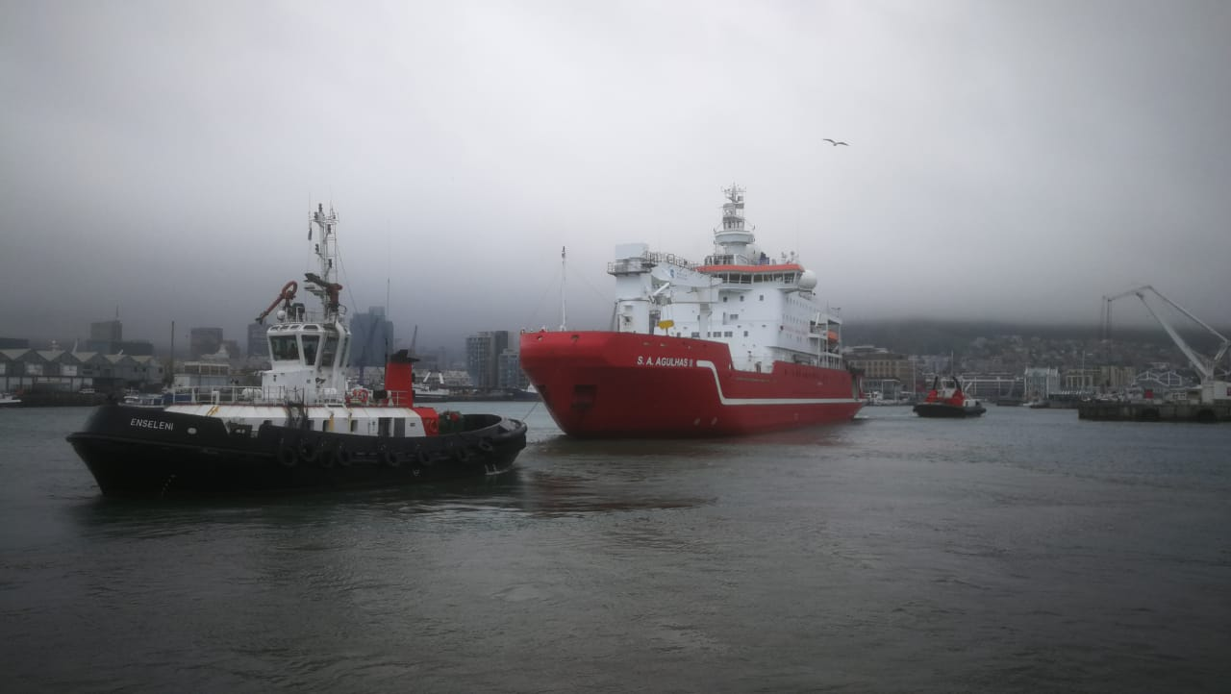
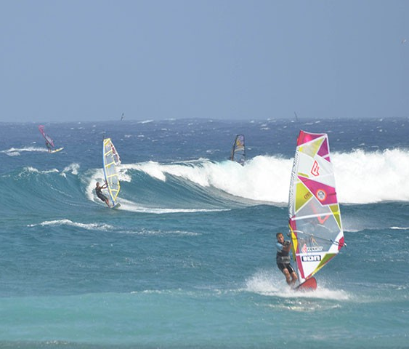
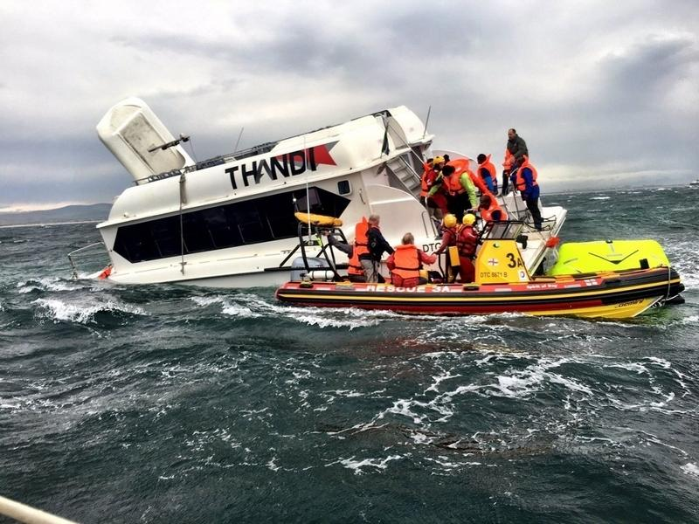
Why Marine Weather Forecasting?
Large range of activities occur over the ocean from recreational to commercial activities
Providing Meteorological Safety Information is a requirement under the Safety Of Life At Sea (SOLAS) Convention
Provide Meteorological Safety Information to all marine users such as (amongst others);
Cargo, fishing, passenger, Research vessels etc. and Port Operations
Surfers, beach goers, wind surfers etc.
Search and rescue operations

Slide 4
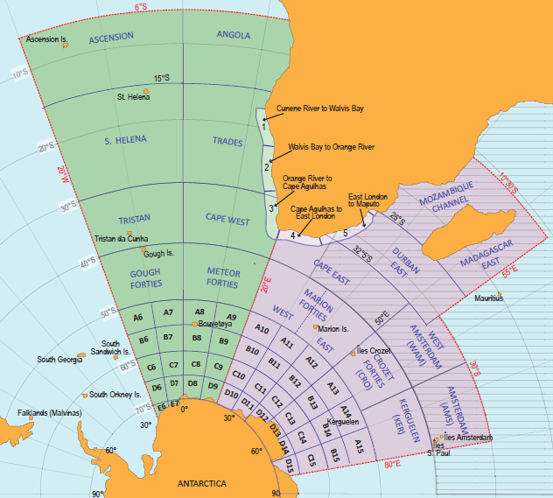
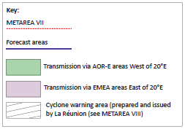
WMO responsibility
SAWS is the nominated preparation and issuing service for METAREA VII
High Seas and Coastal Forecasts issued twice daily as per the minimum requirements
Notes:
Ocean areas surrounding the world have been sub-divided into areas that are known as METAREA VII. SAWS has been tasked with preparing and issuing maritime safety information for METAREA VII. METAREA VII is the second largest METAREA in the world and extends from the ocean areas surrounding southern Africa all the way to Antarctica. The METAREA is divided into various sub regions with areas applicable to high seas and some areas applicable to coastal forecasts (point out these areas)

Slide 5
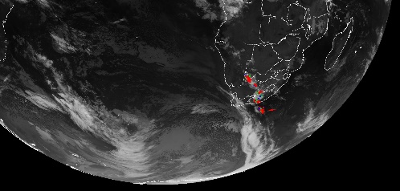
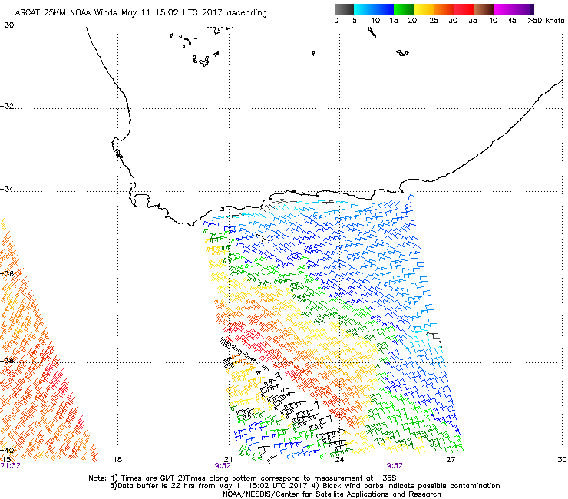
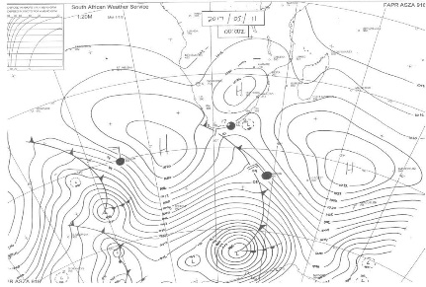
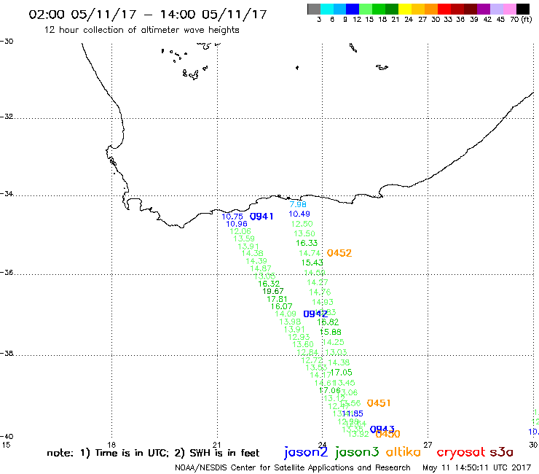
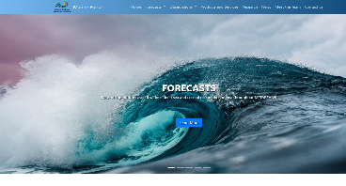
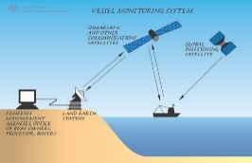
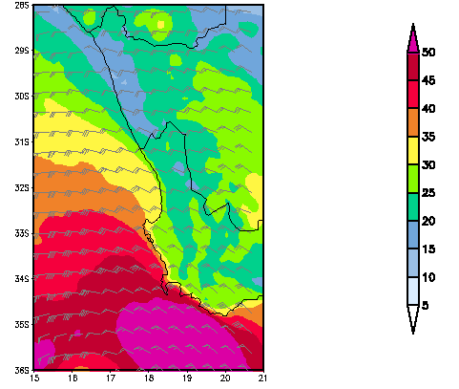
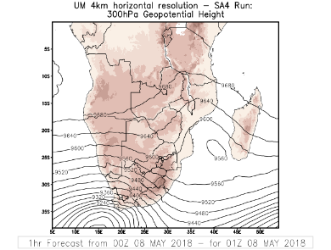
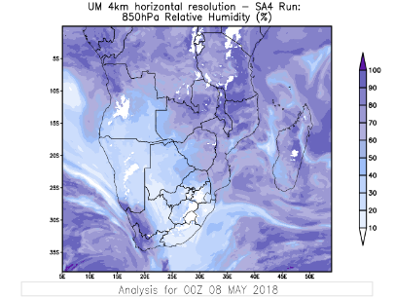
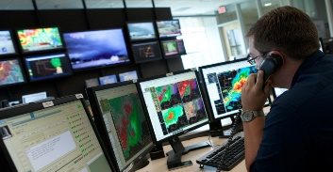
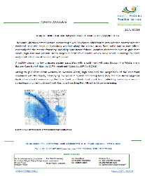
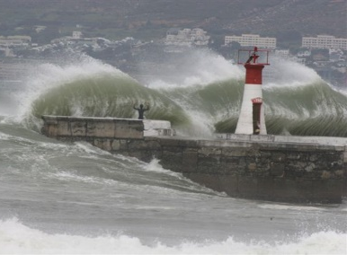
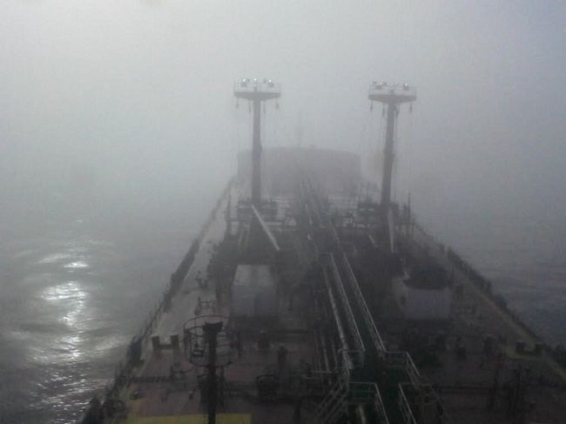
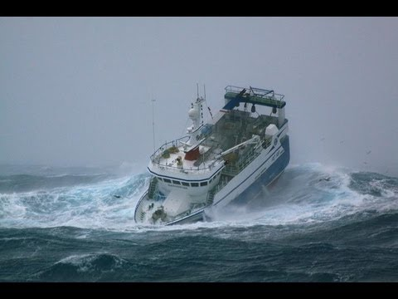
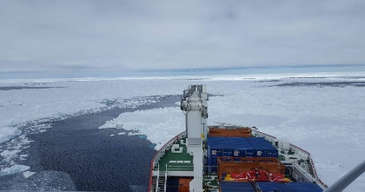
Analyse and Monitor
Forecast Marine weather
Communicate
Marine Weather Forecaster
Competencies
Warn for Hazardous Weather
Ensure Quality
TQM
M de Villiers
Notes:
Cycle from Analysing and monitoring through to Communication by cycle does not end and constantly is repeated with the forecaster having to constantly monitor the weather and adjust the forecasts/warnings etc.

Slide 6
Analyse and monitor continually the marine weather situation
Forecasters will first analyse the weather conditions and monitor all weather systems in the forecast area of interest
Observations are much more limited over the ocean areas but the following information is available to a forecaster operationally;
Satellite (including scatterometer and altimeter) data
Ship observations
Buoy observations
Coastal and island observations
Upper air ascents
Coastal Radar data
Observations are also used to evaluate the forecast models

Slide 7
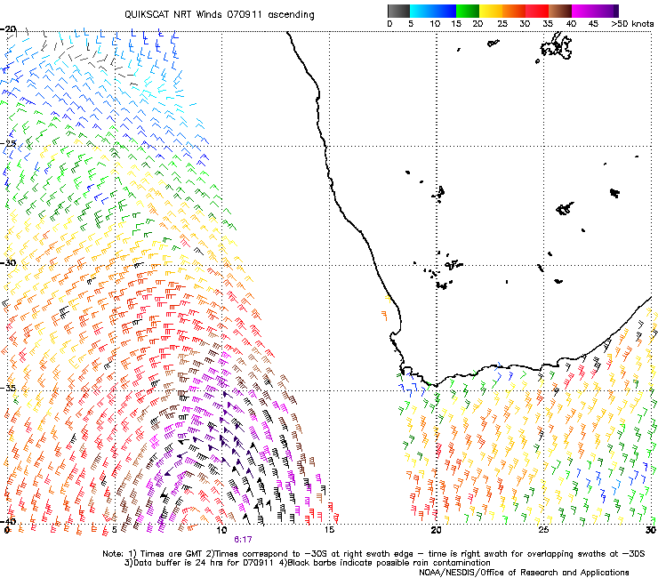
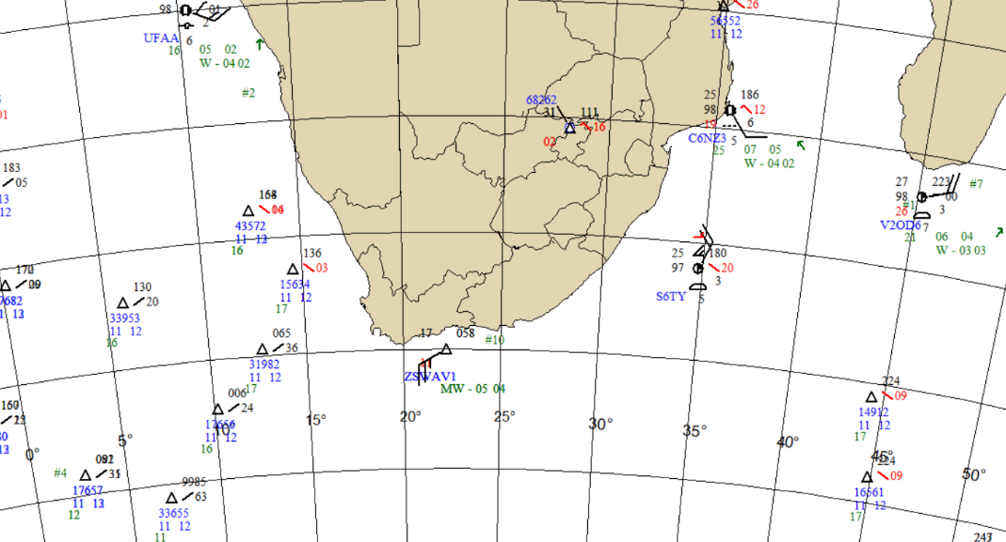
Analyse and monitor continually the marine weather situation
Day Natural Colours RGB at 12 UTC on the 11 September 2007
Satellite derived surface wind observations (scatterometer)
Surface observations
Buoys
Ships
Notes:
Forecasters will use the data to determine the weather systems in the area of interest and to evaluate the weather and wave models.

Slide 8
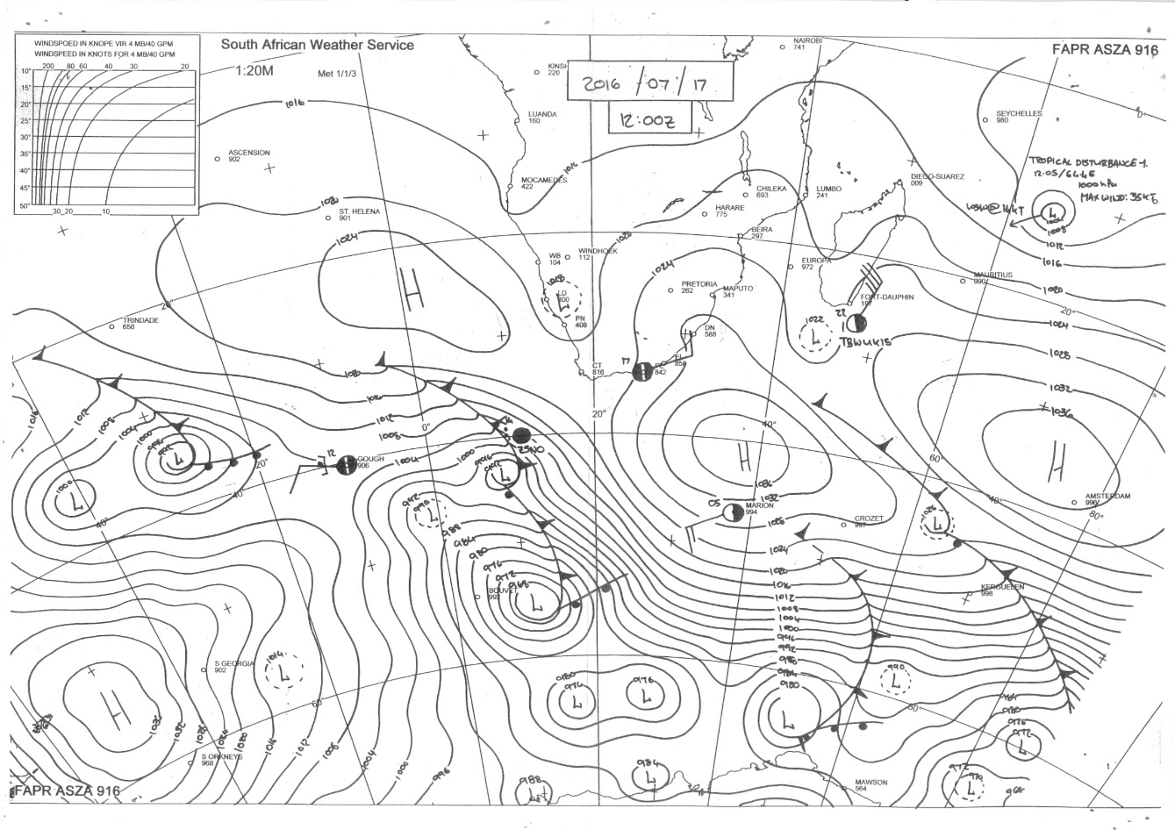
Analyse and monitor continually the marine weather situation
Using all the observations available to them the forecaster will produce a shipping chart
Notes:
You can point out some of the weather system on this chart.

Slide 9
Forecast marine weather phenomena, variables and parameters
Unlike Aviation and Public Weather Forecasting, Marine forecasts rely not only on Numerical Weather Prediction (NWP) Models but also Wave Models
Wave Models rely on atmospheric models (specifically the winds) to model the future conditions of the waves in the ocean
If the winds are inaccurate the wave model will also be affected
Various NWP and wave models available to the forecaster to assist in compiling the various forecasts

Slide 10
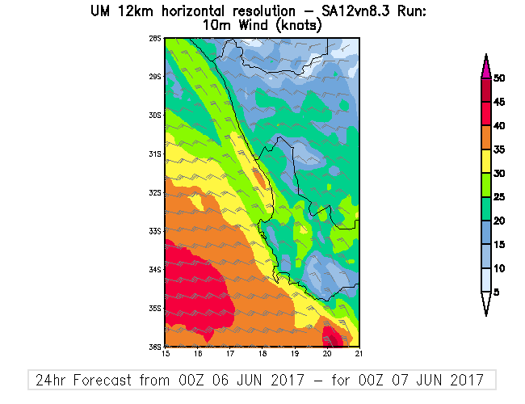
Forecast marine weather phenomena, variables and parameters
Forecasts contain the following information;
Wind
Wind Direction
Wind Speed (in knots)
Make use of wind fields from NWP models

Slide 11
Forecast marine weather phenomena, variables and parameters
Forecasts contain the following information;
Visibility
Use various fields in the NWP models to assist with this
Categorised based on distance that a person would be able to see;
Good: More than 10 km
Moderate: 4 to 10 km
Poor: 1 to 4 km
Very Poor: less than 1 km
Visibility forecasts include the type of conditions resulting in the obscuration;
Fog
Precipitation (rain, snow etc.)
Dust and Sand storms

Slide 12
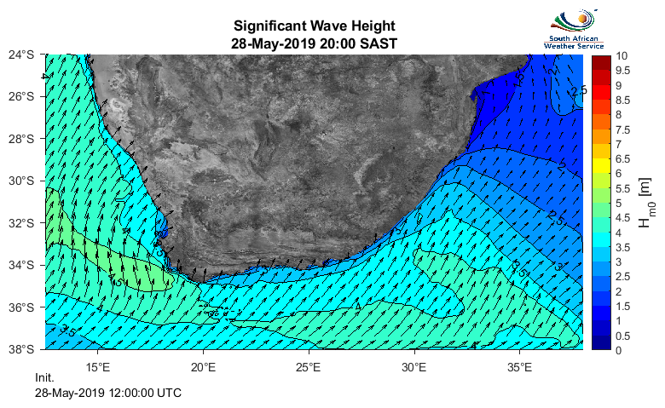
Forecast marine weather phenomena, variables and parameters
Forecasts contain the following information;
Sea State (waves)
Wave models used
Wave heights in meters
Swell direction (from which the swell is travelling)
Wave period in seconds may also be provided

Slide 13
Warn of hazardous marine meteorological phenomena
Wind Alerts:
Various categories based on speeds
Winds warned from 34 knots upwards
Wind Alerts that would be issued for this area;
Gale force (35 to 40 knots)
Strong gale (41 to 47 knots)
Storm strength winds (48 to 55 knots)
Notes:
You could get someone to point out where they see winds exceeding 35 kts (orange colour)

Slide 14
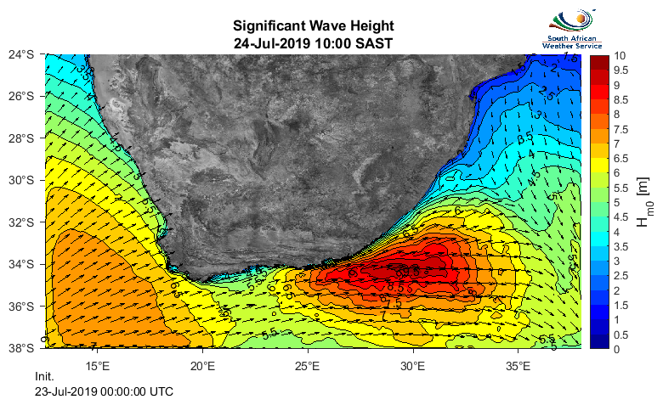
Warn of hazardous marine meteorological phenomena
Wave Alerts:
Hazardous wave conditions are warned for based on heights with various categories used
Waves usually warned for if they exceed 4m or Abnormal Wave conditions are expected
Wave Alerts that would be issued for this area;
Very rough seas (4 to 6m)
High seas (6 to 9m)
Notes:
You could get someone to point out where they see waves of 4m or more ( colour)

Slide 15
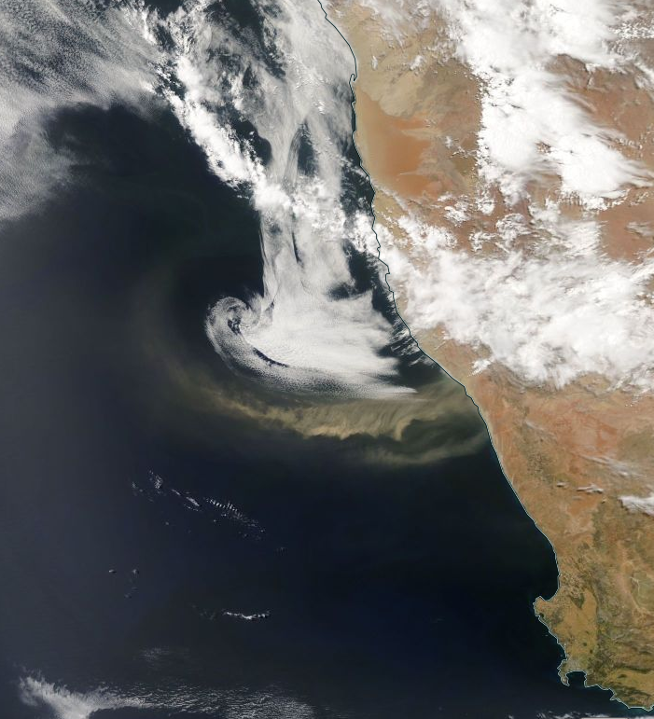
Warn of hazardous marine meteorological phenomena
Visibility Alerts:
Reduced visibility is warned for with associated cause (rain, snow, sand storms, fog etc.)
Based on the same categories of the forecast and issued once conditions are expected to be less than 10km
FOG
Dust/Sand Storm

Slide 16
Ensure Quality and communicate information to users
The following forecast products are issued daily by the marine weather forecaster in set formats;
Synoptic Shipping chart (issued every 6 hours)
High Seas (SOLAS) forecast (issued twice a day)
Synopsis, wind, wave and visibility forecast and wind alerts
Coastal (SOLAS) forecast (issued twice a day)
Wind, wave and visibility forecast and alerts
Specialised client specific forecasts including 3 day forecasts for Marion Island, Gough Island and the SA Agulhas II Research Vessel
Inshore forecast and specialised alerts for main Ports and Harbours

Slide 17
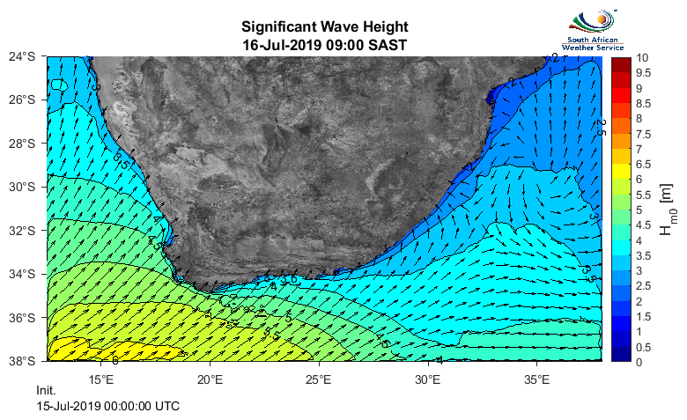
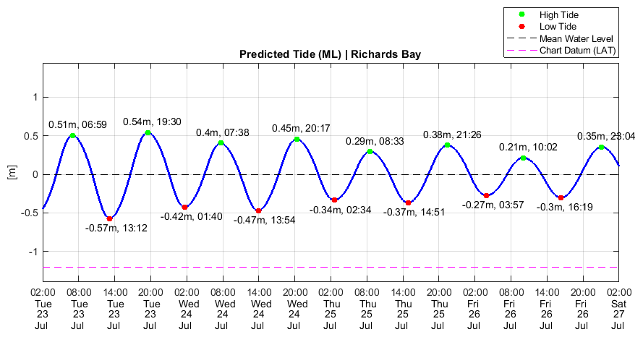
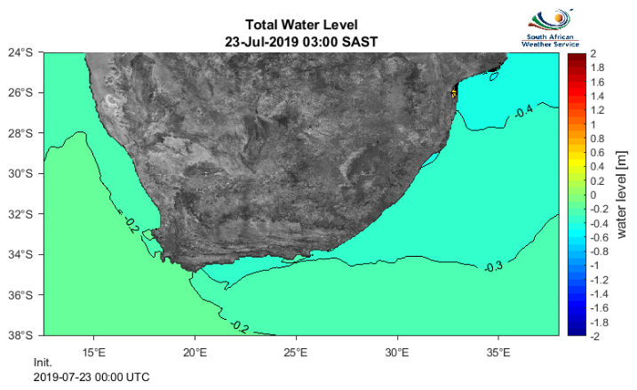
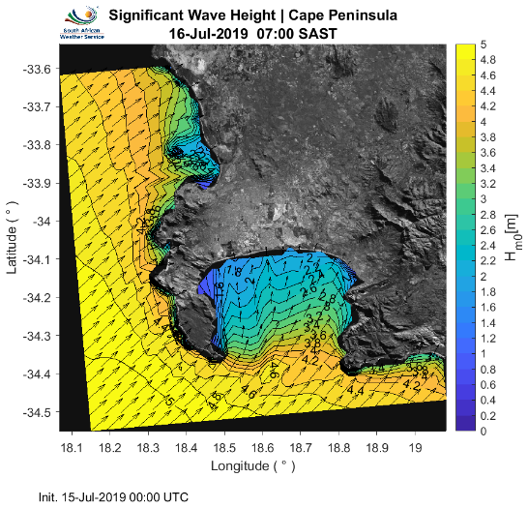
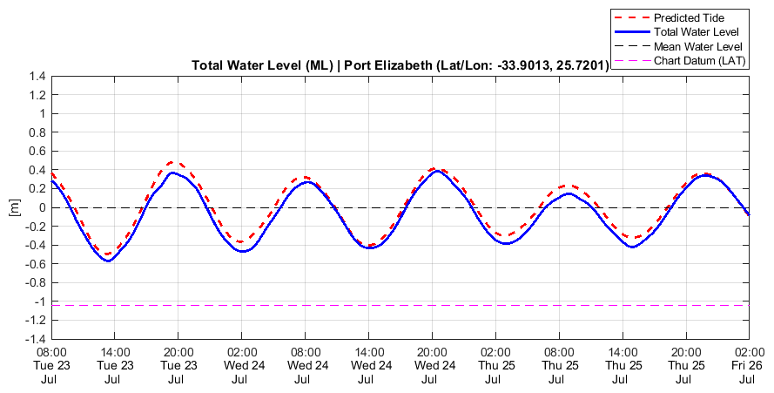
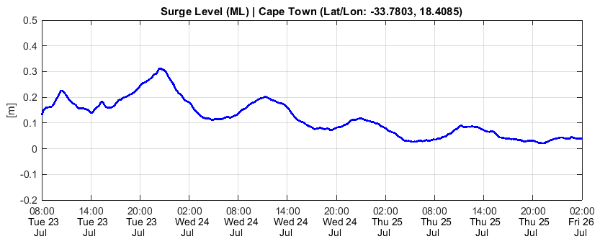
Ensure Quality and communicate information to users
Additional Marine forecast products provided through the SAWS Marine Unit – available on the SAWS Marine portal
Two High resolution Wave forecast systems
Regional Storm Surge forecast system and Regional water level forecast system
Tide forecasting Model
1. Regional
2. Local

Slide 18
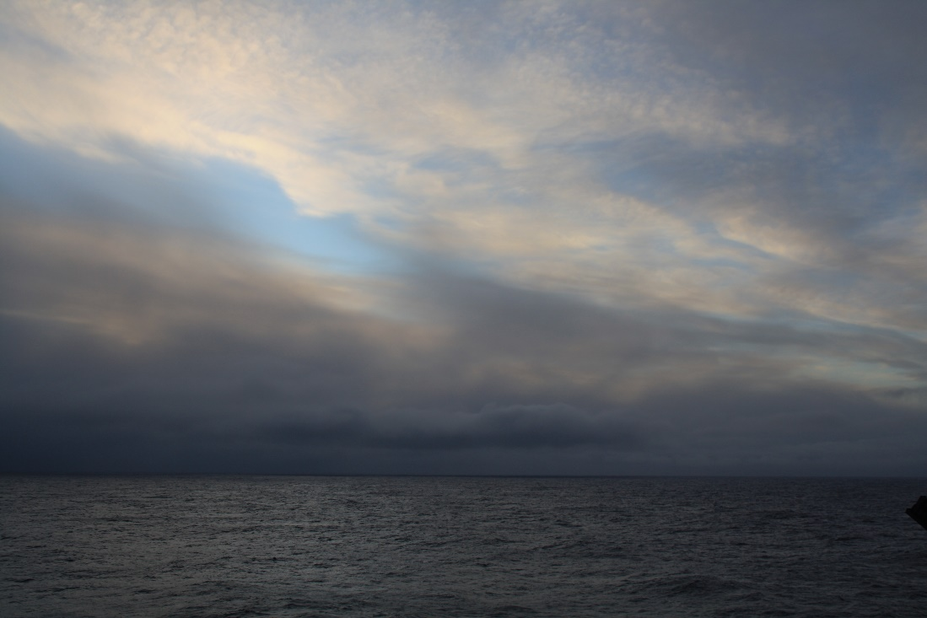
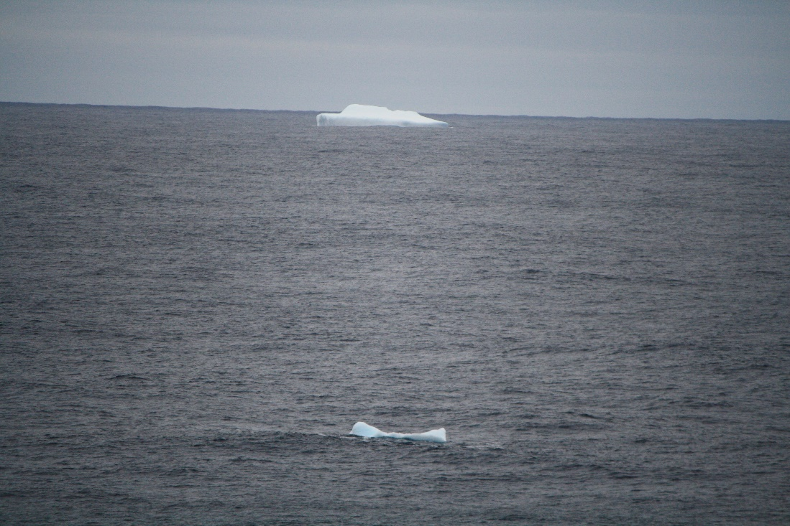
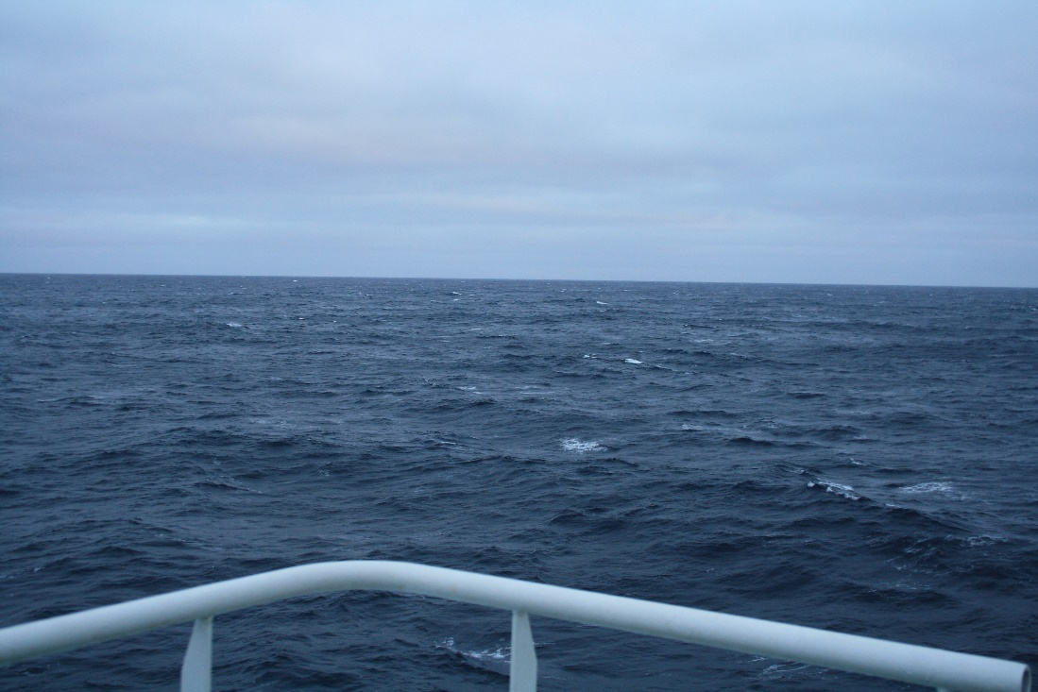
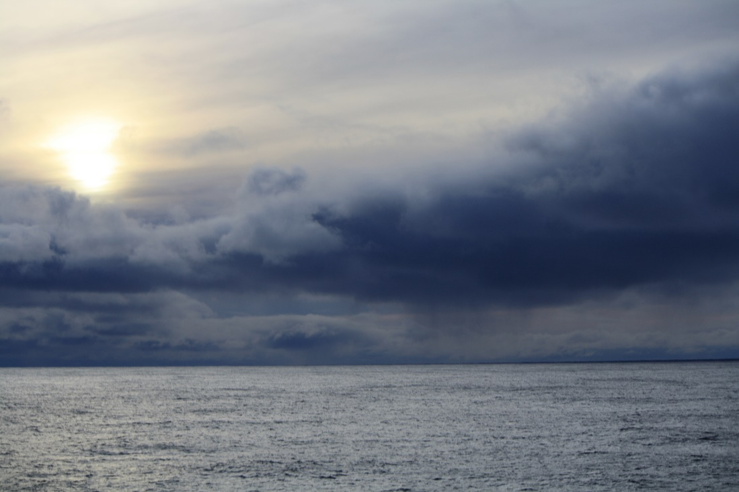
Thank You

