Slide 1
INSTRUMENTATION
For The Measurement of Meteorological variables
Ms. Shine Lithakazi Mkatshwa

Slide 2
Why observe the atmosphere?
Provides the basis for understanding atmospheric processes
  Awareness of the current weather systems
Vital for accurate predictions
Observations include:
  Surface meteorological parameters
  Upper Air data – sampling the Troposphere
  Satellite imagery
  Radar imagery

Slide 3
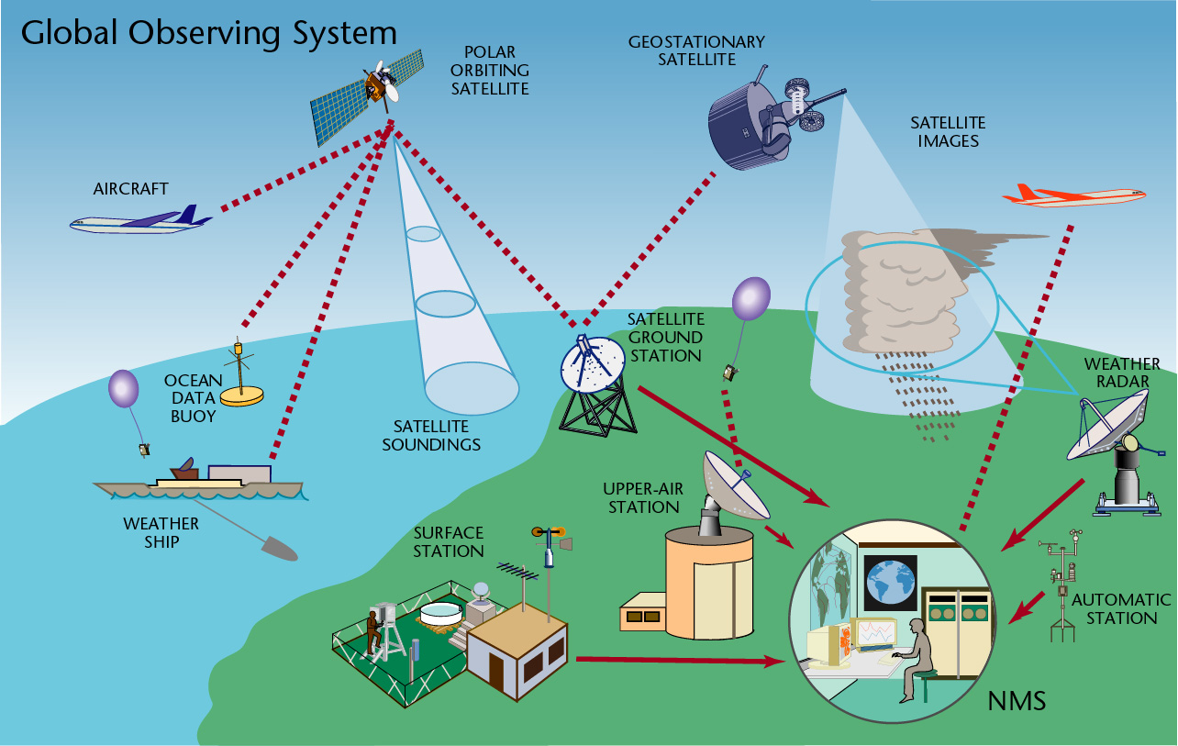
Polar Orbiting Satellite
Geostationary Satellite
Satellite images
Aircraft
Satellite ground station
Weather Radar
Buoy data
Satellite soundings
Upper Air station
Ship data
Surface station
Automatic Weather Stations
Weather Offices

Slide 4
SAWS observation network
Weather offices
Automatic Weather Stations (AWS), including Aviation AWSs
Radar network
SA Agulhas, SA Agulhas II, Volunteer Observing Ships (VOS)
Climate stations(1st, 2nd and 3rd order stations)
ARS & manual Rainfall stations
SST stations

Slide 5
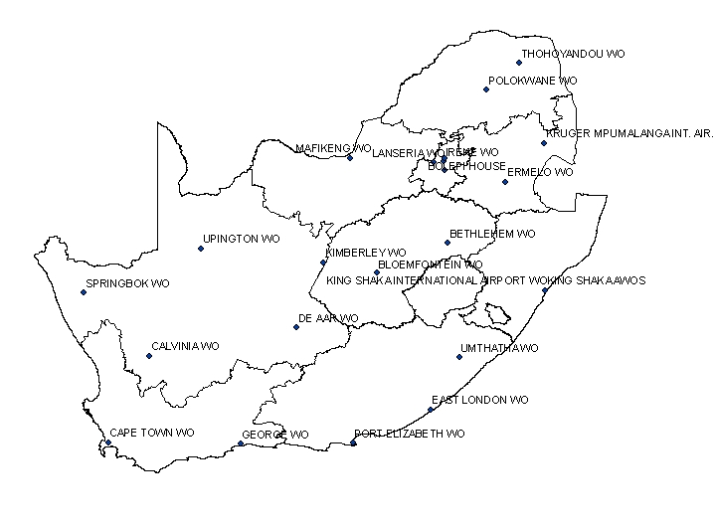
Regional Weather Offices
Weather Offices (SAWS Regional Offices)
Upper Air Stations

Slide 6
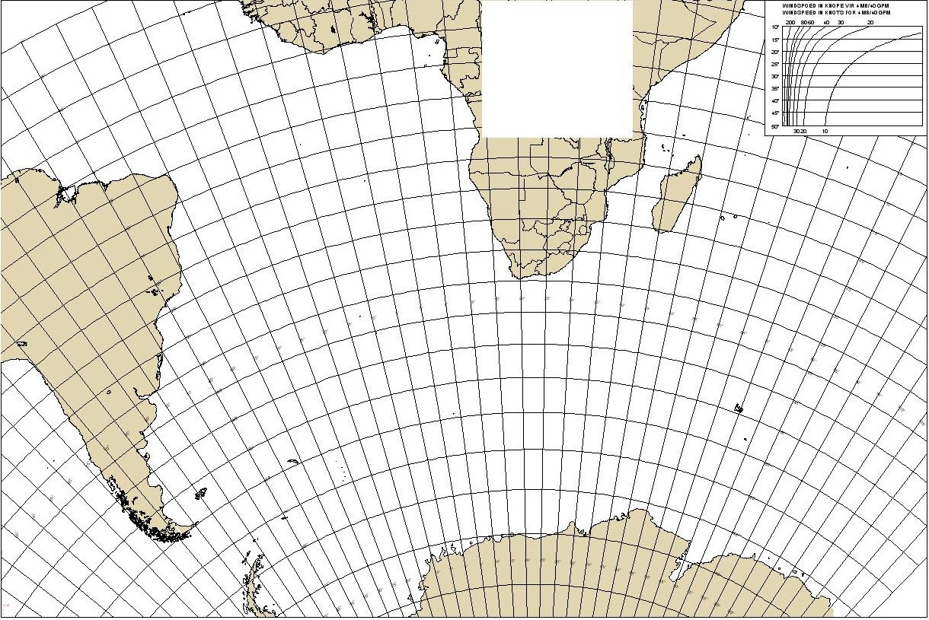
Antarctic and island stations
Tristan da Cunha
Gough Island
Marion Island
SANAE

Slide 7
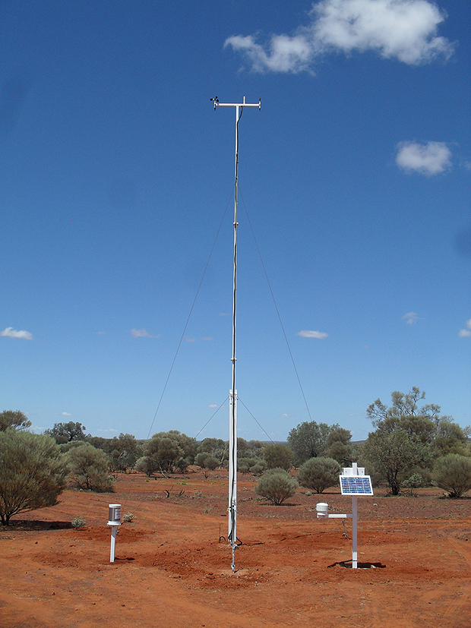
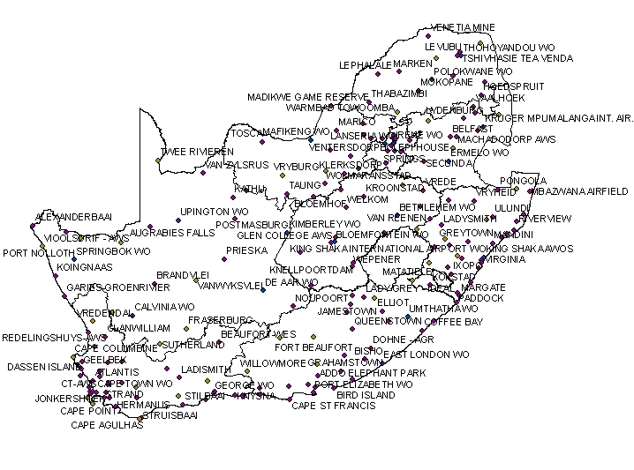
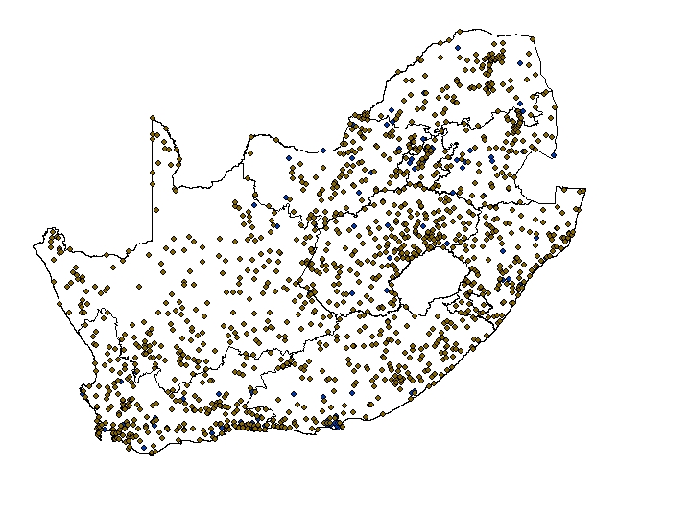
AWS and Rainfall Station Network
Automatic Weather Stations
Rainfall Stations
Notes:
Weather offices (SAWS regional offices)
Automatic Weather Stations AWS
Including Aviation AWSs – requiring minimal human intervention
ARS
Rainfall stations
SST
Climate stations(1st, 2nd and 3rd order stations)

Slide 8
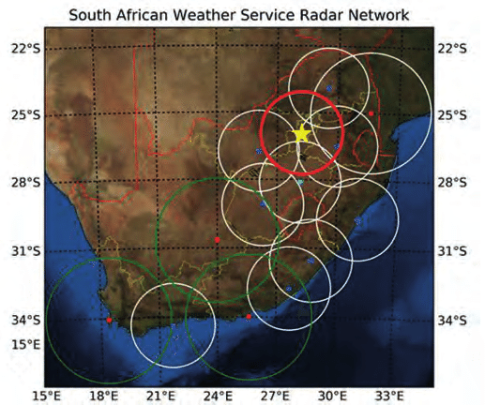

Slide 9
Observed parameters
MEASURED parameters
Parameter Unit
Air Temperature Degrees Celsius (^{O}C)
Relative Humidity Percentage (%)
Air Pressure hectoPascals (hPa)
Precipitation Millimetres (mm)
Wind direction Degrees (^{O} Relative to True North)
Wind Speed Meters per second (m/s) and Knots
Wind gusts Meters per second (m/s) and Knots
DEDUCED Parameters
Parameter Unit
Dew point Temperature Degrees Celsius (^{O}C)
Wet Bulb temperature Degrees Celsius (^{O}C)
QNH hectoPascals (hPa)
QNE hectoPascals (hPa)
Pressure tendency & amount hectoPascals (hPa)

Slide 10
AWS
Advantages of these systems are:
Save on manpower requirements
They are easy to maintain as sub-assemblies and sensors can be easily interchanged in the field.
The sensors used are interchangeable across the networks
The software is internally developed
SAWS technicians can provide comprehensive remote support
Primary and Secondary Power
Battery
Mains
Solar panel
Notes:
These systems are developed to withstand harsh African climate and weather. They require minimum maintenance and can be easily maintained by personnel with basic electronics knowledge.
The system is in-house built and consist of locally accessible components, although the sensors and/or loggers are imported. The whole system is sited at the filed about 300m meters from the runway.
It consists of the control unit, meteorological instrumentation and peripherals.

Slide 11
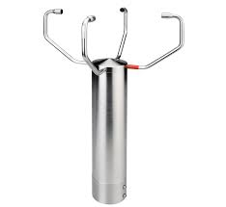

Slide 12
1. Routine/Preventative Maintenance
Planned maintenance activities designed to improve equipment life
  Systematic inspection
  Detection, Correction & Prevention of emerging failures
  Reduce the costs that might be incurred because of system failures and replacement of units.
  Implement additional maintenance tasks when and where needed
  Prevent system failures before they occur.
Notes:
The maintenance plans and schedules must be devised and strictly adhered to.

Slide 13
2. Reactive/Corrective Maintenance
Performed when a fault or problem emerges in the system to restore operability.
Repairs must be effected repairs as soon as possible (48 hrs) as there are costs associated with faults
  Repair costs
  Lost production
  Lost sales
Notes:
Retroactive, not proactive!

Slide 14
3. Verification and Calibration
Calibration assures that a device or system will produce results, which meet (or exceed) defined criteria with a specified degree of confidence.
  Assures precision and accuracy. WMO ICAO ISO9001:2015 requirement
  Requires specialized facilities with controlled environmental conditions
Verification determines the performance parameters of an instrument (or system) by comparing it to a calibrated standard
  Phase 1: Test equipment (or travelling standard) is verified against the calibrated office standard
  Phase 2: Station instruments are then verified against the tested travelling standard
Notes:
Precision refers to the minimum discernible change in the parameter being measured,
while accuracy refers to the actual amount of error that exists in a calibration

Slide 15
Other Meteorological Parameters
Weather
Drizzle
Rain
Snow
Snow Grains
Ice Pellets
Snow Pellets
Hail
Thunderstorms
Fog
Mist
Sand & Dust Storms
Haze
Smoke
Funnel Cloud
Clouds
Stratus
Stratocumulus
Cumulus
Cumulonimbus
Altocumulus
Altostratus
Nimbostratus
Cirrus
Cirrocumulus
Cirrocumulus
Sea state
Swell
Wind waves
Height
Period
Direction
Visibility
Solar radiation
Sunshine
Low Level
Middle Level
High Level

Slide 16
Software
The MetCap software captures and processes and produces data from the AWS
  generated coded messages SYNOPTIC, METAR, SPECI
It acts as a graphical user interface (GUI) used to
  interact with the systems
  Conduct data quality control
It also sends the data to the database tables
Notes:
These systems are developed to withstand harsh African climate and weather. They require minimum maintenance and can be easily maintained by personnel with basic electronics knowledge.
The system is in-house built and consist of locally accessible components, although the sensors and/or loggers are imported. The whole system is sited at the filed about 300m meters from the runway.
It consists of the control unit, meteorological instrumentation and peripherals.

Slide 17
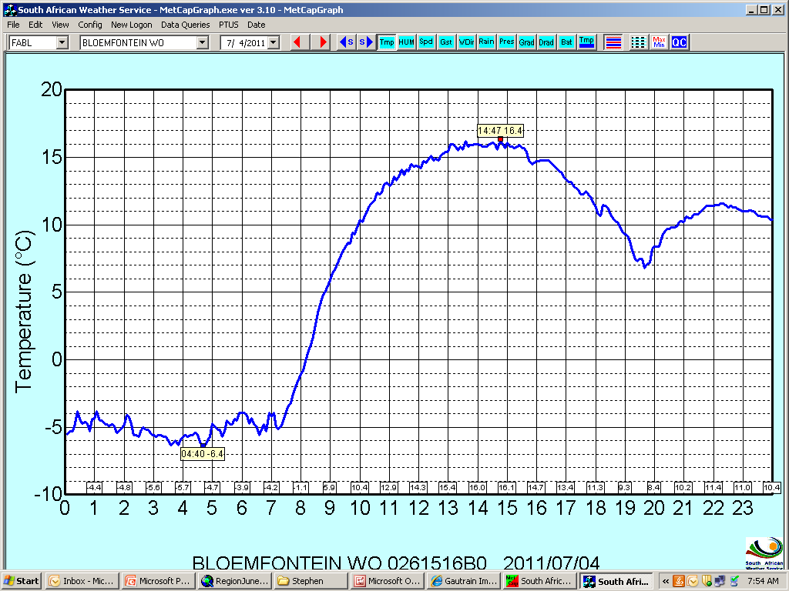
Temperature Graph

Slide 18
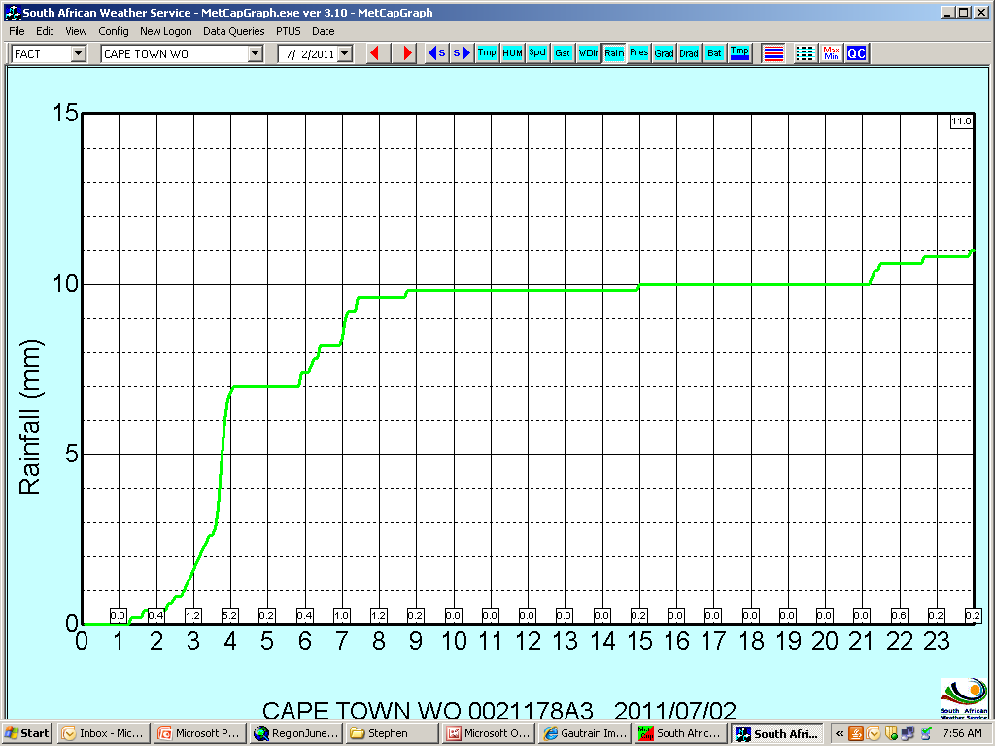
Rainfall Graph

Slide 19
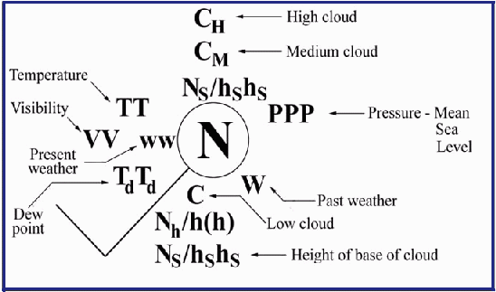
COMMUNICATING METEOROLOGICAL DATA
SMVJ01 KWBC 121800
BBXX ZSAF 12184 99623 50015 41292 83511 11007 21017 39848 49857 5/026 75154 886//
22272 01006 20304 330// 40604

Slide 20
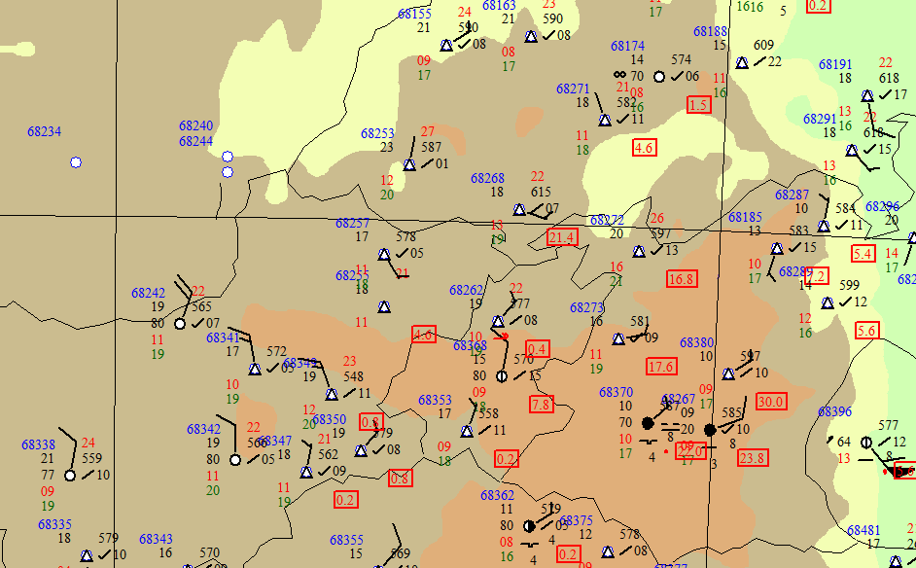

Slide 21
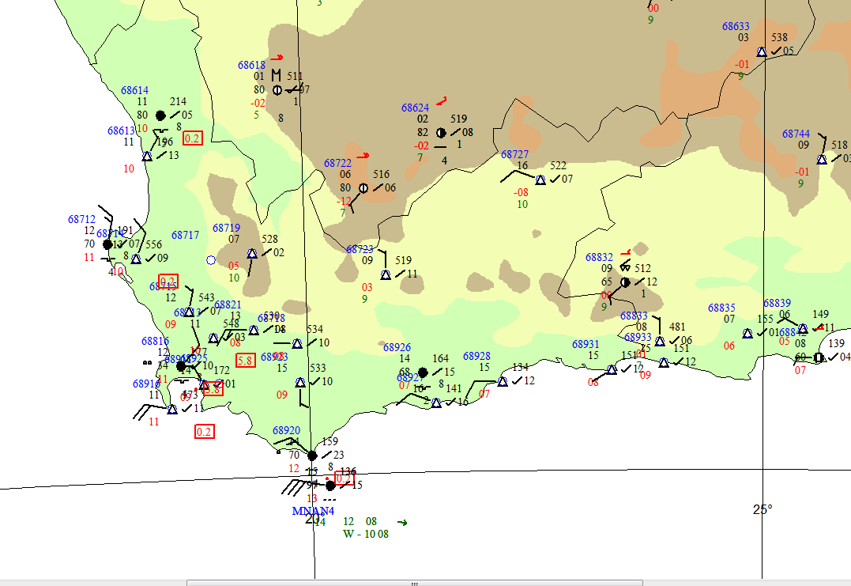
Observational Data
Ship based observation

Slide 22
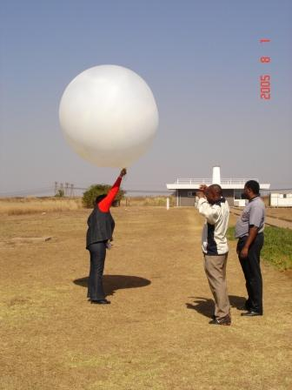
Upper Air Data
The radiosonde records and transmits measurements of air pressure, temperature and humidity, while the onboard GPS allows for satellite calculations of wind direction and wind speed.
Balloons usually burst upwards of 25 000m altitude & ascent is terminated.
Data is coded, and compiled into graphic format too.

Slide 23
TTAA, TTBB, PPAA and the PPBB Upper air codes
USME01 FAME 080000
TTAA 57231 68994 99006 01256 27029
00079 01857 25030 92702 03556 25059 85362 08361 24061 70835 19376
24563 50530 27963 23123 40687 38165 23127 30878 52366 25123 25997
47777 25094 20144 48779 26582 15332 48379 28092 10600 51379 26084
88286 54564 25126
77375 23129=
UKME01 FAME 080000
TTBB 57230 68994
00006 01256 11989 01458 22930 03355 33880 06955 44873
06958 55867 06764 66844 08960 77830 09764 88816 10572
99787 13172 11761 15373 22733 17569 33701 19375 44683
20582 55665 19188 66599 22387 77594 22987 88556 24770
99552 24583 11542 24169 22532 25163 33425 34966 44371
42762 55343 45966 66286 54564 77278 53164 88275 51766
99272 49967 11261 48575 22255 47377 33245 48579 44224
47780 55207 48779 66189 50179 77169 50979 88163 49179
99155 47180 11146 49379 22138 47580 33134 46780 44127
46380 55125 45385 66119 45780 77109 49779 88106 50979
21212 00006 27029 11998 25031 22975 25040 33942 25555
44793 25061 55714 24063 66645 24087 77532 23619 88470
23124 99453 23124 11437 23625 22375 23129 33331 24120
44286 25126 55269 24102 66247 26095 77236 26097 88224
26081 99206 26589 11195 27084 22187 27086 33177 27597
44168 27095 55161 27096 66144 28098 77136 28097 88129
27597 99121 27082 11114 27089 31313 ///// 82300 41414
42500 51515 92702 03556 25059 77072 14171 25061 60975
22387 24096=
UPME01 FAME 080000
PPAA 57230 68994
44200 25030 25059 44385 24061 24563 23123 44340 23127 25123 25094
44320 26582 28092 26084
77375 23129=
UGME01 FAME 080000
PPBB 57230 68994
90123 25542 25557 25061 9078/ 25062 25063 91357 24095 23608 23124
92137 23624 23126 24119 929// 25122=
Standard levels
The heights of the standard levels
The temperature and dew point
Wind direction and speed
Significant levels
The temperature and dew point at significant levels
Standard levels
Wind direction and speed
Fixed regional levels
Wind direction and speed

Slide 24
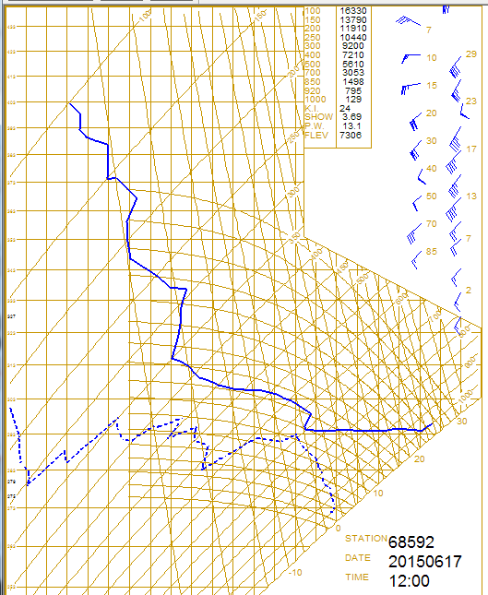
Upper Air Graph
Pressure level heights
Wind direction
Wind speed
Temperature
Dew point temperature

