Slide 1
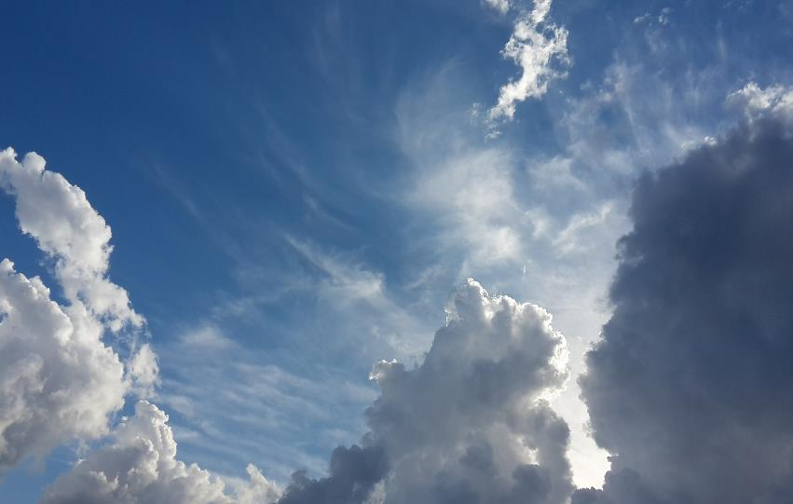
Cloud landscapes
An introduction to clouds

Slide 2
Introduction
Looking up at the clouds in the sky, one feels like the clouds are occupying an unending volume of space – however this is not the case.
There are actually a number of different divisions in the vertical which are classified according to various criteria, the main one being the temperature within that division.
These divisions, going from the Earth’s surface to beyond 80km, are the following: -
Troposhere
Stratosphere
Mesosphere
Thermosphere
Notes:
Have you ever looked up into to the sky with the thought of how far or to what heights the clouds the clouds extend up to

Slide 3
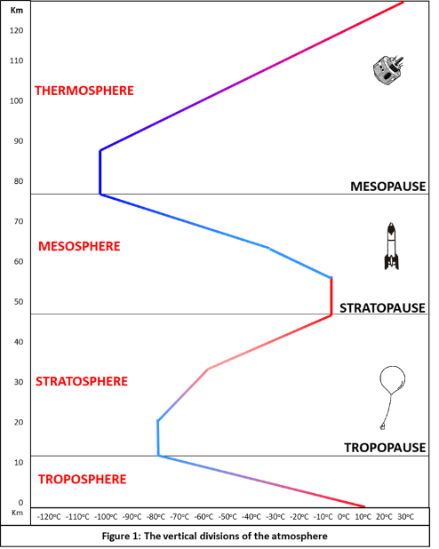
Where clouds form
However, the clouds that we observe, develop and exist only within the Troposphere.
From the Earth’s surface up to the top of the Troposphere it is approximately 10 – 15 km!

Slide 4
Clouds and moisture (water vapour)
In addition, besides the main atmospheric gasses of Nitrogen, Oxygen and Argon that make up 99% of the atmosphere, numerous other gasses combined make up the final 1%, namely:
Water vapor (H₂O)
Carbon dioxide (CO₂)
Neon (Ne)
Helium (He)
Krypton (Kr)
Hydrogen (H)
Ozone (O₃)
So, water vapour is present in less than 1% volume in the atmosphere.

Slide 5
Clouds and moisture (water vapour)
Clouds that are observed, develop and exist in the Troposphere which is only 10-15 km in vertical height.
However, water vapour is a very important atmospheric gas and is the source of moisture for cloud development and resultant precipitation in solid and liquid forms.
BUT water vapour is predominantly found within the first 6 km of the troposphere.
So, it’s important to note that clouds will only form where there is sufficient moisture in the atmosphere

Slide 6
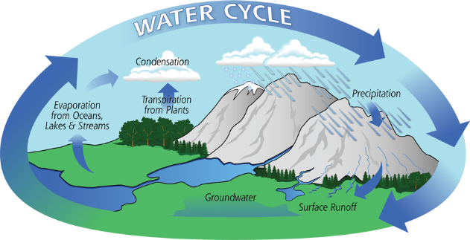
How water gets into the atmosphere
Heat from the sun warms the water in rivers and oceans and causes the water to evaporate changing from water droplets to water vapour which then rises into the air.
Water vapour condenses onto condensation nuclei and the water droplets grow through different processes, merging with other water droplets forming clouds.
The amount of water vapor in the air is referred to as humidity which must be close to 100% for clouds to form along with cooling of the air.

Slide 7
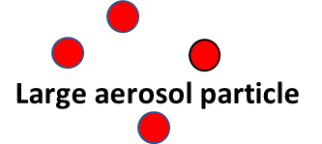
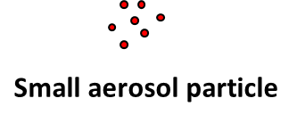
Influences for cloud shape and size
Along with water vapour that is present in differing amounts in the atmosphere there are also minute aerosol particles suspended in the air (like dust, salt, pollutants etc.).
These aerosols are called condensation nuclei
When the air is saturated the condensation nuclei form the base on which water vapour condenses into water droplets.
Typical raindrop
Typical raindrop | = 2 mm
Large aerosol particle | = 0,1 mm
Typical cloud droplet | = 0,02 mm
Small aerosol particle | = 0,0001 mm

