Slide 1

Influences for cloud shape and size
Cloud shapes and forms are the expression of the following:
how cold/warm the air is,
the way in which the air has risen,
if the clouds are composed of water or ice crystals,
their height of the clouds above the ground.

Slide 2
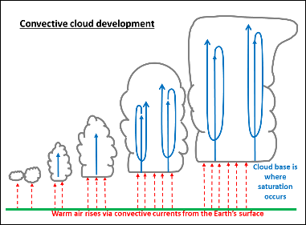
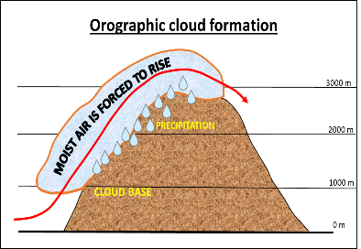
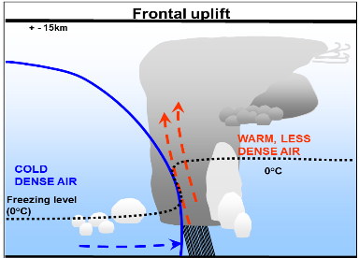

Atmospheric mechanisms leading to saturation
Convective development
Orographic uplift
Frontal uplift

Slide 3
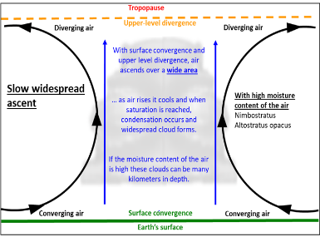
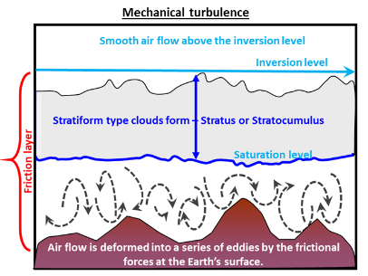
Atmospheric mechanisms leading to saturation
Slow wide-spread ascent
Mechanical turbulence

Slide 4

How clouds are named
Clouds are identified according to different parameters which are listed below.
Type of cloud identifier | Total number of descriptors per cloud identifier | What is described
Cloud genera | 10 | – height of the cloud base above the ground
Cloud specie | 15 | – the shape of the cloud – the internal structure of the cloud
Cloud variety | 9 | – the macroscopic elements of the cloud – the degree of transparency of the cloud
Supplementary cloud features | 11 | – supplementary features can sometimes be attached to or partly merged with them.
Accessory clouds | 4 | – sometimes smaller clouds can accompany other clouds, being separate from the main cloud body or partly merged with it.

Slide 5
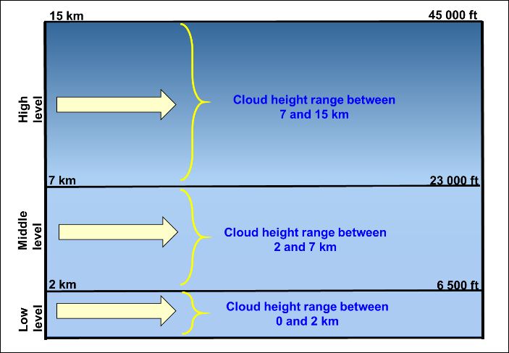
Location of Clouds in the Troposphere
Clouds develop and exist in a very thin layer of the atmosphere, the Troposphere – think how short 15 km on a map is and then visualize that distance in the vertical.
Referring to the first of the cloud identifiers, namely cloud genera (which describes the height above ground at which clouds start developing), the troposphere is divided into three sections, namely:
Low level
Middle level
High level

