Slide 1
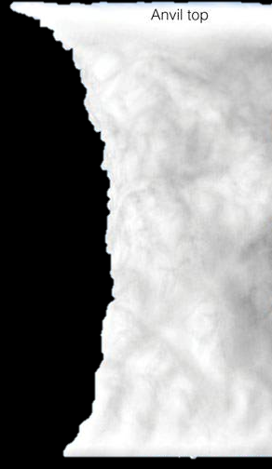

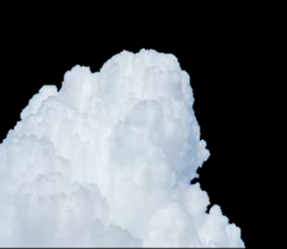
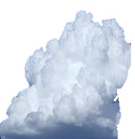
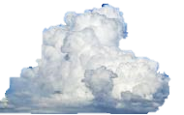





Location of Clouds in the LOW LEVEL
15 km
45 000 ft
Cumulus clouds develop in the low levels starting off as small detached heaps of clouds growing vertically with the cloud tops penetrating into the middle levels in the form of a defined cauliflower type shape.
They are predominately white in colour but have grey areas the more shape the cloud has.
Cumulonimbus capillatus
High level
7 km
23 000 ft
Rain, snow and snow pellets fall from the cauliflower shaped cloud in the form of showers.
Middle level
Cumulus
2 km
6 500 ft
Low level
2021/10/28
Doc Ref no: RTC-PRE-137.2 Cloud Genera_Species
1

Slide 2
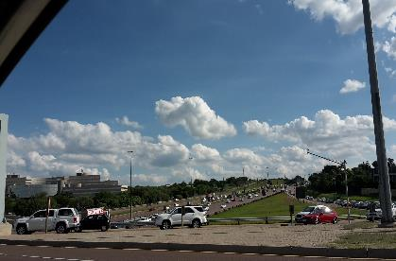
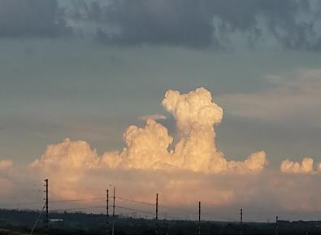
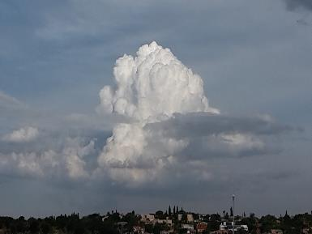
Cumulus cloud examples

Slide 3


Location of Clouds in the LOW LEVEL
15 km
45 000 ft
Cumulonimbus clouds start off as Cumulus clouds which become Cumulonimbus as the Cumulus cloud with the cauliflower shape continues to grow vertically.
These clouds extend from the low levels through to the high levels, becoming flattened in the shape of an anvil in the upper parts of the cloud as it reaches the tropopause (the upper part of the troposphere).
The bottom of the cloud becomes dark while the upper parts are white.
Rain, snow , snow pellets and hail fall from this cloud in the form of showers or thundershowers.
Cumulonimbus capillatus
High level
Cumulonimbus
7 km
23 000 ft
Middle level
2 km
6 500 ft
Low level
Doc Ref no: RTC-PRE-137.2 Cloud Genera_Species
3
2021/10/28

Slide 4
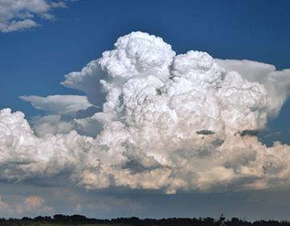
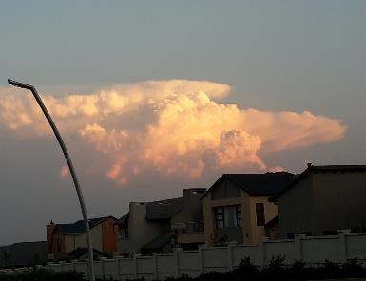
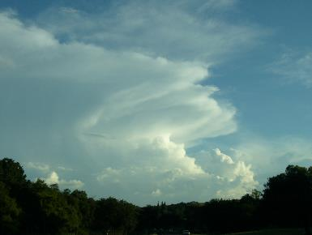
Cumulonimbus cloud examples

Slide 5



Location of Clouds in the LOW LEVEL
15 km
45 000 ft
Stratus clouds are smooth and uniform grey-coloured clouds that develop close to the Earth’s surface (resembling fog).
Drizzle or snow grains fall from this cloud.
Cumulonimbus capillatus
High level
7 km
23 000 ft
Middle level
2 km
6 500 ft
Low level
Stratus
Doc Ref no: RTC-PRE-137.2 Cloud Genera_Species
5
2021/10/28

Slide 6
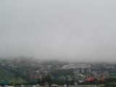
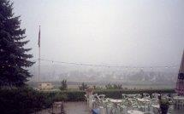
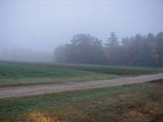
Stratus cloud examples

Slide 7

Location of Clouds in the LOW LEVEL
15 km
45 000 ft
Stratocumulus clouds are puffy clouds that occur in patches or fairly widespread.
They are white and grey due to their shape and resultant shading.
Rain and snow fall from this cloud
Cumulonimbus capillatus
High level
7 km
23 000 ft
Middle level
2 km
Stratocumulus
6 500 ft
Low level
Doc Ref no: RTC-PRE-137.2 Cloud Genera_Species
7
2021/10/28

Slide 8
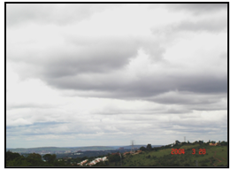
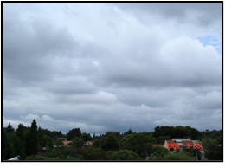
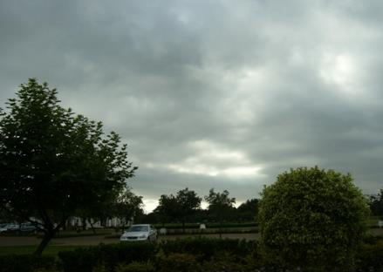
Stratocumulus cloud examples

