Slide 1
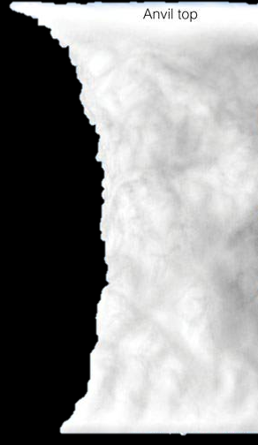






Location of Clouds in the MIDDLE LEVEL
15 km
45 000 ft
Altocumulus clouds develop in the middle levels and are white and grey patches of cloud with shape and shading – either in patches or fairly widespread.
Altocumulus clouds are very similar to Stratocumulus clouds in shape, but as they develop in the middle levels, the size of the shapes will be considerably smaller than those of Stratocumulus.
NO precipitation falls from Altocumulus clouds
Cumulonimbus capillatus
High level
7 km
23 000 ft
Middle level
Altocumulus
2 km
6 500 ft
Low level
2021/10/28
Doc Ref no: RTC-PRE-137.2 Cloud Genera_Species
1

Slide 2
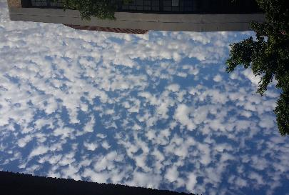
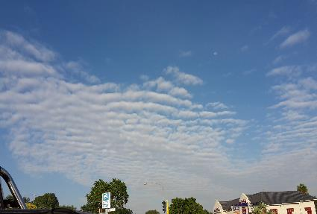
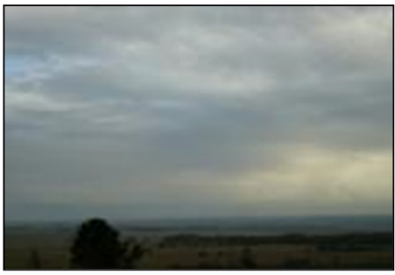
Altocumulus cloud examples

Slide 3

Location of Clouds in the MIDDLE LEVEL
15 km
45 000 ft
Altostratus clouds develop in the middle levels and are smooth and uniform grey looking clouds covering large parts of the sky.
They can be thin layers of cloud which allows one to see the position of the sun or moon behind them or when it becomes a thick layer, the position of the sun or the moon will be hidden.
Rain, snow or ice pellets can fall from this cloud only when it is a thick layer.
Cumulonimbus capillatus
High level
7 km
23 000 ft
Altostratus
Middle level
2 km
6 500 ft
Low level
Doc Ref no: RTC-PRE-137.2 Cloud Genera_Species
3
2021/10/28

Slide 4
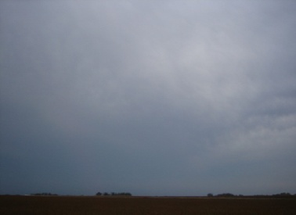
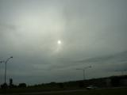
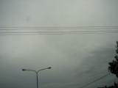
Altostratus cloud examples

Slide 5
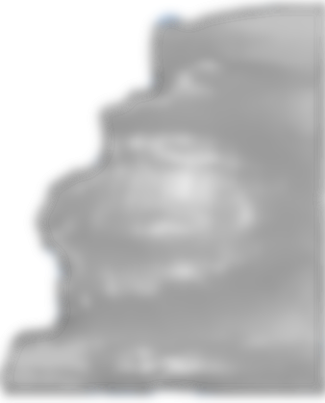

Location of Clouds in the MIDDLE LEVEL
15 km
45 000 ft
Nimbostratus clouds are generally dark uniform clouds covering the sky. They develop in the middle levels but can extend downwards into the low levels as well as upwards into the upper levels.
Steady, continuous rain, snow or ice pellets fall from this cloud
Cumulonimbus capillatus
High level
7 km
23 000 ft
Middle level
Nimbostratus
2 km
6 500 ft
Low level
2021/10/28
Doc Ref no: RTC-PRE-137.2 Cloud Genera_Species
5

Slide 6
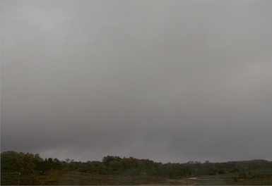
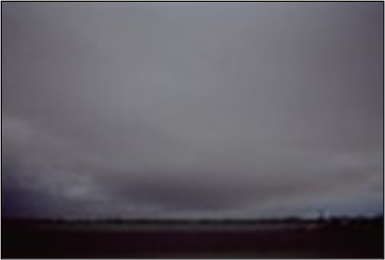
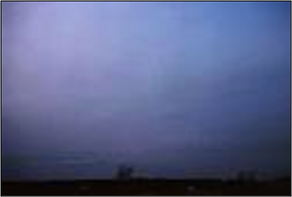
Nimbostratus cloud examples

