Slide 1
Tropical Temperate Troughs
Lee-ann Simpson

Slide 2
Definition
Tropical-temperate troughs (TTT) are troughs that connect westerlies with tropical disturbances and brings heavy rainfall to southern Africa.
Generally, a channel of warm, moist air and associated deep convection extends from the NW to the SE
One of the signatures of the TTT is strong inflow of tropical moisture by a low-level jet at 850 hPa
(Todd & Washington 1999)

Slide 3
Frequency of occurrence

Slide 4
Day 1

Slide 5
Day 2

Slide 7
Day 3

Slide 9
Synoptic Analysis

Slide 10
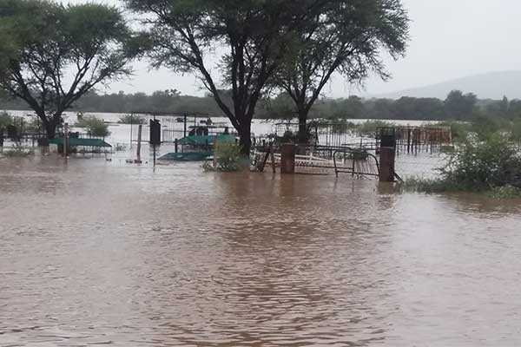
Rainfall distribution
Day 1
Washington and Todd 1998

Slide 11
Day 2
Washington and Todd 1998

Slide 12
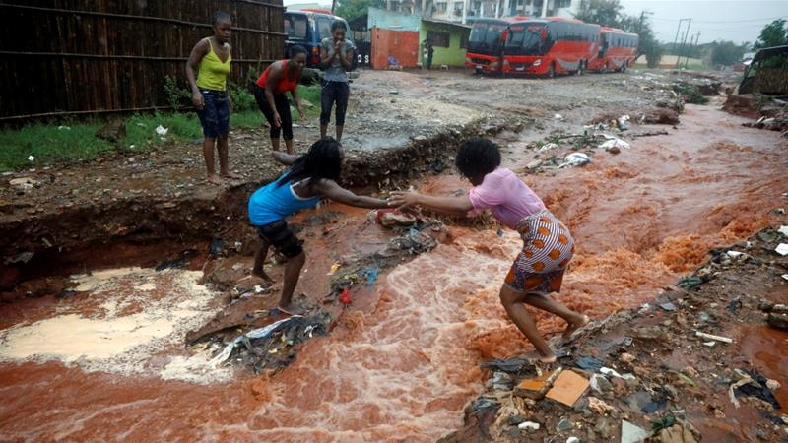
Day 3
Washington and Todd 1998

Slide 13
Day 4
Washington and Todd 1998

Slide 14
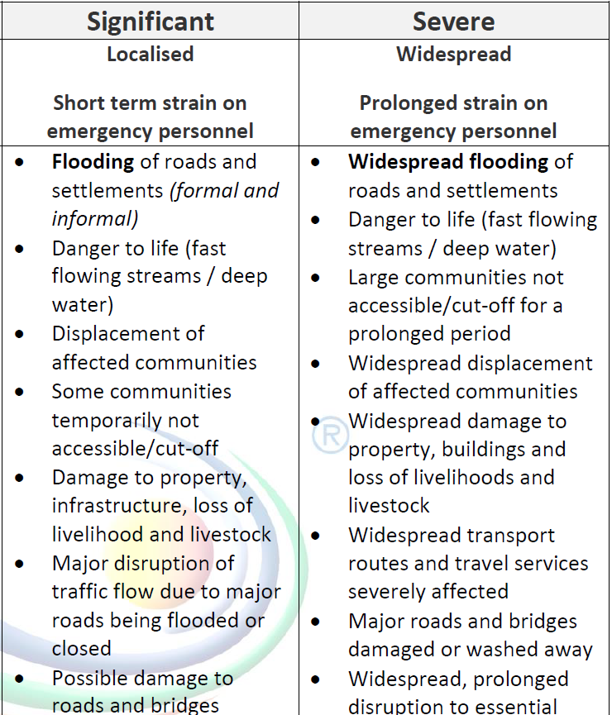
Impact based alerts
RAINFALL

